Slide 1
o
W
e
e
M
l
C

Slide 2
Teacher’s Identity
ASMA KHANOM
ASSISTANT TEACHER
KALACHANDPUR GPS SADAR,NOAKHALI

Slide 3
LESSON
INTRODUCTION
Class :One
Subject: English
Lesson’s name : Commands
Unit:5
Lesson:1-3

Slide 4
Learning outcomes
Students will be able to-
Listening: 1.1.1 become familiar with English sounds by listening to common English words.
2.1.1 follow simple commands and instructions.
Speaking: 1.1.1 repeat after the teacher simple words and phrases.
1.1.2 say simple words and phrases.
7.1.1 give simple commands and instructions.

Slide 5
Let’s enjoy the audio.

Slide 6
Today’s lesson
Commands

Slide 7
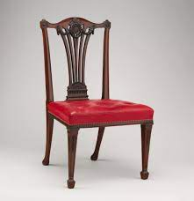
Look, listen and say.
window
door
chair
floor

Slide 8
Look, listen and say.
table
book
pencil
bag

Slide 9
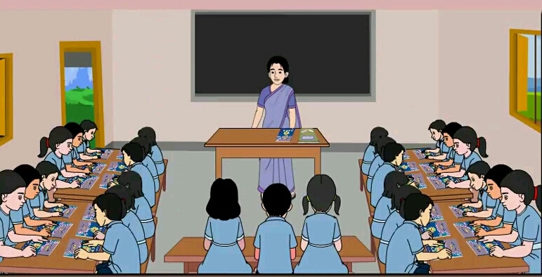
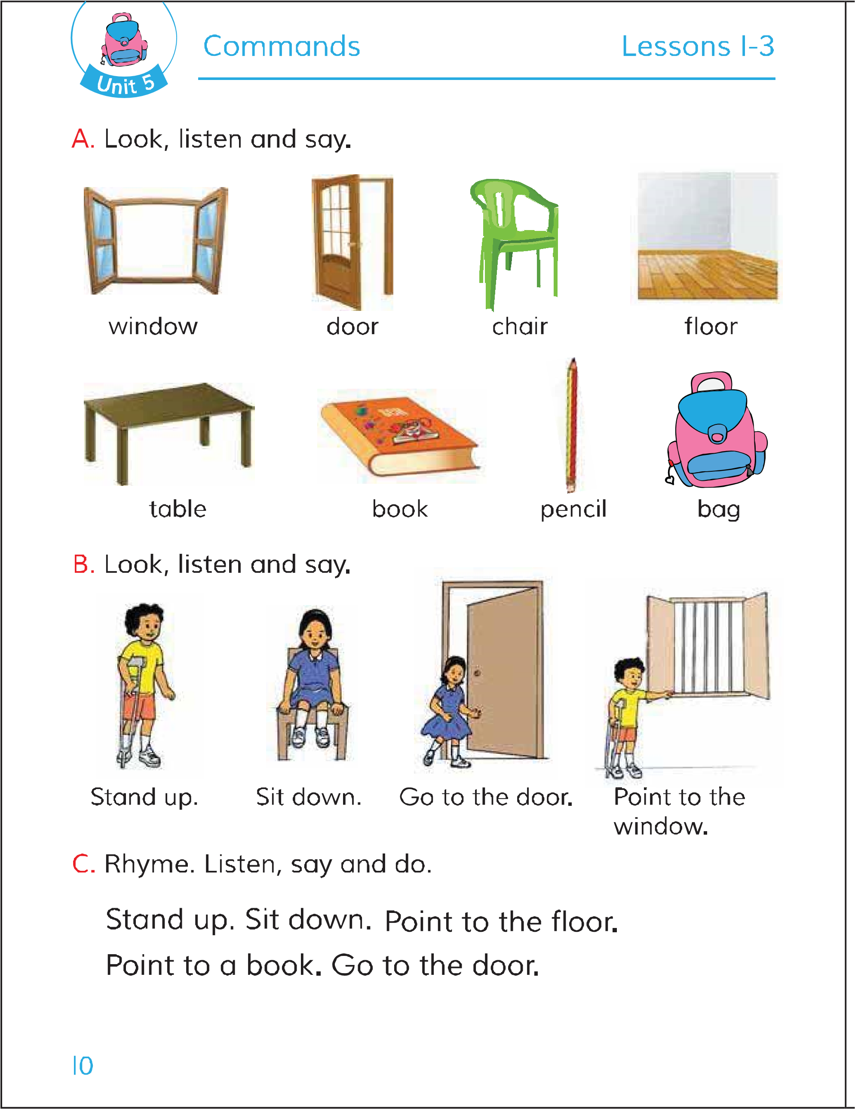
Open your English book at page 10.

Slide 10
Look, listen and say.
Stand up.
Sit down.

Slide 11
Look, listen and say.
Go to the door.
Point to the window

Slide 12
Look, listen and say.

Slide 13
Listen, say and do.

Slide 14
Student-1 do commands “Stand up”
Studend-2 act the command
Pair work.
Student-1
Student-2

Slide 15
Student-2 do commands “point to a book”
Studend-1 act the command
Pair work
Student-2
Student-1

Slide 16
Evaluation
Teacher do commands to the students
Students will act the command.
Point to the floor
Point to a book.
Go to the door.

