Slide 1
Welcome to my new English class

Slide 2
Identity
Mst. Nurani Begum
Assistant teacher
Tarapur Govt.Primary School
Sundarganj,Gaibandha.
E-mail:nuranigps88@gmail.com

Slide 3
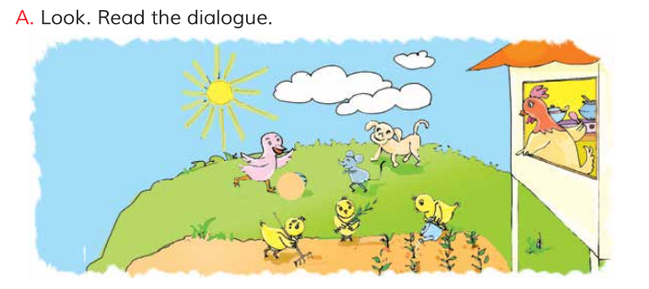
A Hen and her checks ,a dog ,a duck and a mouse.
What can you see in the pictures?

Slide 4
Our today’s topic is….
Story: The hen and her chicks.

Slide 5
Learning outcomes
Listei
ing
1.1.1 recognize sound differences in the context of words.
1.2.1 recognize which syllable in a word is stressed.
1.3.1 recognize which words in a sentence are stressed.
3.4.1 understand statements made by the teacher and students.
4.2.1 enjoy and understand simple stories.
Speak
ing
1.1.1 repeat after teacher and say words, phrases and sentences with proper sound and stress.
8.1.1 take part in conversation on simple topics (likes/dislikes , hobbies, holidays, family , friends .Etc)
1.4.1 read words, phrases and sentences in the text.
1.5.1 read words, phrases and sentences in the text with proper pronunciation, stress and intonation.
1.7.1 read short paragraphs, dialogues and simple letters.
Read
ing

Slide 6
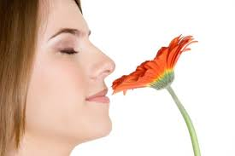
Let’ know about new words
Hard
শক্ত
Difficult
Smell
Flavor
গন্ধ

Slide 7
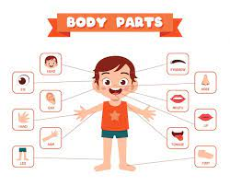
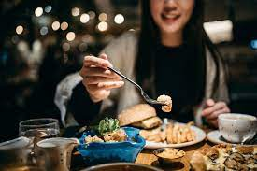
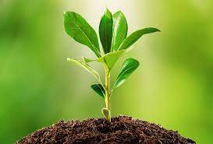
Part
Portion
অংশ
Dine
Eat
আহার করা
Plant
Sapling
চারা

Slide 8
Teacher’ loud reading

Slide 9
Read with your friend

Slide 10
Act the story with your friends……

Slide 11
Let’s enjoy a game…….
Say the missing word………
Hard
laugh
done
know
work
mine
smell
part
plant
stand

Slide 12
Rearrange the word to make sentence.
1. hard, this, is, work!
Ans: This work is hard!
2. fine, so, it, smells!
Ans: It smell so fine !
3. some, I, bread, want!
Ans: I want some bread!

Slide 13
4. cook, work, or , you, didn’t, plant
Ans: You didn’t plant or work or cook
5. can, and , look, you, stand
Ans: You can stand and look !
6. know, when, work, done, you, will, is, the
Ans: You will know when the work is done.

Slide 14
Make sentences with the following words
Smell
Flowers smell is very sweet.
Hard
The farmer’s work is so hard.
Plant
We should care of all plant.
Part
There are many parts in our body.

Slide 15
Match A column with B column.
A column
B column
Hard
Portion
Smell
Difficult
Part
Eat
Plant
Flavor
Dine
Sapling

Slide 16
Write True or false.
1. The bread smell is not fine
False
2. It’s cold in the sun.
false
3. The hen made a bread.
True
4. Mouse, Duck and dog are having fun.
True

Slide 17
Homework
1. How is the work ?
2. Who makes the bread ?
3. Who wants the bread ?
4. How is the bread’s smell ?

Slide 18
Good bye for today

