Slide 1
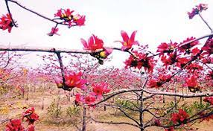

Slide 2
Welcome to my new class

Slide 3
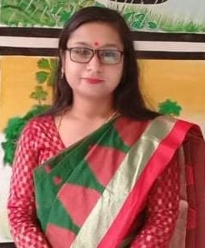
Identity
Kanan Roy
Assistant teacher
Dakshin Chand Pur-1 Govt Primary school
Harirampur , Manikganj
The hen and her chicks
Lesson : 3-5
Act : ABC

Slide 4
Learning outcomes
Students will be able to
Speaking
3.1.1
Ask and answer Wh questions .
Read silently with understanding paragraphs, stories and other text meterials.
Reading
5.1.1
Copy and write cardinal numbers up to 50 both in fingures and in words .
Writing
4.1.1

Slide 5
Teacher’s Reading
Chick 1 : This work is hard ! It’s hot in the sun!
Chick 2 : Mouse, Duck and Dog are having fun !
Chick 3 : Why can’t we laugh and play and run ?
Hen : You will know when the work is done .
Dog : Is that bread ? It smells so fine !
Mouse : I want some bread ! What part is mine ?
Duck : I want some, too ! When do we dine ?
Hen : You didn’t plant or work or cook .
Chicks : So you can’t eat ! You can stand and look !

Slide 6
Student’s Reading
Chick 1 : This work is hard ! It’s hot in the sun!
Chick 2 : Mouse, Duck and Dog are having fun !
Chick 3 : Why can’t we laugh and play and run ?
Hen : You will know when the work is done .
Dog : Is that bread ? It smells so fine !
Mouse : I want some bread ! What part is mine ?
Duck : I want some, too ! When do we dine ?
Hen : You didn’t plant or work or cook .
Chicks : So you can’t eat ! You can stand and look !

Slide 7
Answer the question
1. What are the chicks doing at the beginning of the story ?
Ans : At the beginning of the story, the chicks are working
hard in the sun .
2. Who is not working at the beginning of the story ? What
are they doing ?
Ans : At the beginning of the story, Mouse , Duck and Dog
are not working . They are having fun .

Slide 8
Answer the question
3. Why can’t Dog, Mouse and Duck have any bread ?
Ans : Dog, Mouse and Duck can’t have any bread because
they didn’t plant or work or cook .
4. Look at the first picture. What is mother hen doing ?
Ans : In the first picture , mother hen is cooking and
watching her chicks through the window .

Slide 9
What is the moral of the story
B . Group work
1 It’s fun to play and laugh .
2 Good things come to people who work .
3 Everyone can have good things .

Slide 10
Underline the punctuation
2
There are ----------- full stops in the story .
Chick 1 : This work is hard ! It’s hot in the sun!
Chick 2 : Mouse, Duck and Dog are having fun !
Chick 3 : Why can’t we laugh and play and run ?
Hen : You will know when the work is done .
Dog : Is that bread ? It smells so fine !
Mouse : I want some bread ! What part is mine ?
Duck : I want some, too ! When do we dine ?
Hen : You didn’t plant or work or cook .
Chicks : So you can’t eat ! You can stand and look !
1
2

Slide 11
Underline the punctuation
4
There are ----------- question marks in the story .
Chick 1 : This work is hard ! It’s hot in the sun!
Chick 2 : Mouse, Duck and Dog are having fun !
Chick 3 : Why can’t we laugh and play and run ?
Hen : You will know when the work is done .
Dog : Is that bread ? It smells so fine !
Mouse : I want some bread ! What part is mine ?
Duck : I want some, too ! When do we dine ?
Hen : You didn’t plant or work or cook .
Chicks : So you can’t eat ! You can stand and look !
1
2
3
4

Slide 12
Underline the punctuation
8
There are ----------- exclamation marks in the story .
1
Chick 1 : This work is hard ! It’s hot in the sun!
Chick 2 : Mouse, Duck and Dog are having fun !
Chick 3 : Why can’t we laugh and play and run ?
Hen : You will know when the work is done .
Dog : Is that bread ? It smells so fine !
Mouse : I want some bread ! What part is mine ?
Duck : I want some, too ! When do we dine ?
Hen : You didn’t plant or work or cook .
Chicks : So you can’t eat ! You can stand and look !
2
3
4
5
6
7
8

Slide 13
Home work
Circle the capital letters
Chick 1 : This work is hard ! It’s hot in the sun!
Chick 2 : Mouse, Duck and Dog are having fun !
Chick 3 : Why can’t we laugh and play and run ?
Hen : You will know when the work is done .
Dog : Is that bread ? It smells so fine !
Mouse : I want some bread ! What part is mine ?
Duck : I want some, too ! When do we dine ?
Hen : You didn’t plant or work or cook .
Chicks : So you can’t eat ! You can stand and look !

Slide 14
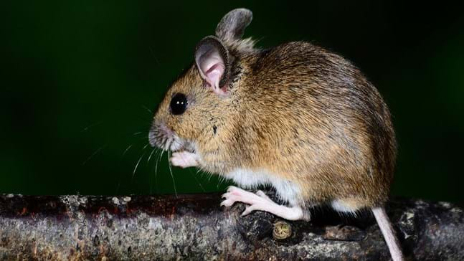
One day one word
Mouse
Murine
ইঁদুর বা মুষিক
We’ve got a mouse in the house .

Slide 15
Good bye the students

