Slide 1

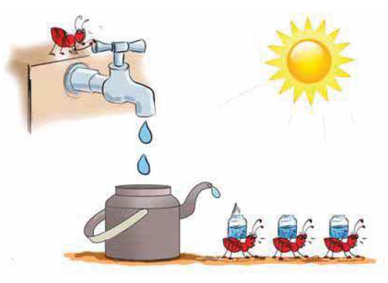

Slide 2

Welcome to all

Slide 3
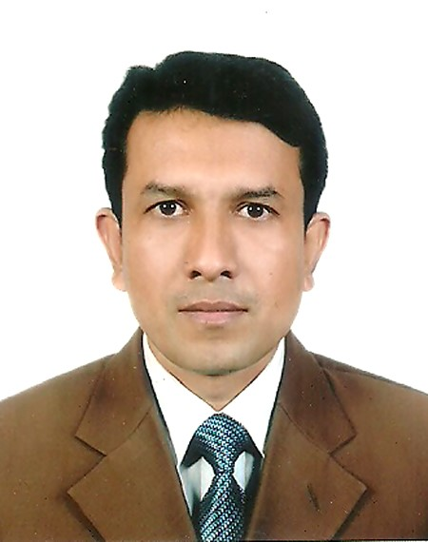
Md Jakir Hossin
Maishadi govt. primary school
Chandpur sadar
Chandpur

Slide 4
Class: one
Subject: English
Unit 23: Alphabet
Lesson: 4-6

Slide 5
Learning outcome -
Student will be able to-
1.1.1 repeat after the teacher
simple word and phrases.
1.1.2 say simple word and phrase.

Slide 6

Lesson title: Alphabet
a b c d e f g
h i j k l m n o p
q r s t u v w x y z

Slide 7
Look at the picture.
T
t
tap

Slide 8
Say and read, trace and write.
T
T
T
t
t
t

Slide 9
Say, trace and write.
tap
tap
___

Slide 10

Home work
Write three word with ‘t’

Slide 11

Thanks
to
all

