Slide 1
Welcome
Everybody.

Slide 2
Teacher’s Name:
Mijanur Rahman
Assistant Teacher
Gopalpur(Uttar) Gov’t Primary School
Durgapur , Netrakona.

Slide 3
Lesson title: See You
Unit: 2
Lesson: 1-2

Slide 4
Learning Outcomes:
At the end of the lesson students will be able to………………………
Say words, phrases and sentences with correct pronounciations.
Act out the dialogue.
exchange greetings .

Slide 5
What learners already know.
Bookshop, friend
great, meet,
medicine,
bookfair, hour.
Notes:
What learners already know:

Slide 6
Classroom language:
1. Good afternoon/ Good Morning students
2. How are you
3. Iisten to carefully, please.
4. Please, repeat after me.
5. Make pair, please.
6. Please, look at the picture.
7.Think about it, Please.

Slide 7
Greetings: Exchange greetings.
I will play a song:
1.Good morning, students.
How are you today ?
2. I’m fine ; I’m fine
I wish you a good day.
Now SS will introduce each other.
Notes:
Lead in: Firstly I will sing and ss will only listen to me carefully then I will sing with them.

Slide 8
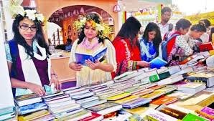
Do you like going to the bookfair?
Notes:
Think about the picture.

Slide 9
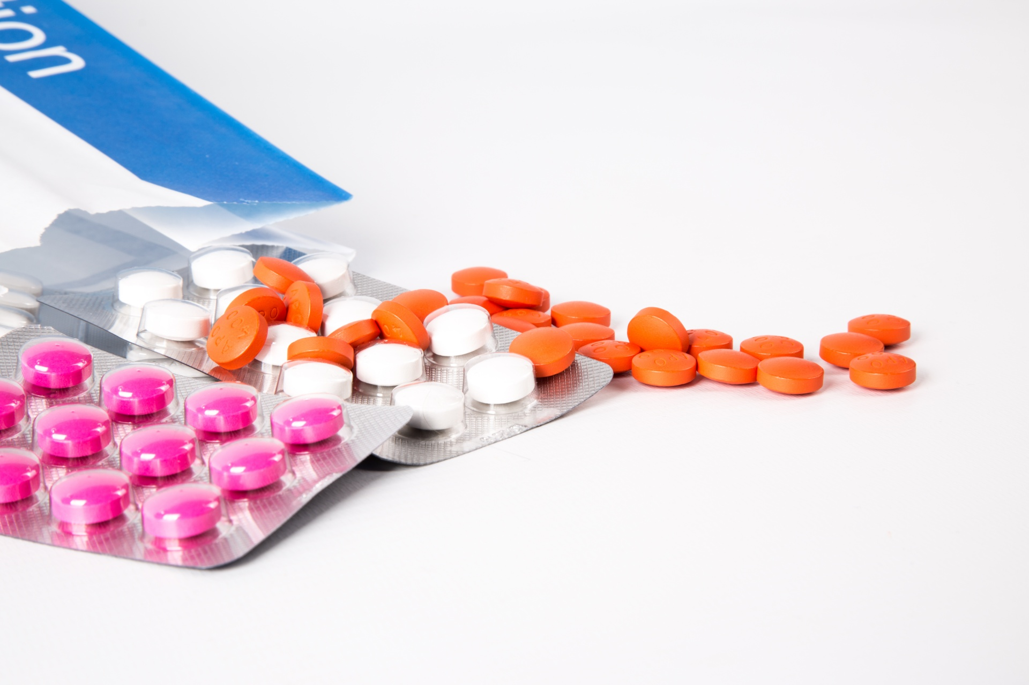
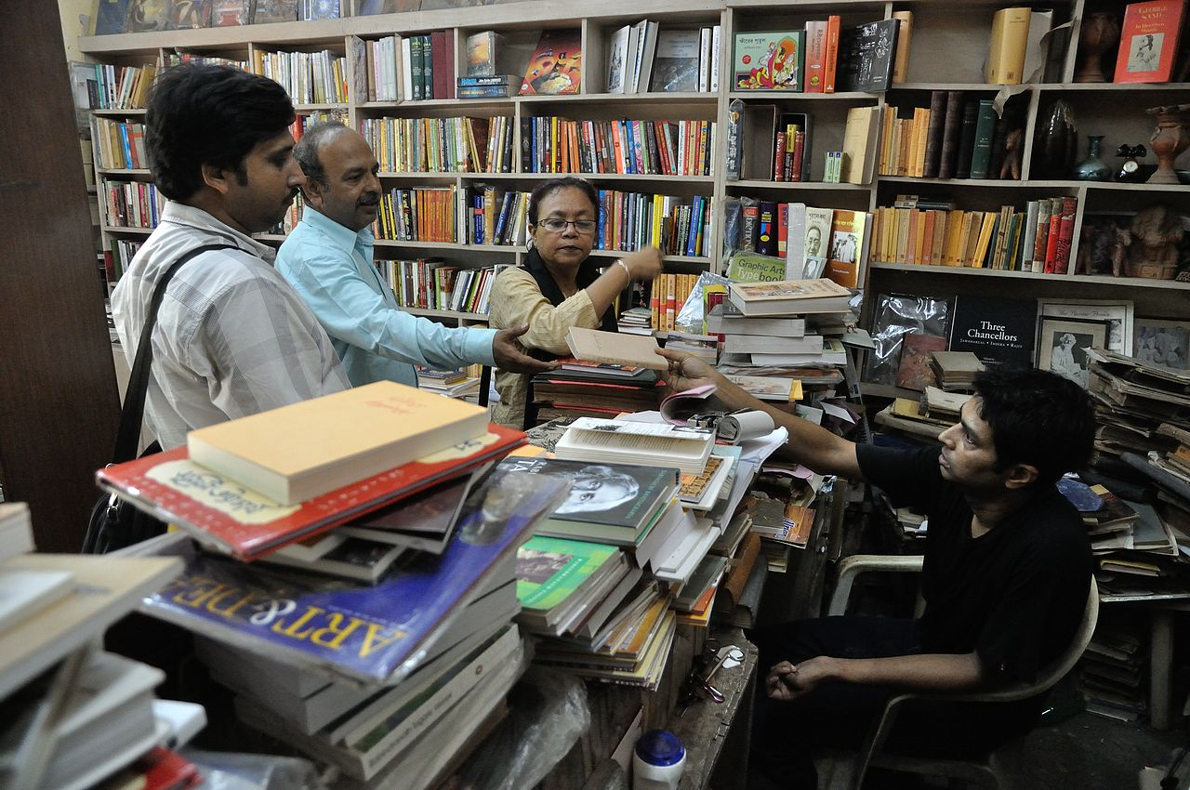
Medicine
Bookshop

Slide 10
Notes:
What can you think about the picture?

Slide 11
1. Where is Andy going?
2. Where is Tamal going? Why?
3.When can Tamal meet Andy?

Slide 12
Notes:
I will read the dialogue—(Front chaining and back chaining.)

Slide 13
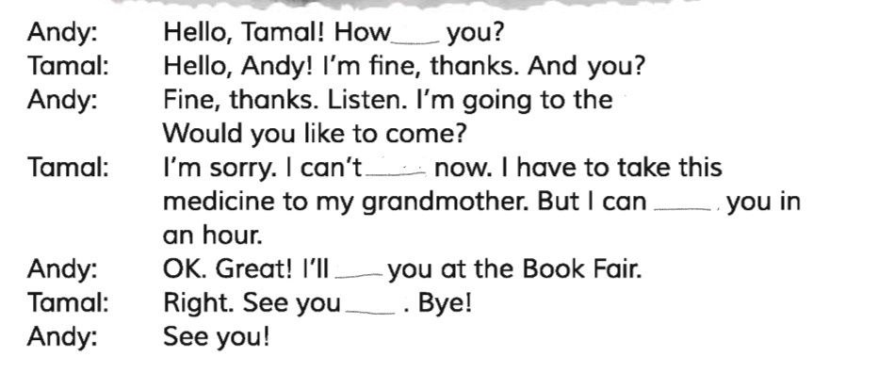
are
right
meet
see
later

Slide 14
Andy:
Hello, Tamal! How are you?
Tamal:
Hello, Andy! I’m fine thanks. And you?
Andy:
Fine, Thanks. Listen. I’m going to the bookfair.
Would you like to come?
Andy:
Ok, great I’ll see you at the bookfair.
Tamal:
Right see you later, bye!
Andy:
See you!

Slide 15
Andy:
Tamal:
Hello, Tamal! How are you?
Hello, Andy! I’m fine thanks. And you?
Andy: Fine, thanks. I’m going to the bookfair.
Would you like to come?
Notes:
I will call two ss and ask to role play as andy and Tamal.

Slide 16
Andy: Ok, great I’ll see you at the bookfair.
Tamal: Right see you later, bye!
Andy: See you!
Notes:
I will act the dialogue and students will follow me.

Slide 17
Ok, great I’ll see you at the bookfair.
Right see you later, bye!
Alom
Halima
See you!
Alom

Slide 18
Fine , thank you.
How are you?
Apu
Tasin

Slide 19
See you later, Bye!
See you!
Salma
Abid

Slide 20
Ok , No more today.

