Slide 1


Slide 2


Slide 3


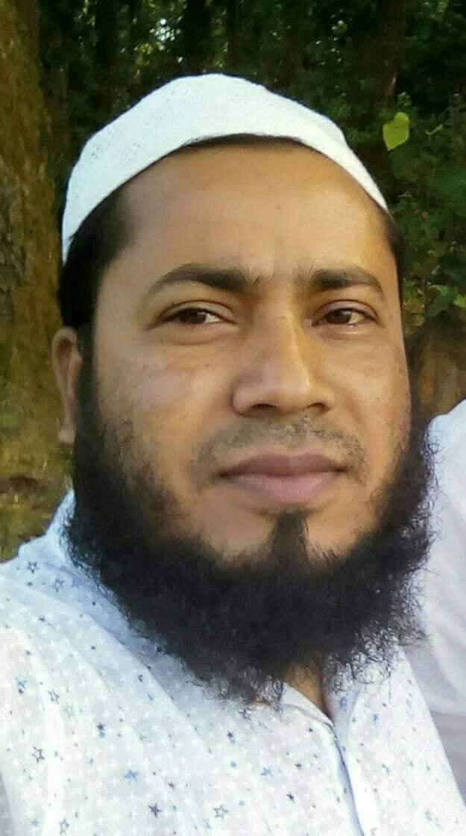
Identity
Shohel Miah
Assistant Teacher
Kongsherkul Govt: Primary School.
Bhaluka, Mymensingh.
Email: shohelkgps@gmail.com

Slide 4


Lesson’s Introduction
Class: Five
Unit: 6
Lessons: 2-3
Section: E
Lesson’s title:
Eat healthy

Slide 5
Learning Outcomes
Students will be able to-

Slide 6

Creating emotion
By watching video

Slide 7
Look at the picture

Slide 8

Lesson declaration
Eat healthy

Slide 9
Open your English book page at 23

Slide 10

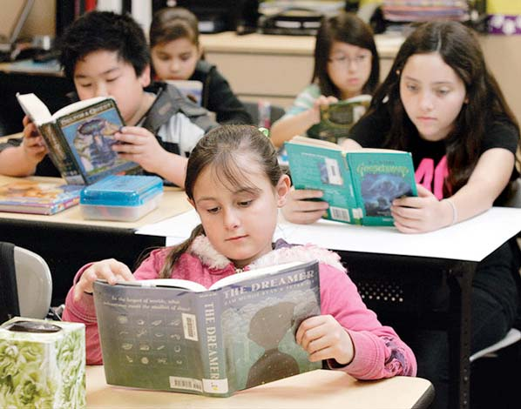
Students loudly reading

Slide 12
Fat and oil
Ghee, mustard oil.
Fish,meat,dairy,
beans,lentils
Milk, egg.
Fruits
Banana, apple.
vegetables
Carrot, tomato.
Grains
Rice, ruti

Slide 13


