Slide 1
Welcome
to
My Multimedia Classroom.

Slide 2
Teacher Identification
Mijanur Rahman
Assistant Teacher
Gopalpur (Uttar) Gov’t Primary School
Durgapur, Netrakona.
Sub: English
Class:Two
Unit: 4 (Alphabet)
Lesson: 4-6(Pp - Tt )

Slide 3
Today’s lesson
Alphabat Pp-Tt
Unit : 4
Lessons : 4-6
Activity : A,B & C
Page : 9

Slide 4
Learning Outcomes:
At the end of the lesson students will be able to-
become familiar with English sounds by listening to common English words.
repeat after the teacher simple words and phrases with proper sounds and stress
use small and capital( non cursive).

Slide 5
Let’s we sing a song.
We shall overcome
We shall overcome
We shall overcome someday
Oh deep in my heart, I do believe,
………………………………..
Notes:
Lead in:

Slide 6
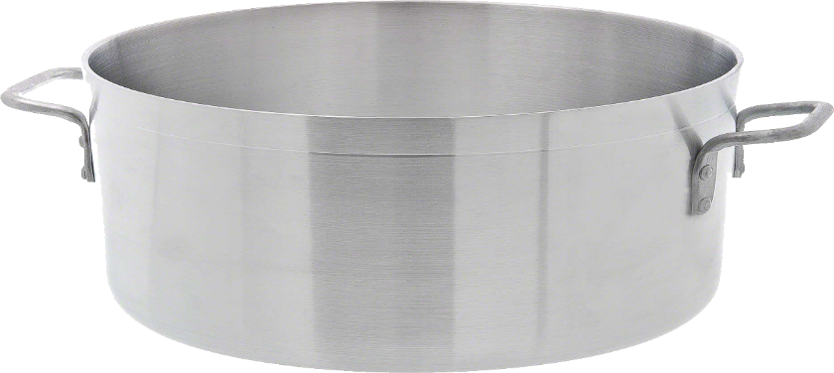
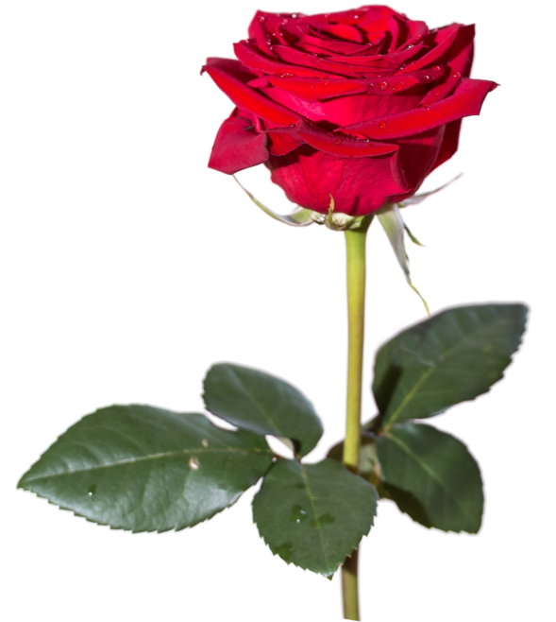
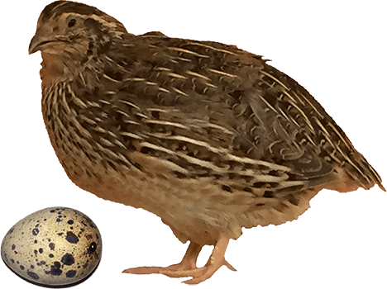
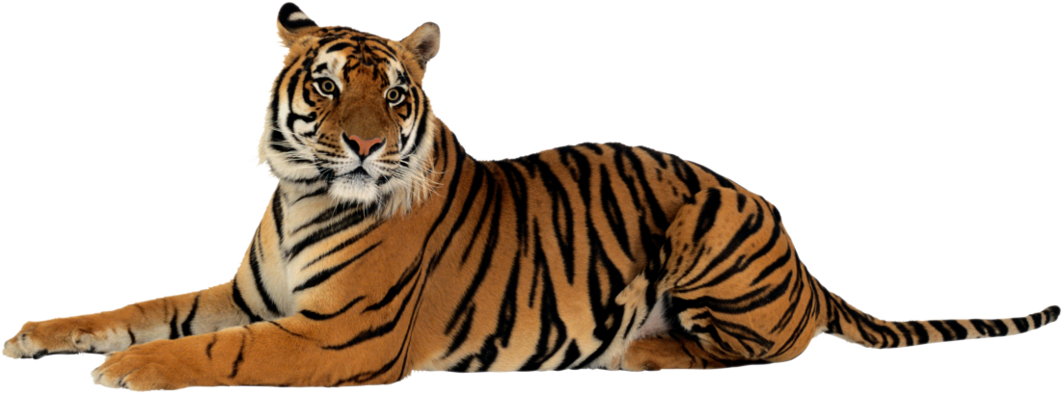
What can you see in these pictures?
Pot.
rose.
Quail
tiger.
Notes:
Input:

Slide 7
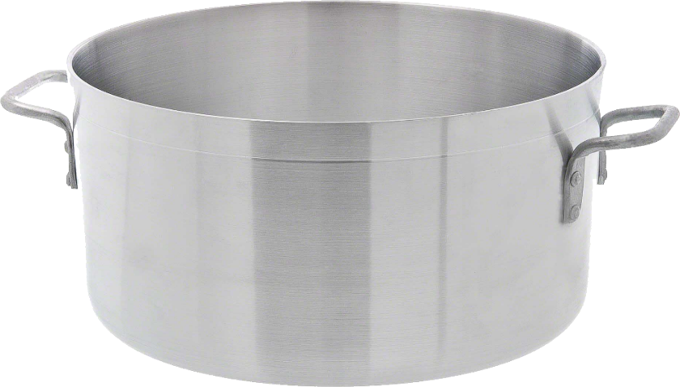
What’s this?
What’s this?
This is a pot.
This is a rose.
What’s this?
What’s this?
This is a quail.
This is a tiger.
Notes:
Input:

Slide 8
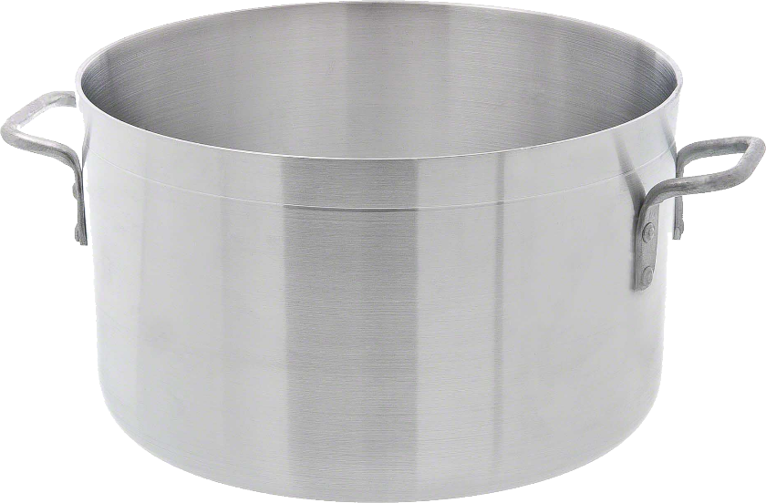
Look, listen and say-
P p
Pot

Slide 9
Look, listen and say-
Q q
Quail

Slide 10
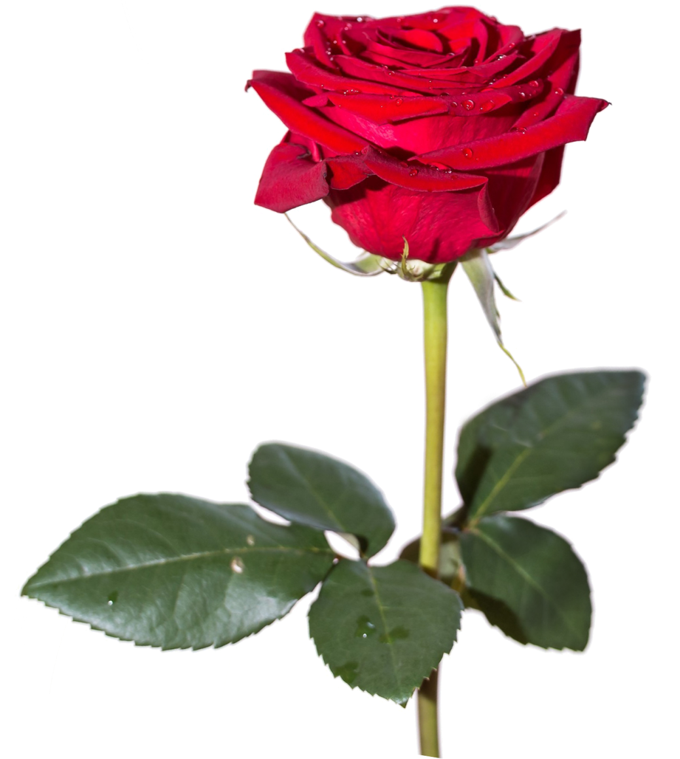
Look, listen and say-
R r
Rose

Slide 11
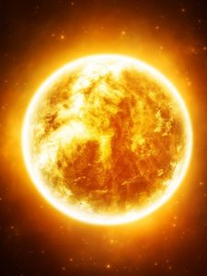
Look listen and say-
S s
Sun

Slide 12
Look, listen and say-
T t
Tiger

Slide 13
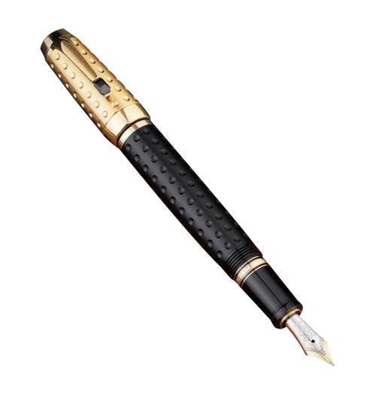
Look, listen and say-
P p
Pen

Slide 14
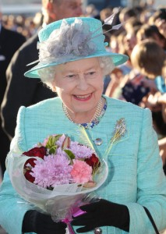
Look listen and say-
Q q
Queen

Slide 15
Look listen and say-
R r
Red

Slide 16
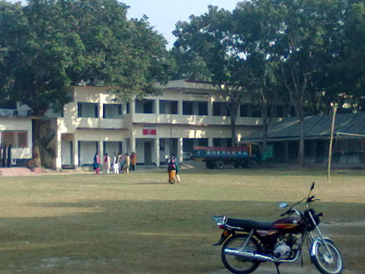
Look listen and say-
S s
School

Slide 17
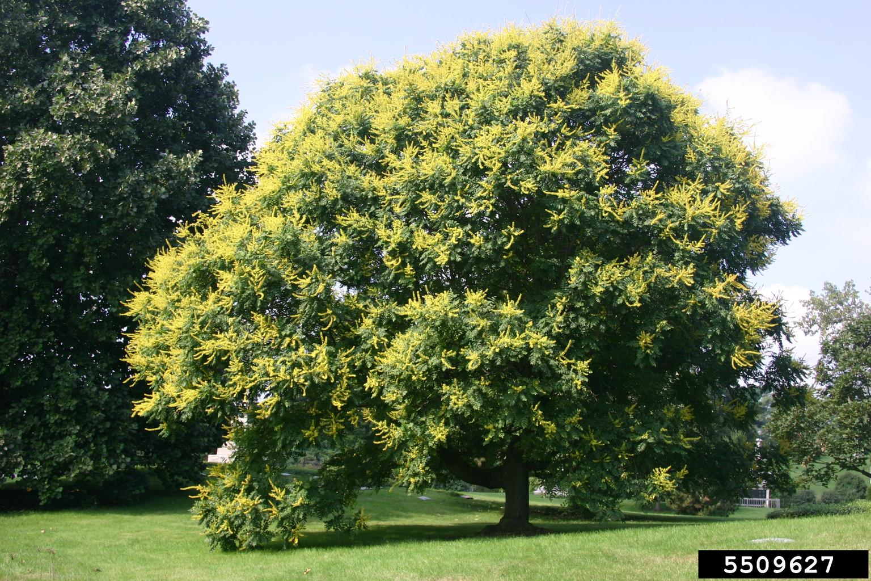
Look listen and say-
T t
Tree

Slide 18
Sound and Pronounciations:
Pot rose
Quail tiger
Sun queen
Notes:
Practice:

Slide 19
Read and say. Trace and write-
pot
quail
rose
sun
tiger
Notes:
Practice -Group work:

Slide 20
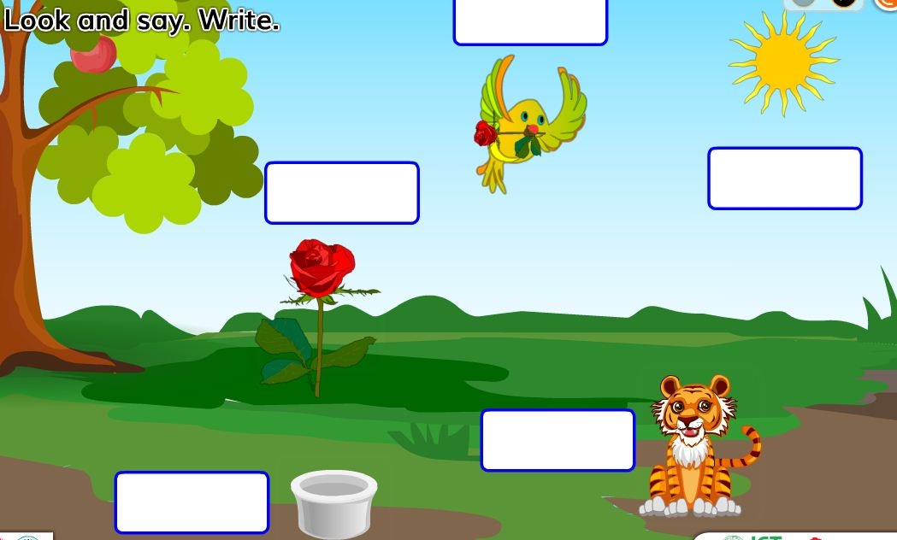
Fill in the box.
quail
Sun
rose
Tiger
Pot
Notes:
Individual work:

Slide 21
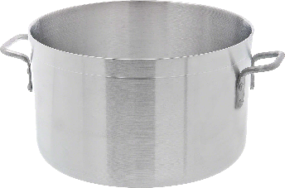
Say read and match
Queen
Pot
Tree
Sun
Notes:
Evaluation

Slide 22
Thank you
so much.
See you again
tomorrow.

