Slide 1

Welcome Everybody
to
my Multimedia Classroom.

Slide 2
Mijanur Rahman
Assistant Teacher
Gopalpur(Uttar) Govt. Primary School
Durgapur, Netrakona
Mobile: 01912793491
E-mail: sabitmijan@gmail.com

Slide 3
Rearrange the word to make a meaningful word.
gleoulace

Slide 4
Match your word
colleague
সহকর্মী

Slide 5
What do you use to say goodbye?
We use to say goodbye –
        bye!
        See you later.
        See you.

Slide 6
Let's know the meaning of some words.
No. | Words | Meanings
1 | Add | যোগ করা, যুক্ত করা
2 | Information | তথ্য
3 | Married | বিবাহিত
4 | Men | পুরুষ লোক
5 | Nickname | ডাকনাম, উপনাম

Slide 7
Let's know the meaning of some words.
No. | Words | Meanings
6 | Pronounced | উচ্চারিত, কথিত
7 | Spell | বানান করা
8 | Title | উপাধি, পদবি, নাম
9 | Use | ব্যবহার করা
10 | Women | মহিলা, নারী

Slide 8
Home work review:

Slide 9
Home work review

Slide 11
Write your answers
> What is your full name?
> Do you have a nickname?

Slide 12
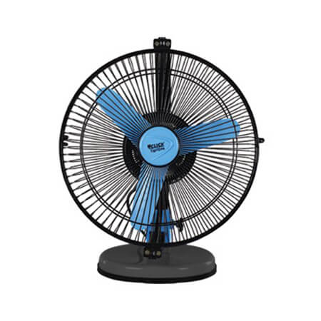
Tell me what about this picture?
Fan

Slide 13
Tell me what about this picture?
The fan is on the van.

Slide 14
Tell me what about this picture?
Vine – আঙ্গুর গাছ
Grapes on a vine

Slide 15
Pronounce these
Fan, Van
Fine, Vine

Slide 16
Try another
I feel fine.
I like grapes from the vine!

Slide 17
Write the words about each pictures:
Vase, Fish, Vegetables, Elephant

Slide 18
Home Work.
Page No 10 in your textbook.

Slide 19
Thank you everybody See you next class

