Slide 1
Welcome
To my English class.

Slide 2
Introduction of teacher
Md. Shafiul Alam
Assistant teacher,
Bazitkhila govt. primary school.
Sherpur Sadar, Sherpur
01721082430

Slide 3
Lesson Introduction
Class-Five
Unit-8
Lesson title- Write to me soon.
Lesson-1
Time-45 Minute

Slide 4
Learning Outcomes
Students will be able to –
Listening-1.2.1 , 1.3.1
Speaking-1.1.1 , 1.1.2 , 6.1.2 ,6.2.1
Reading-1.5.1 , 1.6.1 , 1.7.1 , 5.1.1

Slide 5
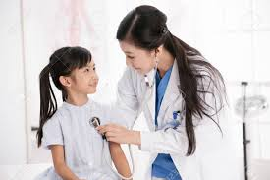
What can you see in the picture?
We can see a patient and a doctor in the picture.

Slide 6
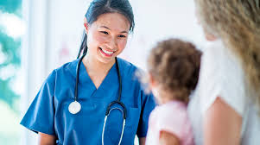
So today we will learn about a patient and her sickness.

Slide 7
Declaration of lesson Title
Write to me soon.

Slide 8
New Word
Cough -কাশি । Eat -খাওয়া
Fever -জ্বর - a disease of high temperature
Medicine - ঔষধ - drug .
Sore throat -গলাব্যাথা - pain in one’s throat.

Slide 9
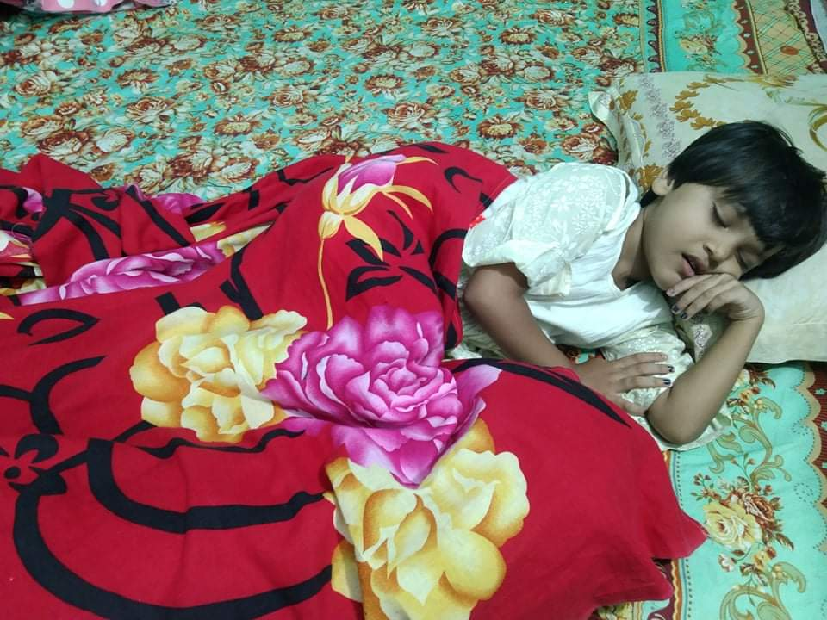
At first I want to show you a patient’s condition. Please watch carefully and listen attentively.
Sima is at home today.She didn’t go to school because she is ill.

Slide 10
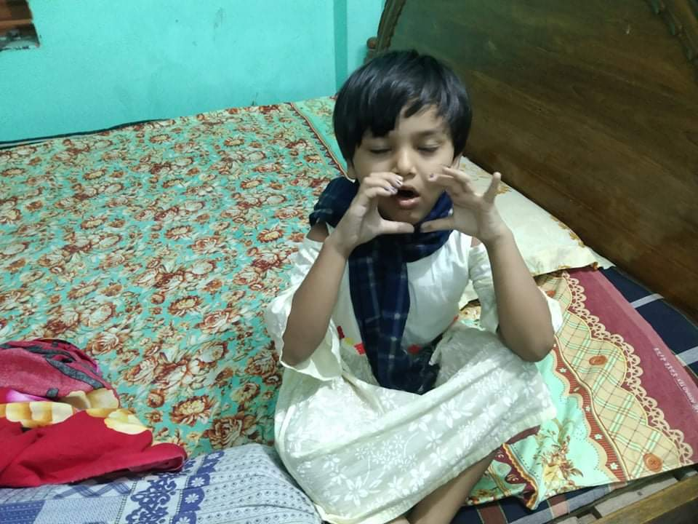
She has a cough and a sore throat.

Slide 11
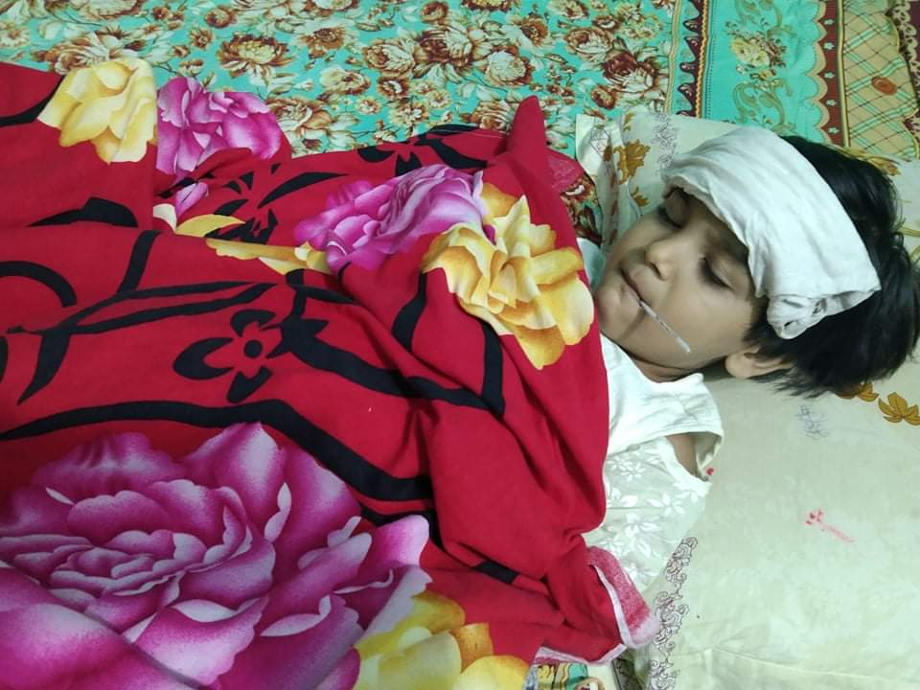
She also feels very warm because she has a fever.

Slide 12
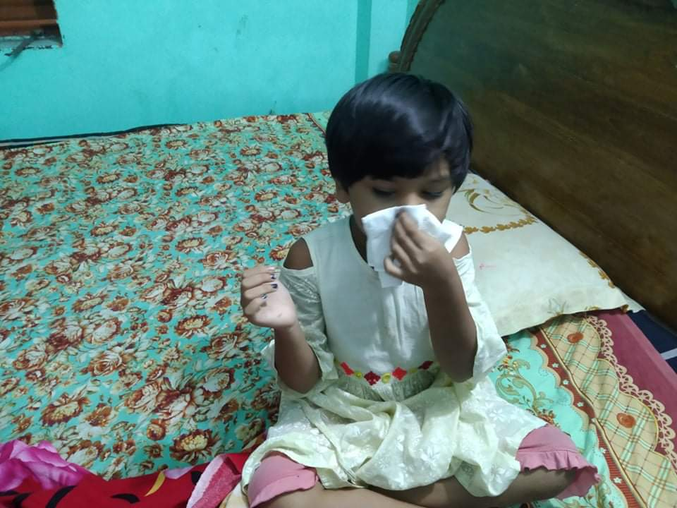
She has the flu.

Slide 13
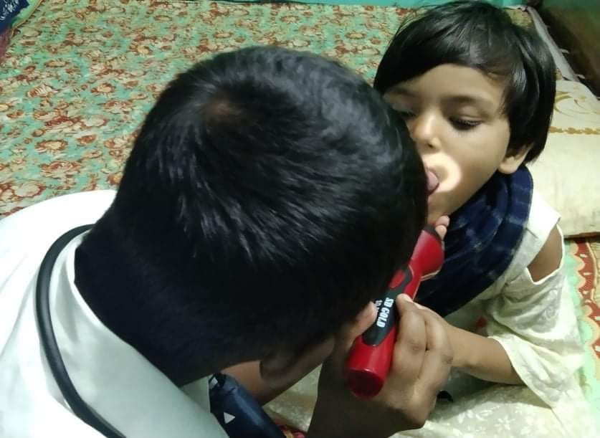
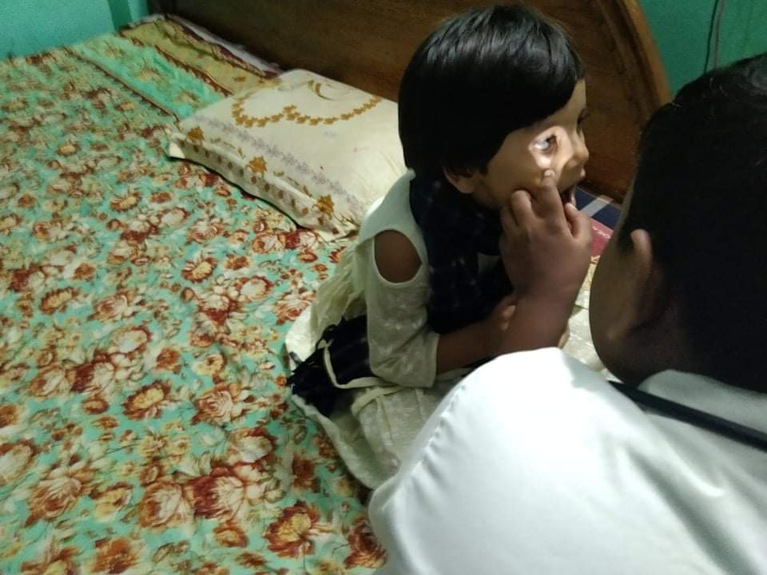
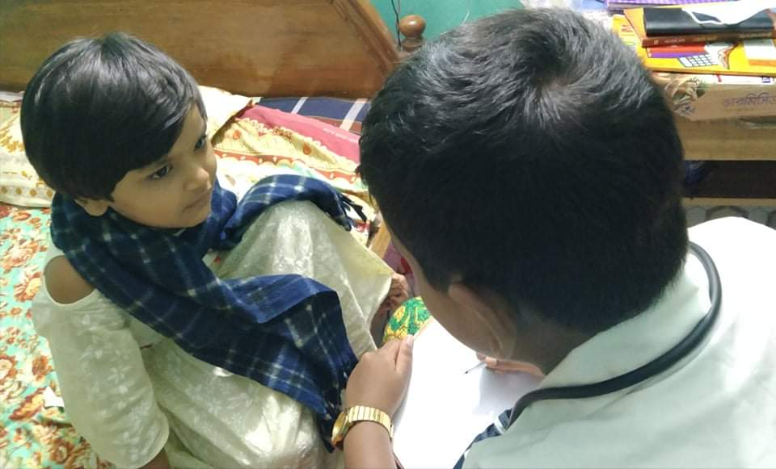
The doctor visited Sima last night.She needs some medicine.He also told her what to do in order to get well soon.

Slide 14
Now open your book at page number 30 and listen to me attentively.

Slide 15
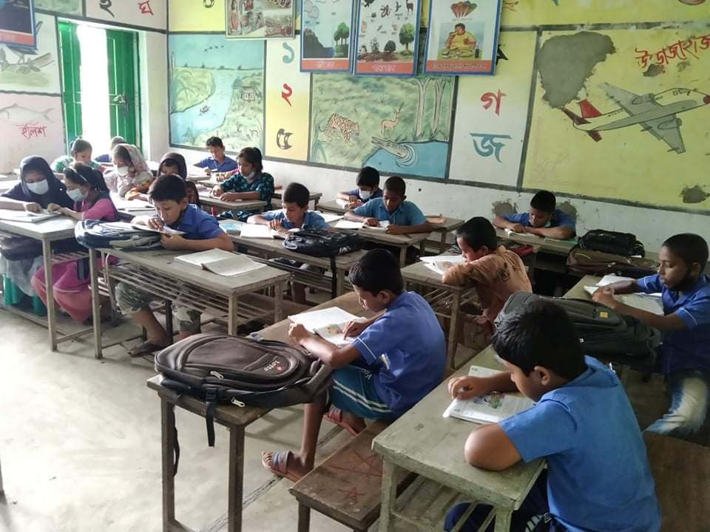
about five minutes.
Student’s silent reading.

Slide 16
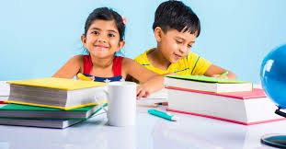
Pair work
Fill in the gaps:
1)Sima is at ---------------today.
2) The doctor visited sima -----------.
3) She has a cough and a -----------.
4) She also feels very -------------.
5)She -------------some medicine.
home
Last night
Sore throat
warm
needs

Slide 17
Group work
Write three sentences about a doctor.
Group-A
Group-B
Write three sentences about a patient.

Slide 18
Evaluation
1) Where is Sima today?
Sima is at home today.

Slide 19
2)Why did not Sima go toSchool?
Sima did not go to School because she is ill.
3)Who visited Sima last night?
The doctor visited Sima last night.

Slide 20
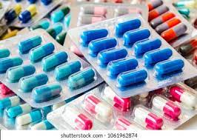
One day one word
ঔষধ
Medicine

Slide 21
Homeork
Write five sentences about fever / flu.

Slide 22
&
Good
bye

