Slide 1
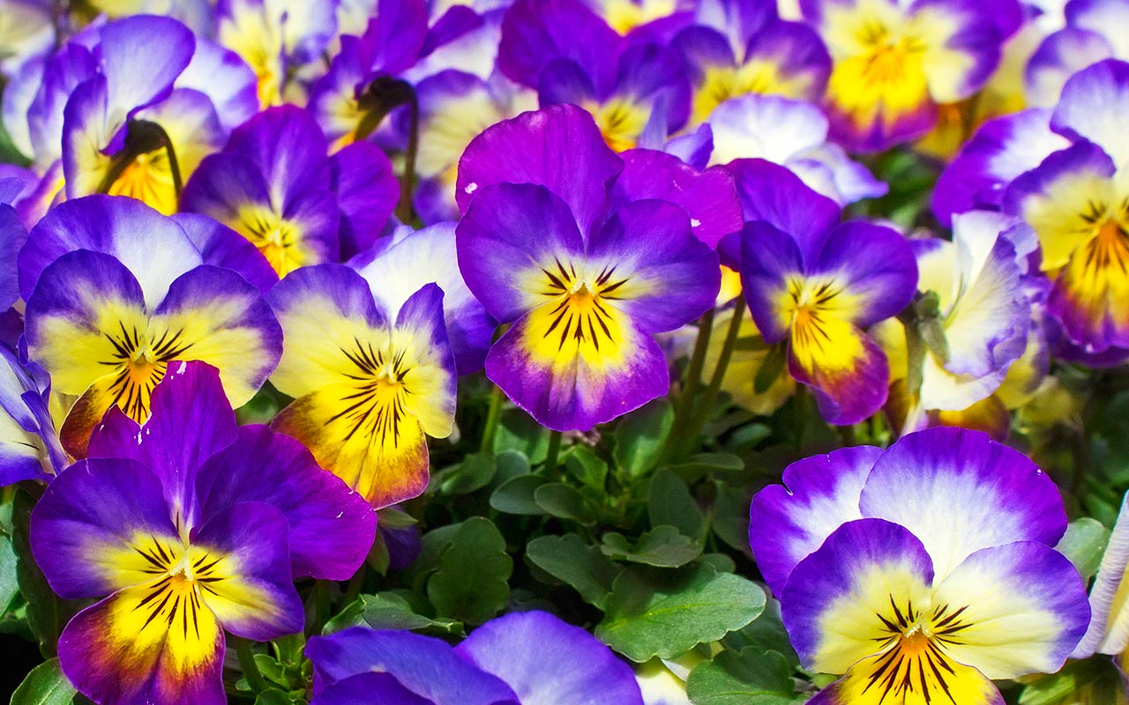
WELCOME

Slide 2
Introduction
MST. KOHINOOR AKTER BANU
ASSISTANT. HEAD MASTER
ALAMPUR SECENDARY GIRLS SCHOOL
KUSHTIA SADAR KUSHTIA.
MOBILE NO-01716494605.

Slide 3
PART IDENTITY

Slide 4
Learning outcomes
##. At the end of the lesson, Students will be able to ---- ----
#. Learn the rules of tag question.
#.identify the method of tag question.
#.make tag questions.

Slide 5
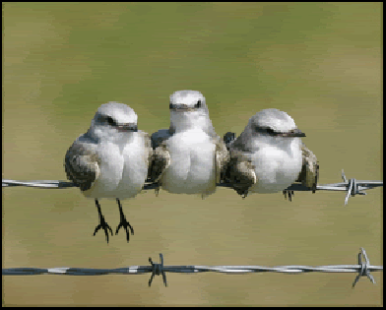
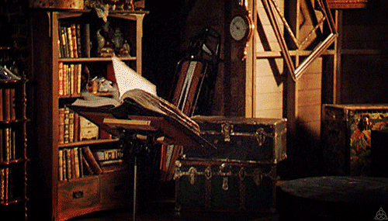
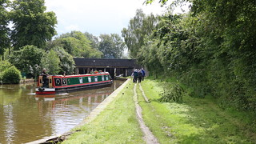
#.He is an honest man, isn’t he?
#.She was a housewife, wasn’t she?
Example
#. Birds can fly, can’t they?
#. Hasan has a book, hasn’t he?
#. We should love our country, should’t we?
#.Mina must read a book, mustn’t she?

Slide 6
Rules of tag questions
is |  | Isn’t
are |  | aren’t
am |  | ain’t
was |  | wasn’t
were |  | weren’t
has |  | has’t
have |  | haven’t
had |  | hadn’t
will | won’t
shall | shan’t
can | can’t
must | mustn’t
may | mayn’t
would | wouldn’t
should | shouldn’t
could | couldn’t
ought | oughtn’t

Slide 7
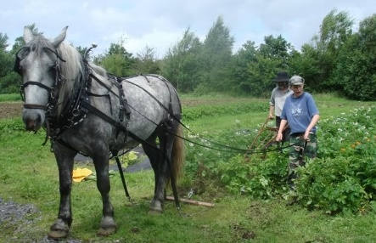
Example
##. He helped the poor, didn’t he?
##. The girl drew a picture, didn’t she?
##. They play in the field, don’t they?
##. The farmer ploughs the land, doesn’t he?
[ Rules: present indefinite tense হলে don’t/doesn’t হয় এবং past indefinite tense হলে, didn’t হয়]

Slide 8
s
Example
#. Read attentively, will you?
#. Always speak the truth, will you?
#. Let us play now, shall we?
#. Let him go, will you?
[ Rules: Imperative sentences এ will you, let us থাকলেshall we, let পরে অন্য object থকলে will you হয়]
#. I am not happy, am I?
#. He hardly comes here, does he?
[Rules: Sentence যদি negative হয় বা hardly,badly. Few, little,not seldom etc. থাকলে Negative হবে না]

Slide 9
Evaluation
##. Make tag questions.
(a)I am one of them, --- --- ?
(b) We hardly forget the golden past, --- ---?
(c) Every students read attentively, --- --- ?
(d) Do not tell a lie, --- ---?

Slide 10
Home work
##.Make tag questions.
(a) Money is must for our life,--- --- ?
(b) We have to work hard, --- --- ?
(c) Everybody wants to lead a better life, ---?
(d) Nobody phoned him, --- ---- ?
(e) You need not to go there, --- --- ?

Slide 11
Thanks all

