Slide 2
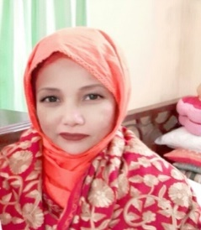
Identity
Mst. Lucky Akhter Parveen
Assistant teacher
Bihari Govt Primary school
Pirgachha, Rangpur
English for Today
Class: five
Unit: 2, See you
Lesson: 5-6
Time: 45 minutes

Slide 3
Learning Outcomes
Students will be able to:
Listening: 1.4.1 recognize and use intonation patterns for Yes/No and Wh question.
Speaking:2.1.1 exchange greeting and farewells.
3.1.2 ask and answer Yes/ No question.

Slide 4
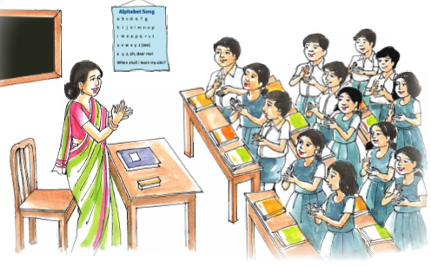
Warm up activities: Singing a song

Slide 5
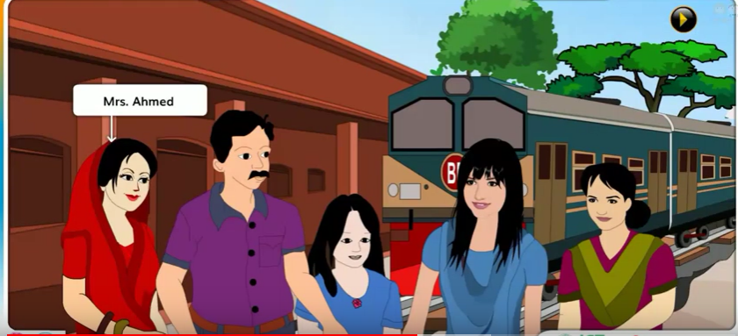
Look at the picture

Slide 6
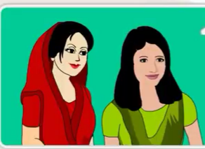
See you

Slide 7
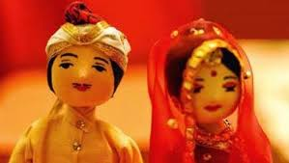
Word meaning
a surname
‘Bony
Roy’
Title
Married
one who is wedded

Slide 8
Word meaning
one’s name by which one is informally called
Nickname
Naznin Nahar
Munny

Slide 9
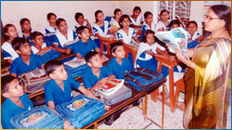
Teacher’s reading

Slide 10
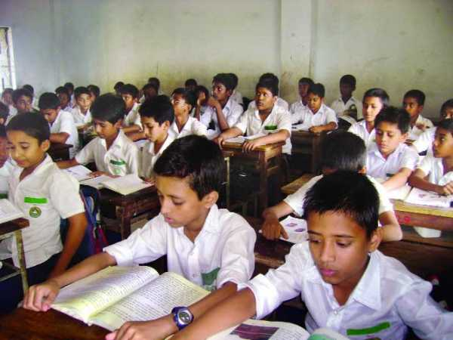
Student reading

Slide 11
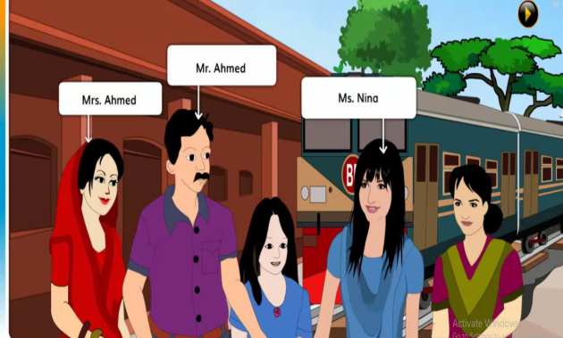
Let’s we know where we use Mr., Mrs and Ms

Slide 12
Let’s we know where we use Mr.

Slide 13
Let’s we know where we use Mrs.

Slide 14
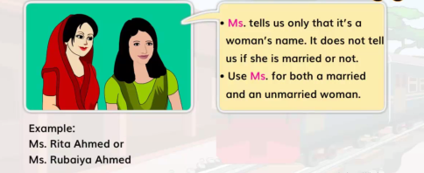
Let’s we know where we use Ms.

Slide 15
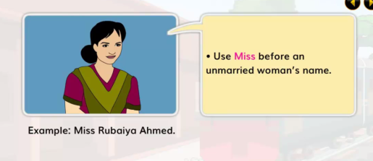
Let’s we know where we use Miss.

Slide 16
Pair work.
Read and match.
Yes, it’s Andy.
Smith
Andrew Smith
4. Do you have a nickname?
A-N-D-R-E-W

Slide 17
Pair work.
Choose the correct answer.

Slide 18
Pair work.
Choose the correct answer.

Slide 19
Pair work.
Choose the correct answer.

Slide 20
Group work.
Write your friend information below.

Slide 21
Evaluation.
Answer the following question.

Slide 22
Thank you

