Slide 2
Identity
Mst. Lucky Akhter Parveen
Assistant teacher
Bihari Govt Primary school
Pirgachha, Rangpur
English for Today
Class: five
Unit: 2, See you
Lesson: 7
Time: 45 minutes

Slide 3
Learning Outcomes
Students will be able to:
Listening: 1.1.1 recognize sound differences in the context of words.
Speaking:1.1.1 say words and sentences with proper sounds and stress.

Slide 4
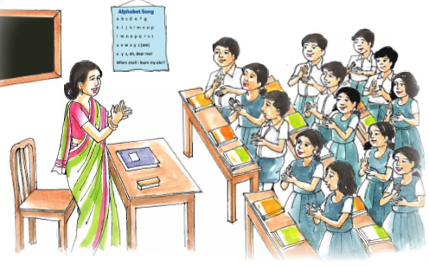
Warm up activities: Singing a song

Slide 5
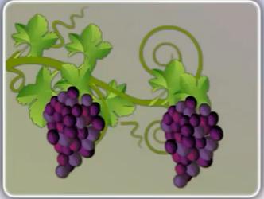
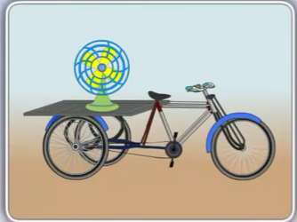
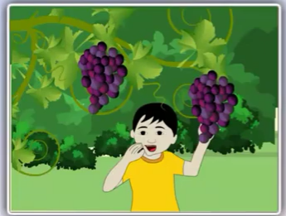
Let’s see the pictures.

Slide 6
To days Lesson
Sound practice

Slide 7
Word meaning
Fan
a tools to blow wind
A vehicle
Van
In a very good condition
Fine

Slide 8
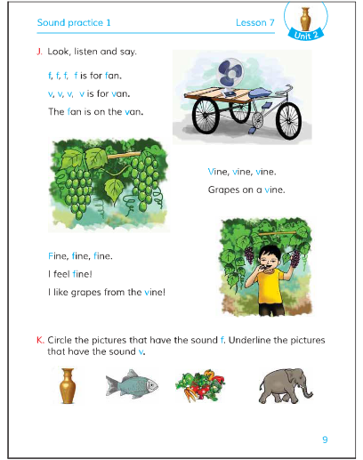
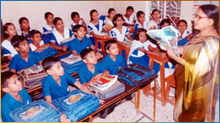
Teacher’s reading

Slide 9
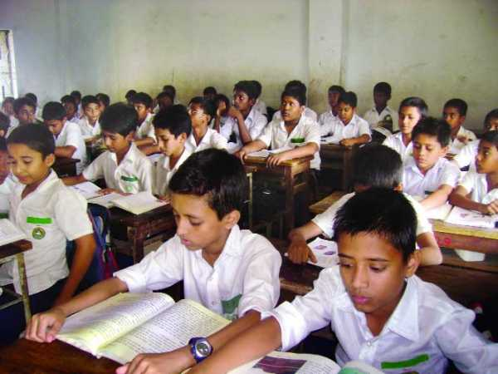
Student reading

Slide 10
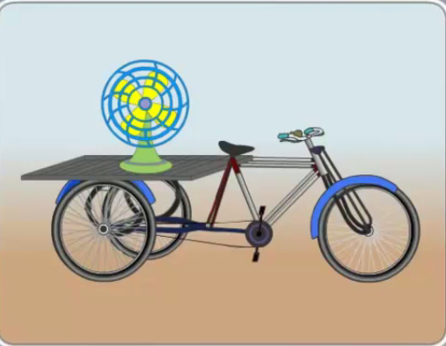
Group work.
Look, listen and say.

Slide 11
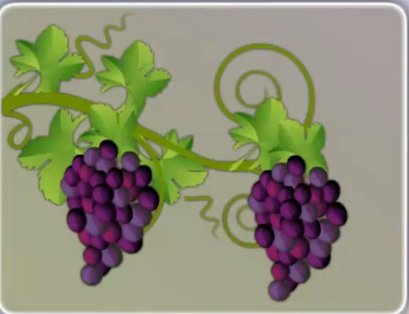
Group work.
Look, listen and say.

Slide 12
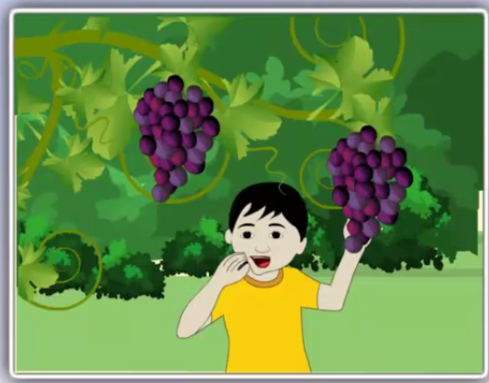
Group work.
Look, listen and say.

Slide 13
Group work.
Look, listen and say.

Slide 14
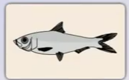
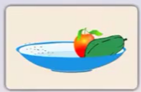
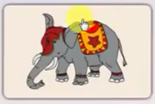
pair work.
Choose the picture that have sound V

Slide 15
pair work.
Choose the picture that have sound F

Slide 16
Group work.
What do you see in the picture?
Farm
Fish
vase
village

Slide 17
Group work.
What do you see in the picture?
Fire
Friend
vote
vault

Slide 18
Evaluation
Choose the pictures that have sound V

Slide 19
Evaluation
Choose the pictures that have sound F

