Slide 1
Welcome to my class

Slide 2
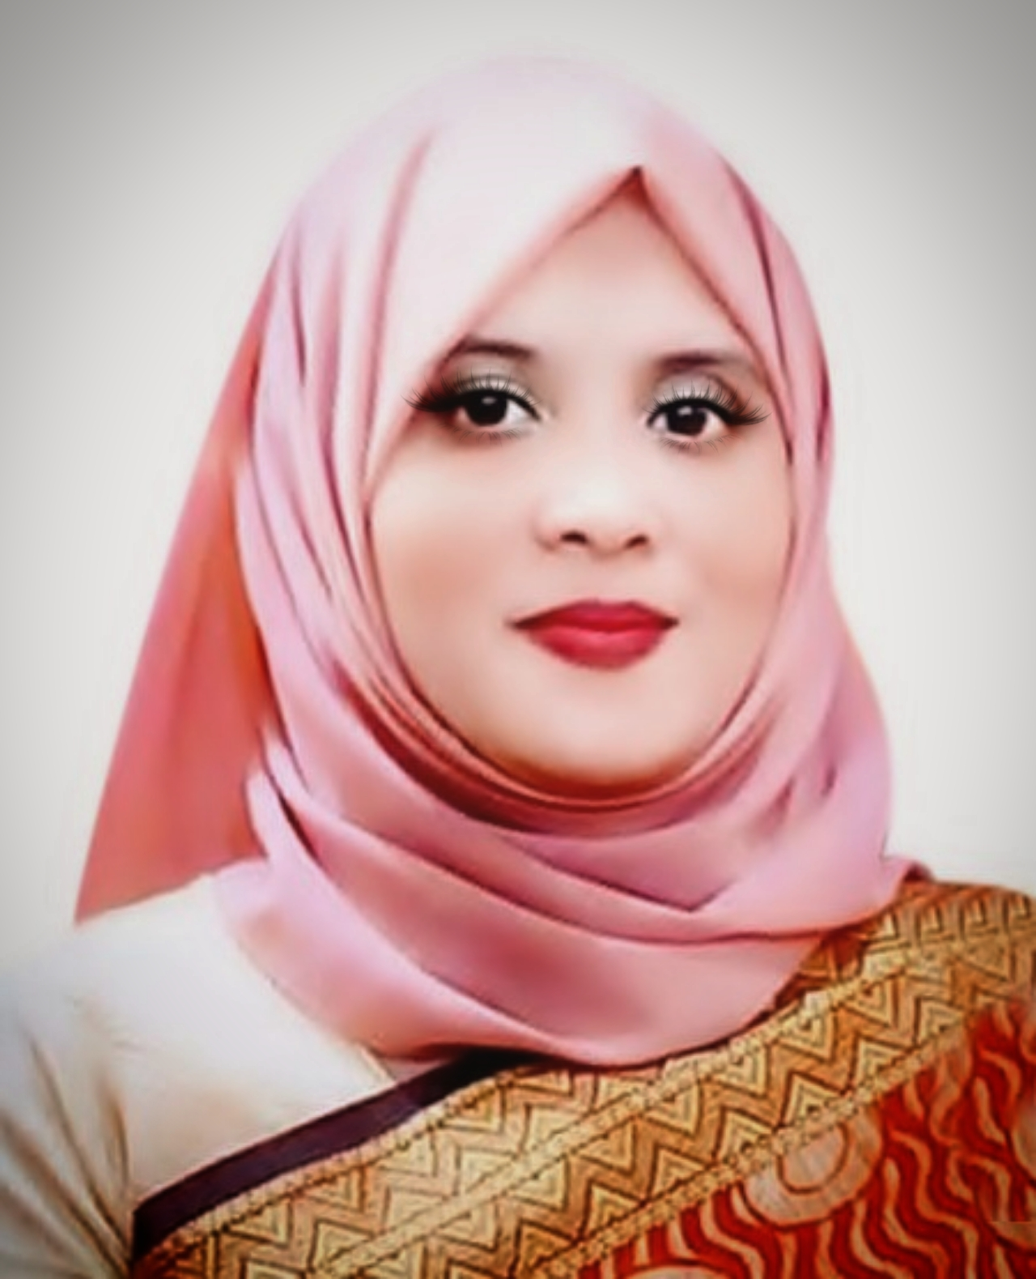
Teacher Identity
Shahnaz ferdousi jui
Assistant Teacher
Madhobpur government primary school.
Chhatak, Sunamgonj.

Slide 3
Subject Introduction
Subject:-English Class:-one
Unit : 6
Lesson : (4_6)
Alphabet

Slide 4
Let's go . We are singing good morning song.

Slide 5
Learning outcome
Student,s will be able to............
Listening:
1.1.1 to bcome familiar with English sounds by listening to common English word.
Speaking:
1.1.1 to repeat after the teacher simple words and phrases
1.1.2 to say simple words and phrases.
Reading:
1.2.1 to recognize and read the alphabet both small and capital. (non-cursive).
Writing
1.1.1 to practice letter shapes/simple writing patterns,etc
1.1.2 to write non-cursive capital and small letters.

Slide 6
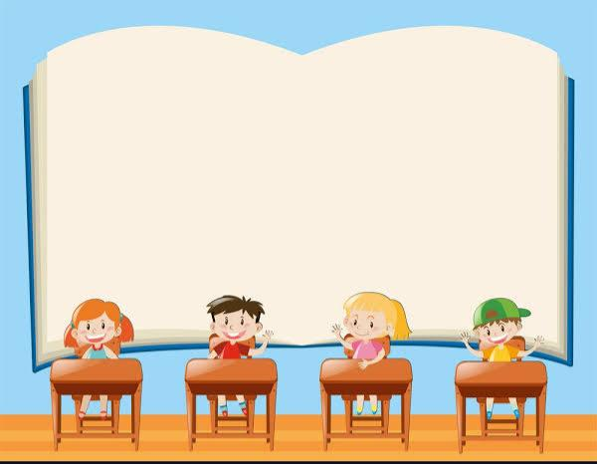
Lesson Declaration
Today we are going to read about Alphabet (Ee-Ff)
Unit: 6 & 8 . Lesson 4-6
Page: 13 & 17.

Slide 7
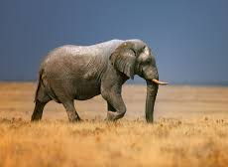
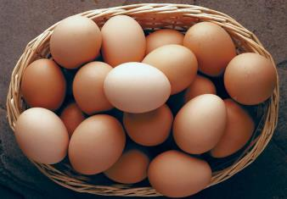
E
e

Slide 8
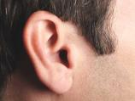
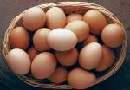
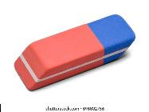
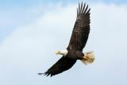
Look, listen and say
Elephant
Ear
Egg
Ee
Eraser
Eagle
Earth

Slide 9
Look, listen and say.
Elephant
Ee
Ear
Egg
Eraser
Eagle
Earth

Slide 10
Look, and say. Trace in the air.
E
E
E
e
e
e

Slide 11
Look, listen and say. Trace in the air.
e
E

Slide 12
Say and read. Trace and write.

Slide 13
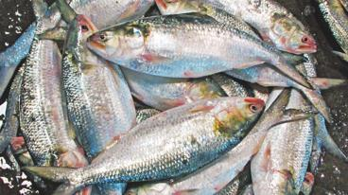
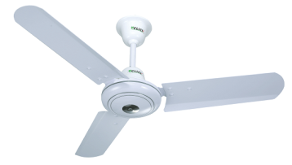
F
f

Slide 14
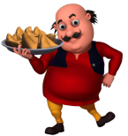
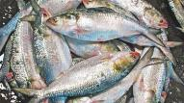
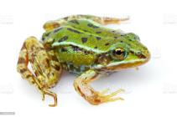
Look, listen and say
Farm
Fat
Fish
Ff
Frog
Father
Fan

Slide 15
Look, listen and say.
Farm
Ff
Fat
Fish
Frog
Father
Fan

Slide 16
Look, and say. Trace in the air.
F
F
F
f
f
f

Slide 17
Look, listen and say. Trace in the air.
f
F

Slide 18
Say and read, Trace and write.

Slide 19
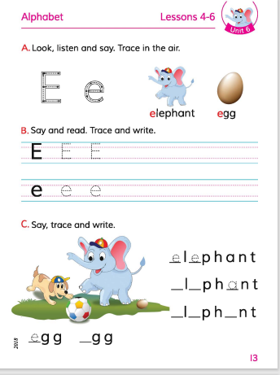
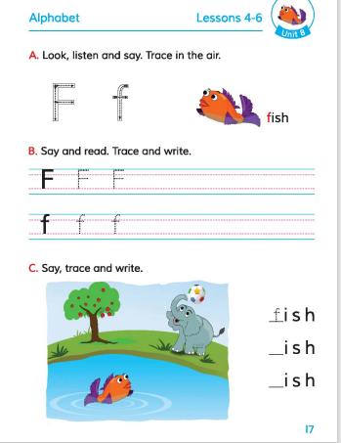
Open at page 13 & 17. Unit: 6 & 8. Lesson 4-6

Slide 20
Loud reading by the teacher
WCW
E,e
Elephant
F,f
Fish

Slide 21
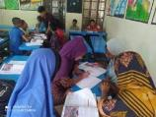
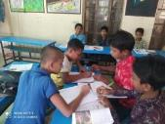
Match the pictures with the letters:
GROUP WORK
E
Fish
F
Elephant

Slide 22
Evaluation
Look and say. Write.
Look at the picture and fill in the gaps:
Elephant
Fish

Slide 23
Thank you Everyone Good bye

