Slide 1
Welcome

Slide 2
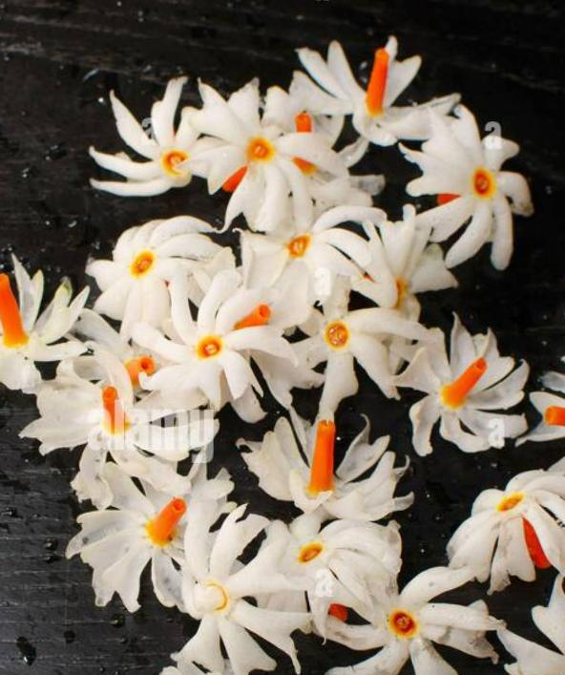
Teacher’s Identity
Mst. Sewli Khatun
Assistant Teacher (English)
Bangala Kazi Sydhur Rahman Smrity High School
Ullapara, Sirajgonj

Slide 3
Look at the picture & Guess
A crow is flying in the sky under hot sunny day.

Slide 4
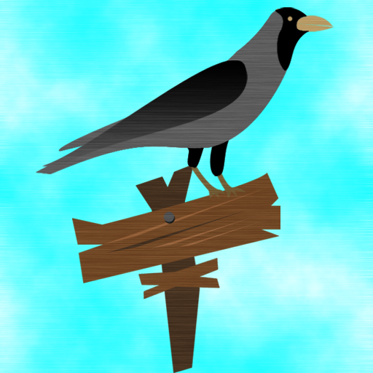
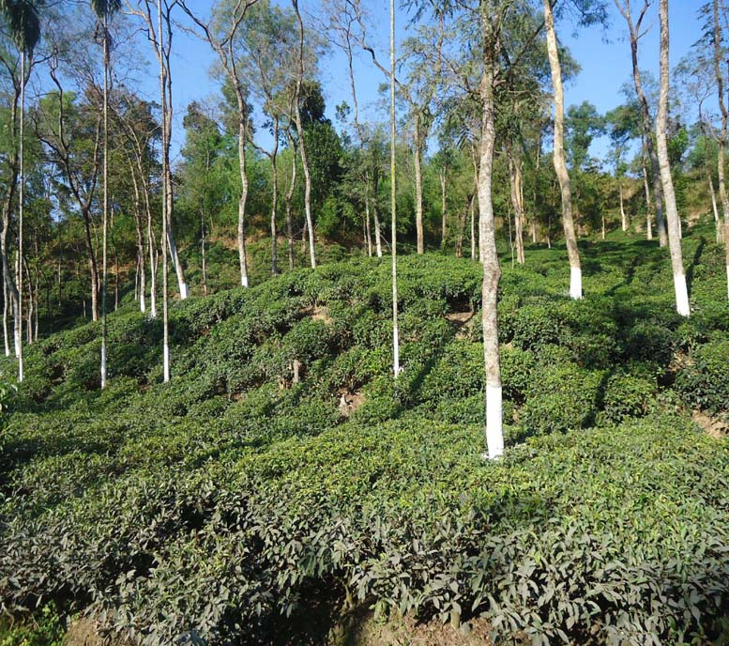
What do you see in these pictures ?
We see a crow & some trees in a forest.

Slide 5
Our Today’s Lesson is-
A Thirsty Crow
Subject : English First Paper
Class : Nine
Learning Areas: Story Writing
Duration : 50 Minutes

Slide 6
Learning Outcomes
After having studied this lesson, students will be able to-
Know about a thirsty crow.
ask and answer questions.
develop imaginative power.
write a story.

Slide 7
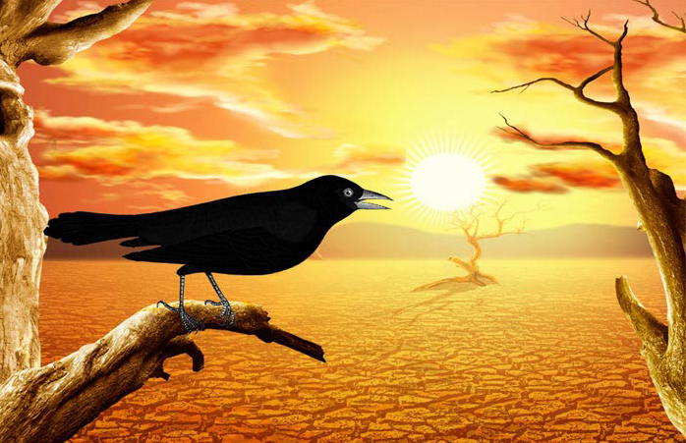
Once a crow sat on a branch of a tree in a forest.

Slide 8
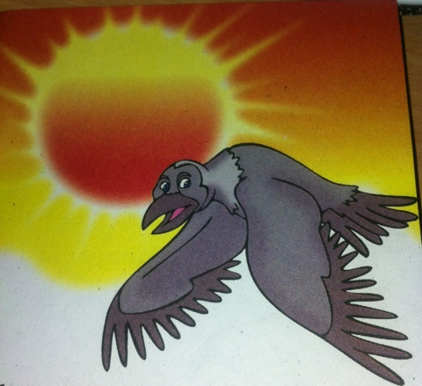
The day was very hot and it felt very thirsty.

Slide 9
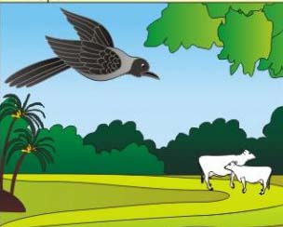
It tried to find out a source of water.

Slide 10
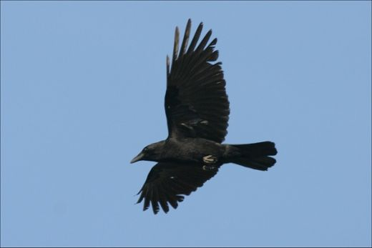
It looked here and there but could not find out water.

Slide 11
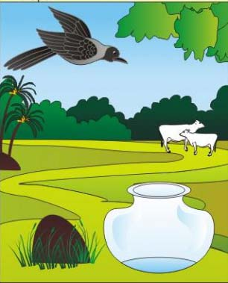
At last, the crow saw a pitcher near a tree.

Slide 12
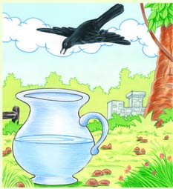
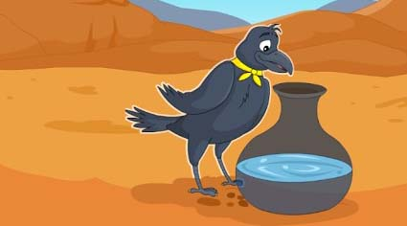
It flew to the pitcher at that moment hoping for water.

Slide 13
It sat on the top of pitcher.

Slide 14
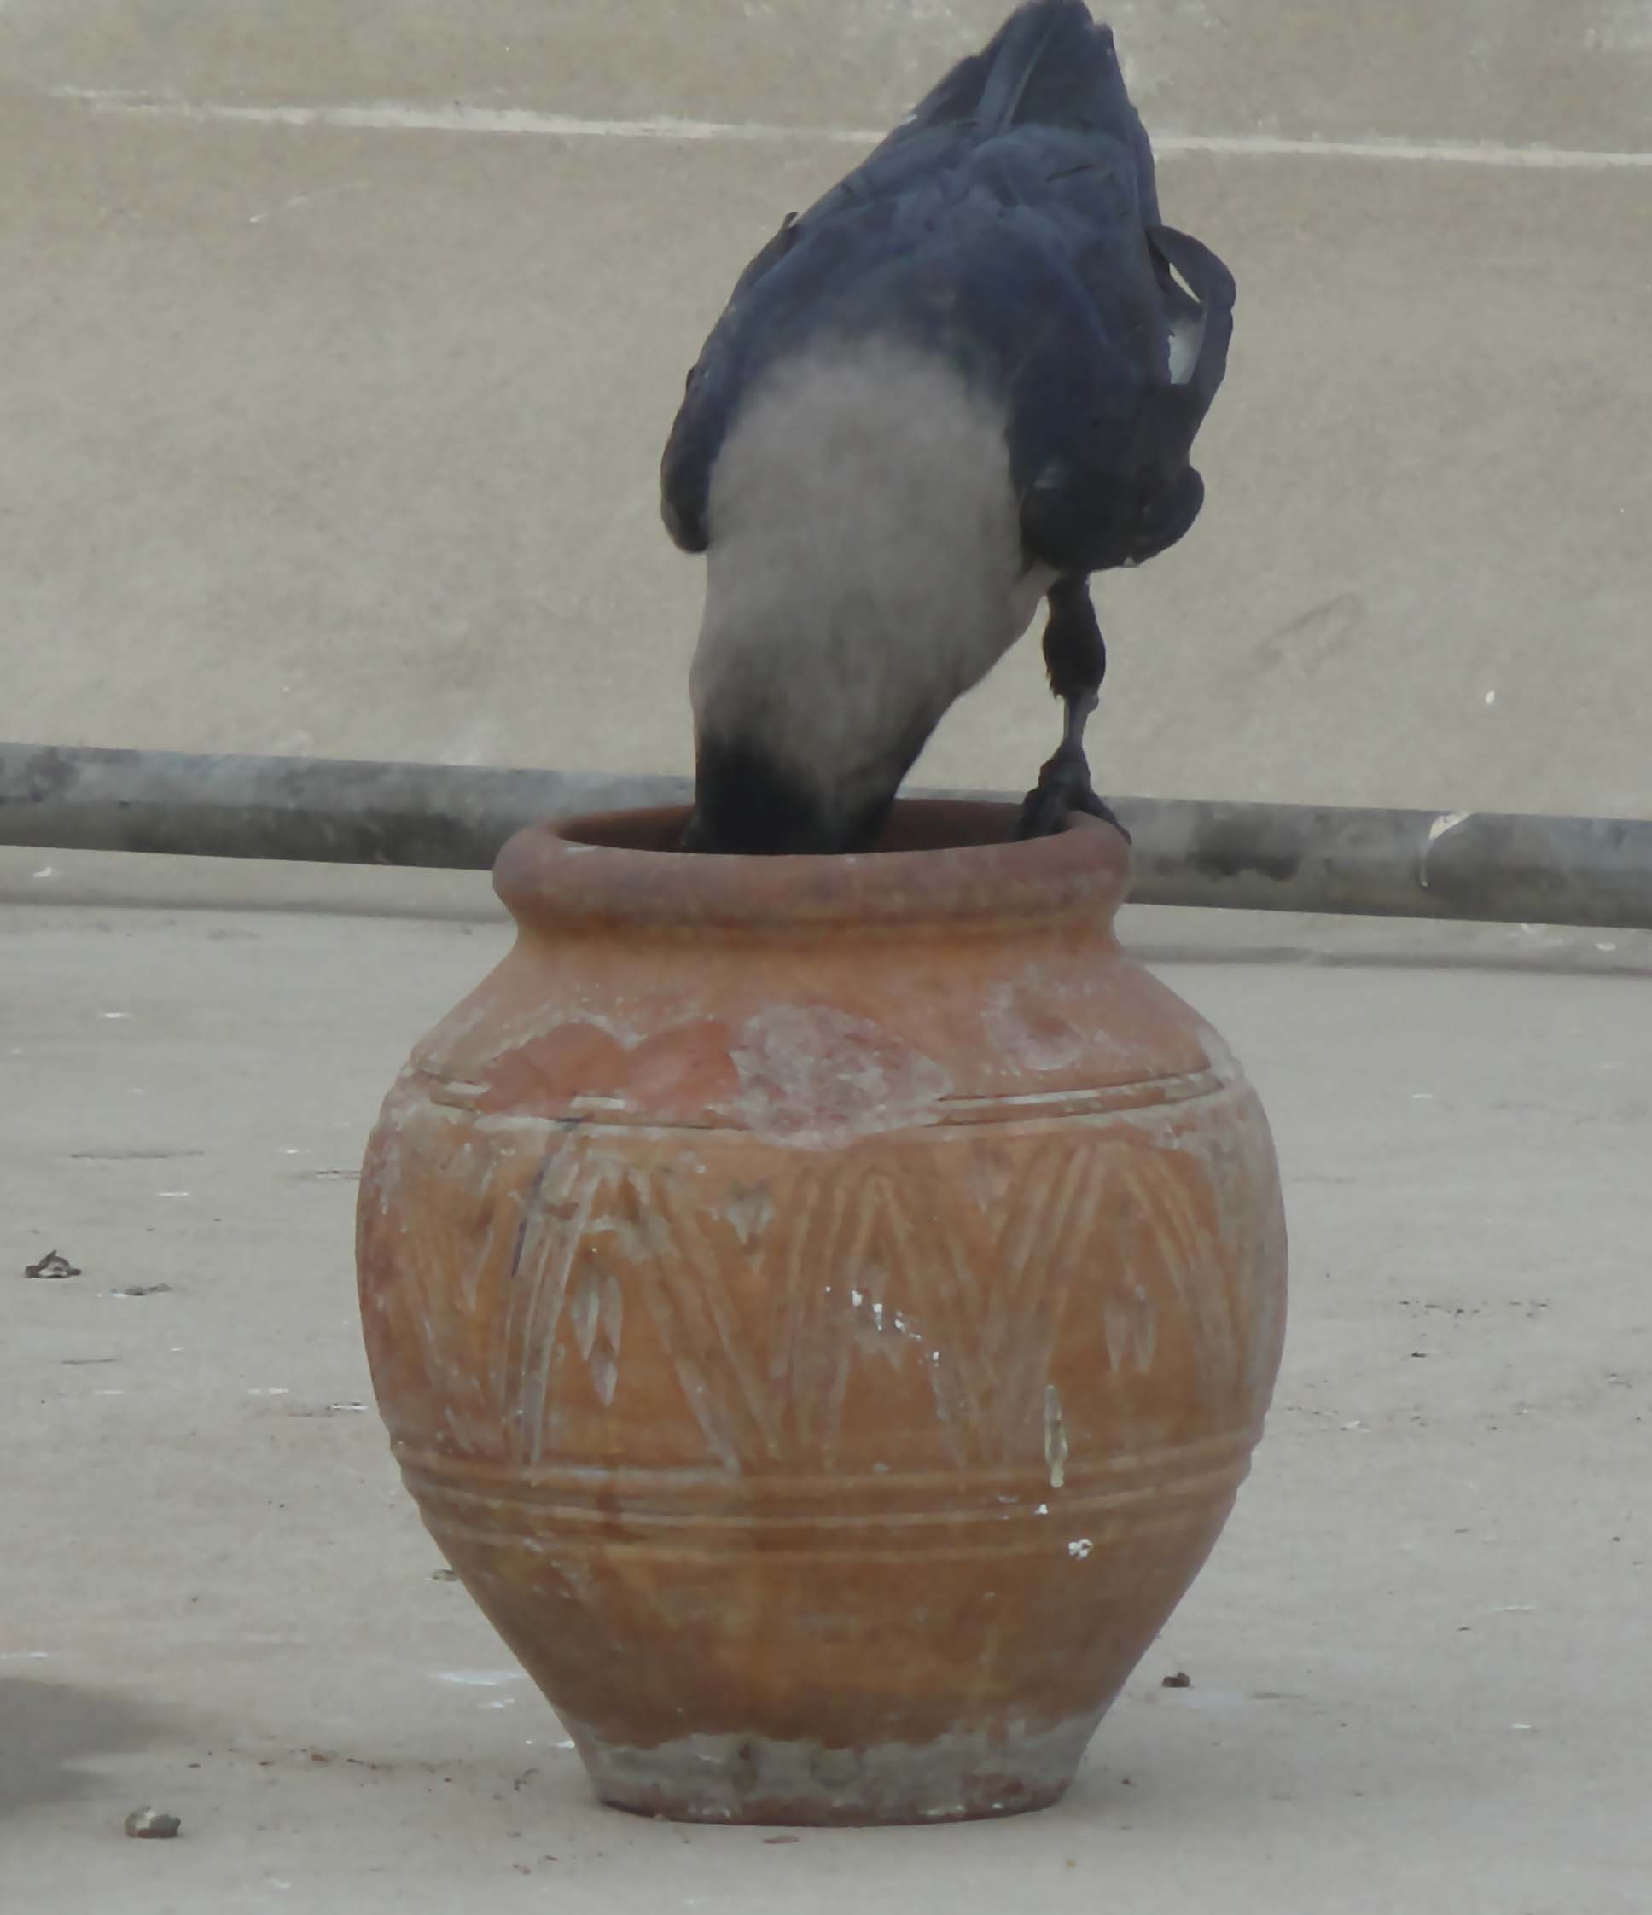
It looked down to see the level of water.

Slide 15
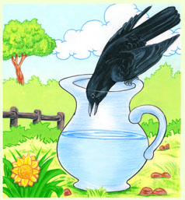
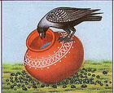
It found a little water at the bottom of the pitcher.

Slide 16
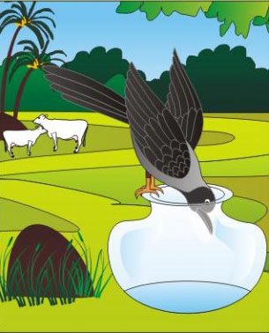
It tried heart and soul to drink the water by using it’s beak.

Slide 17
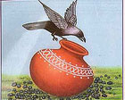
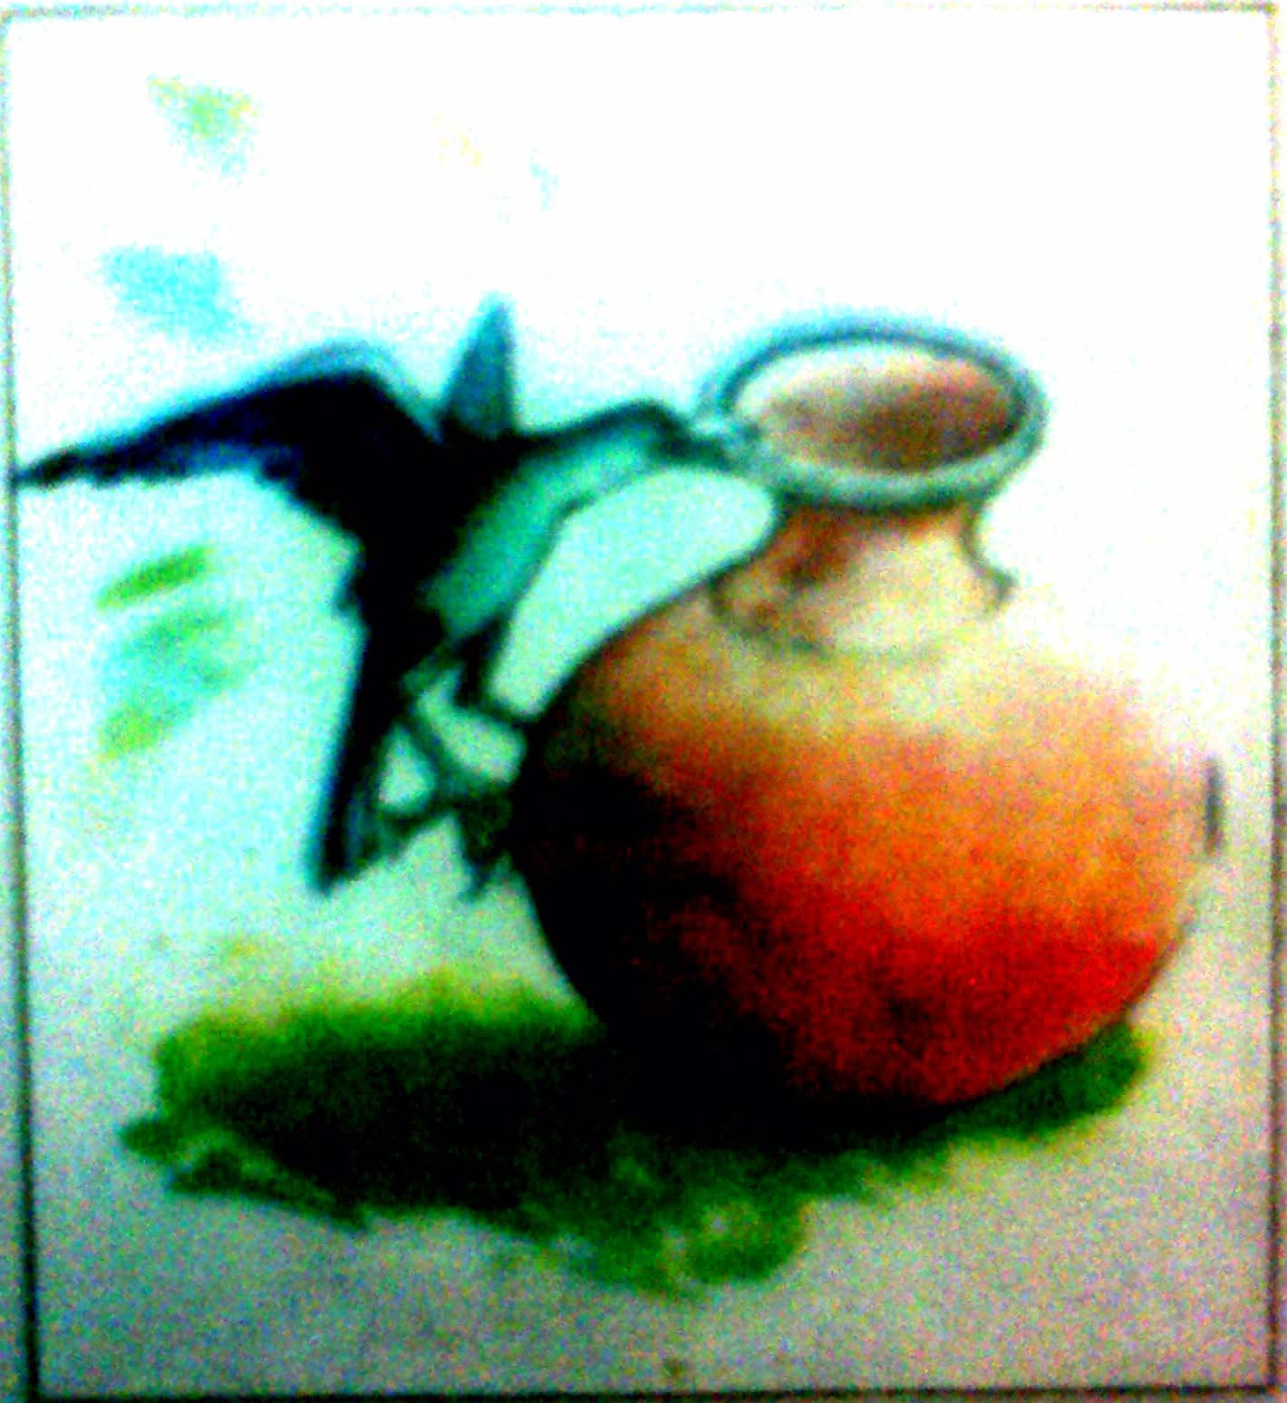
But could not drink water as it’s beak could not reach there. Then it tried to overturn the pitcher.

Slide 18
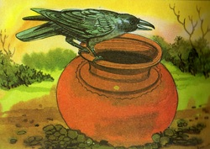
It could not over turn it.

Slide 19
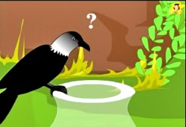
It thought and thought but could not find a way out.

Slide 20
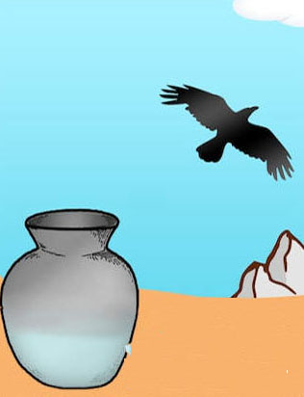
At last the crow decided to fly away loosing it hope.

Slide 21
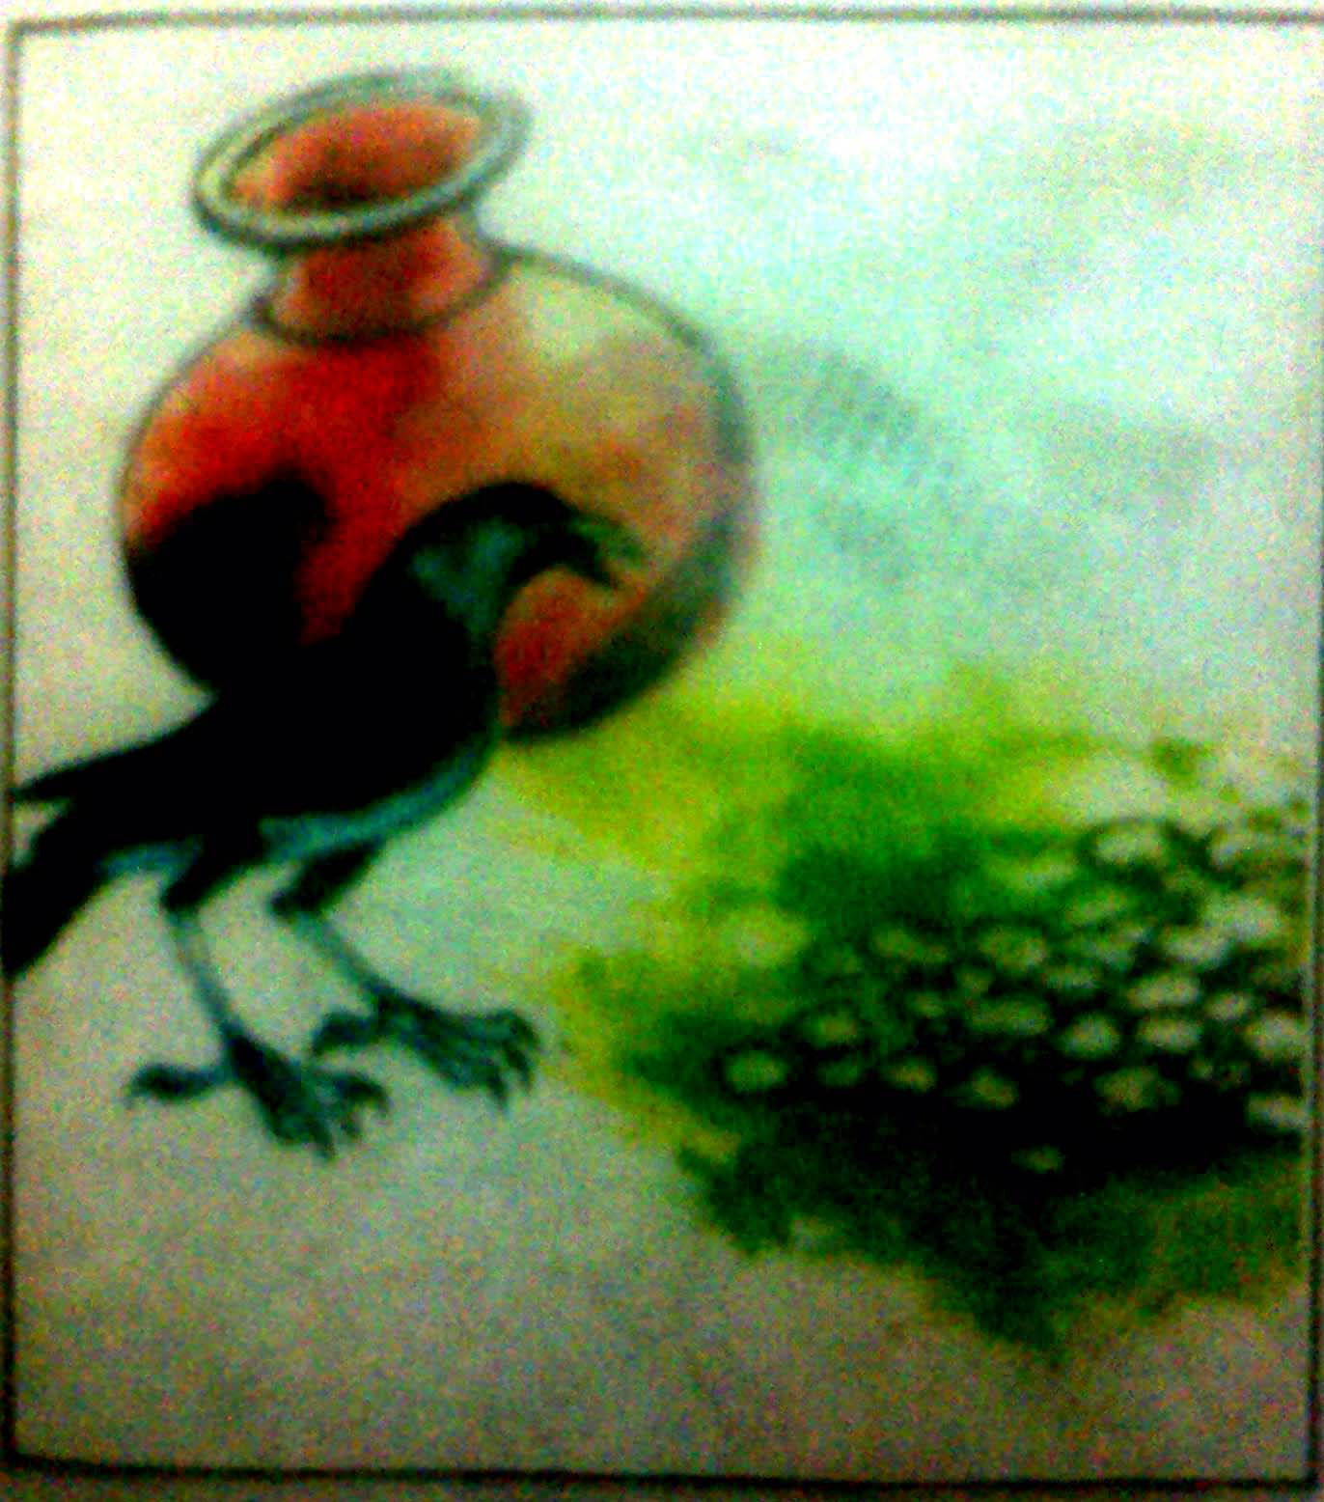
At that time, it saw some stone near the pitcher.

Slide 22
It thought sometime and made a plan. It flew near stones.

Slide 23
It took one stone and flew to the pitcher. Then it dropped the stone into the pitcher.

Slide 24
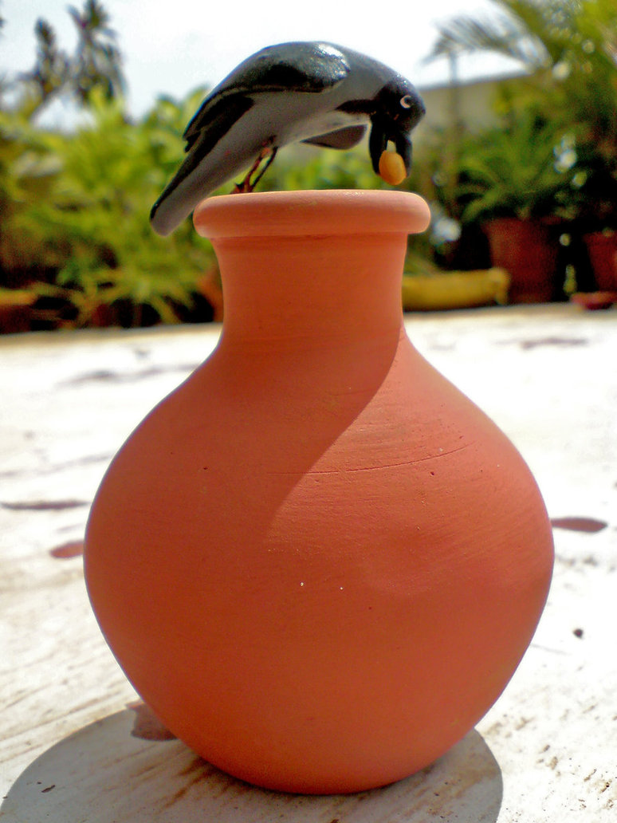
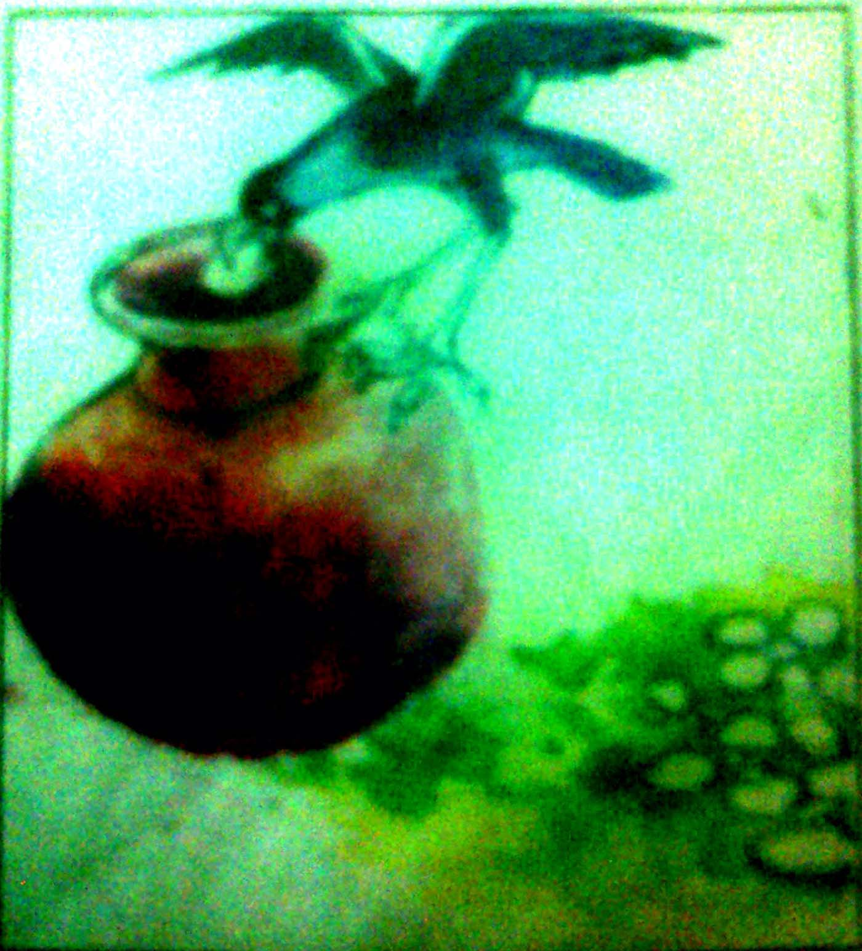
The crow dropped stones one after one into it.

Slide 25
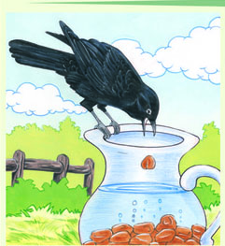
The crow continued its work in hot weather until the water level rose up.

Slide 26
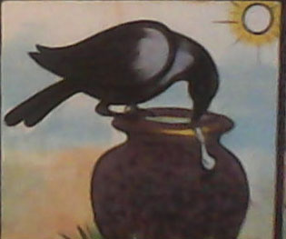
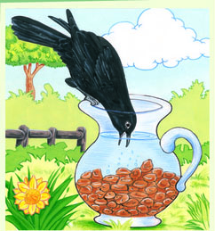
At last the crow drank water with its heart content.

Slide 27
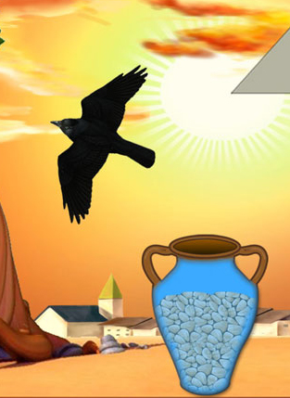
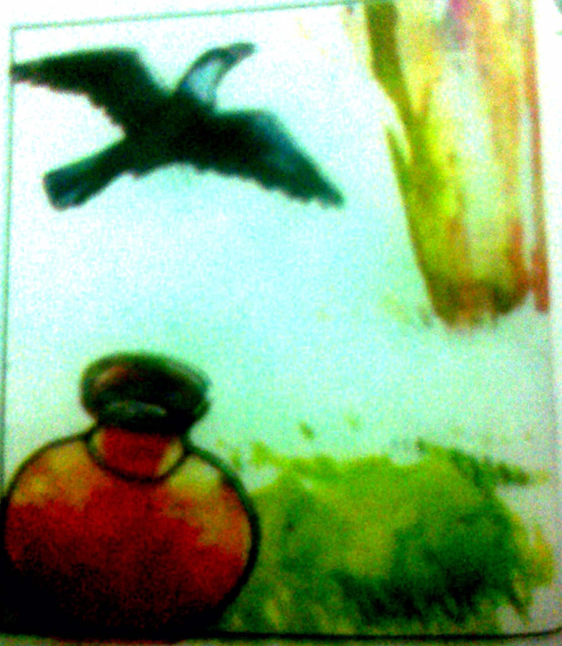
After drinking water, the crow flew away into the forest.

Slide 28
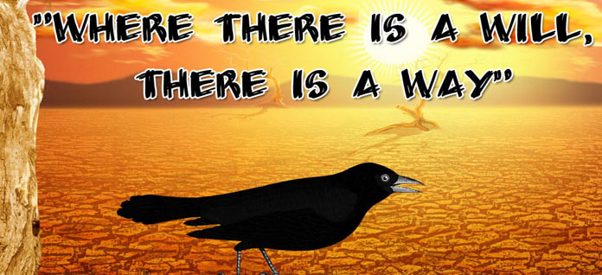
Moral of the Story

Slide 29
Individual Work
* Write a short story on “The Thirsty Crow”.

Slide 30
Evaluation
Where was the crow flying?
What did the crow want to drink?
How can it find a pitcher?
What did it do by stones?

Slide 31
Home Work
* Write a story on “The Thirsty Crow”

Slide 32
Thank You

Slide 33
The Thirsty Crow
=================================
Once a crow sat on a branch of a tree in a forest. The day was very hot and it felt very thirsty. It tried to find out a source of water. It looked here and there but could not find out water. At last it saw a pitcher near a tree. It flew to the pitcher at that moment hoping for water. It sat on the top of pitcher. It looked down to see the level of water. It found a little water at the bottom of the pitcher. It tried heart and soul to drink the water by using it’s beak. But could not drink water as it’s beak could not reach there. Then it tried to over turn the pitcher. It could not overturn it. It thought and thought but did not find a way out. At last the crow decided to fly away loosing it hope. At that time, it saw some stone near the pitcher. It thought sometime and made a plan. It flew near stones. It took one stone and flew to the pitcher. Then it dropped the stone into the pitcher. The crow dropped stones one after one into it. The crow continued its work in hot weather until the water level rose up. At last the crow drank water with its heart content. After drinking water, the crow flew away into the forest.
Moral: Where there is will, there is a way.

