Slide 1
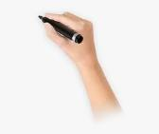
WELCOME TO THE CLASS

Slide 2
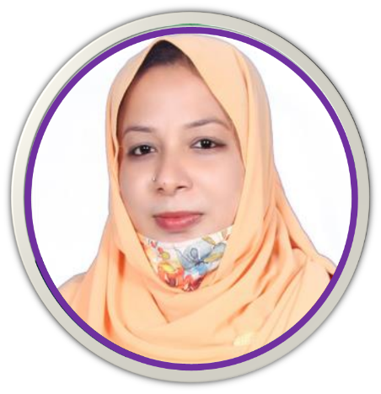
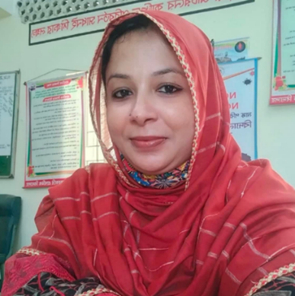
Presented By:
Mst. Asma Akter
Assistant Teacher Naighar Govt. Primary School
Brahmanpara, Cumilla
Subject: English
Class: Two
Unit: 22
Lesson: (1-3) ,Text-A

Slide 3
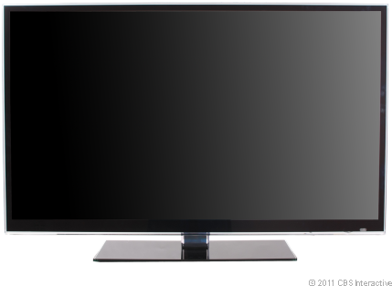
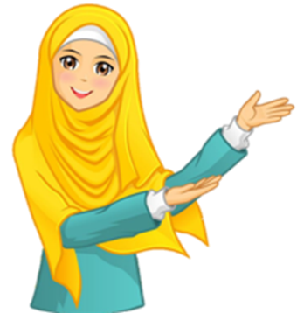
Let’s watch the video -
https://youtu.be/ipCjtvHgd4I

Slide 4
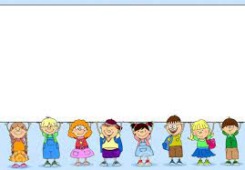
Todays lessons is –
Sizes
Text-A
Look Listen And Say

Slide 5
Learning outcomes
Students will be able to…
1.1.1 become familiar with English sounds by listening to common English words.
1.1.2 say simple words and phrases with proper sounds and stress.
1.3.1 recognize and read the names of objects having the same initial and final sounds.

Slide 6
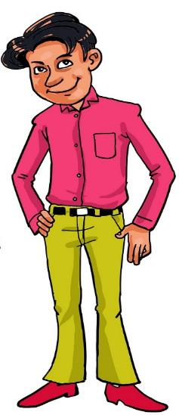
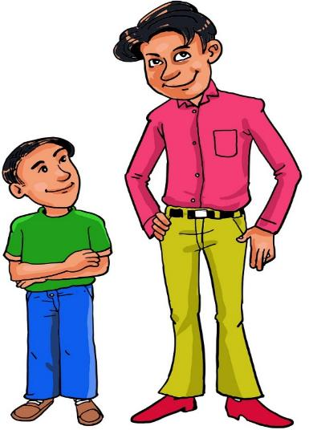
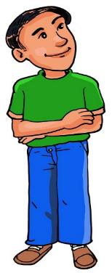
Who is tall?
Who is short?
short
tall

Slide 7
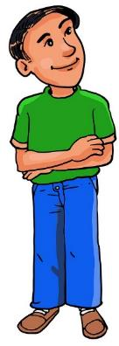
Tall-লম্বা
Short-খাটো

Slide 8
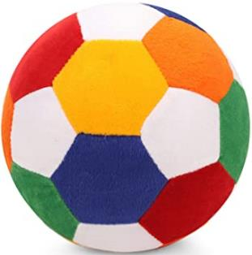
Which is big?
Which is small?
big
small

Slide 9
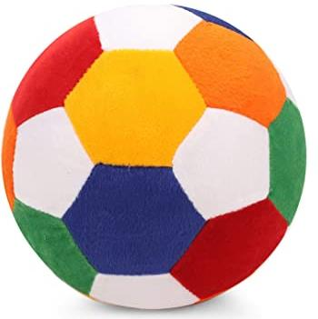
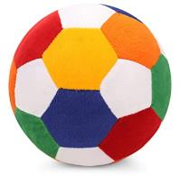
Small-ছোটো
Big-বড়ো

Slide 10
Very good

Slide 11
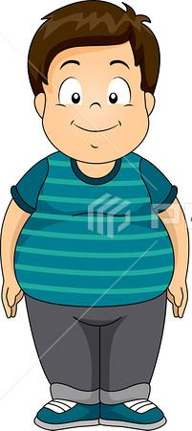
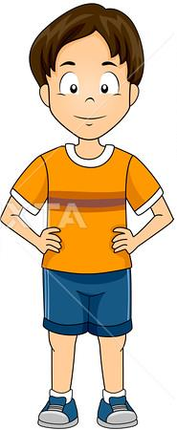
Who is fat?
Who is thin?
thin
fat

Slide 12
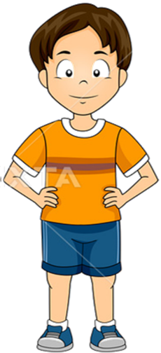
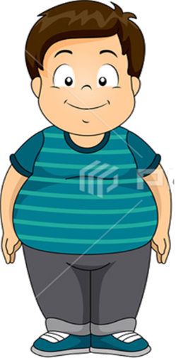
Thin-চিকন
Fat-মোটা

Slide 13
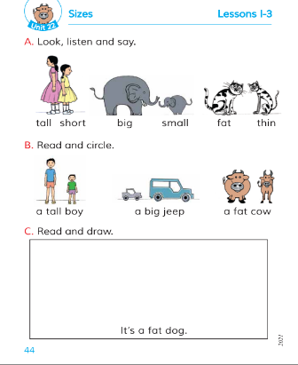
Open your book at page 44 .
What can you see in the pictures at book?

Slide 14
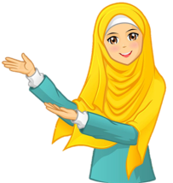
https://youtu.be/vku2D6DL6eo

Slide 15
Is she tall/short?
This girl is tall.
This girl is short.

Slide 16
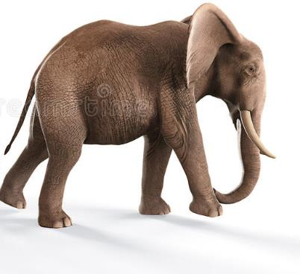
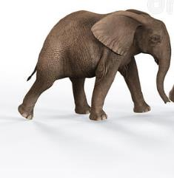
Is it big/small?
This Elephent is big.
This Elephent is small.

Slide 17
Lets play
Thin
Fat
Big
Small
Tall
Short

Slide 18
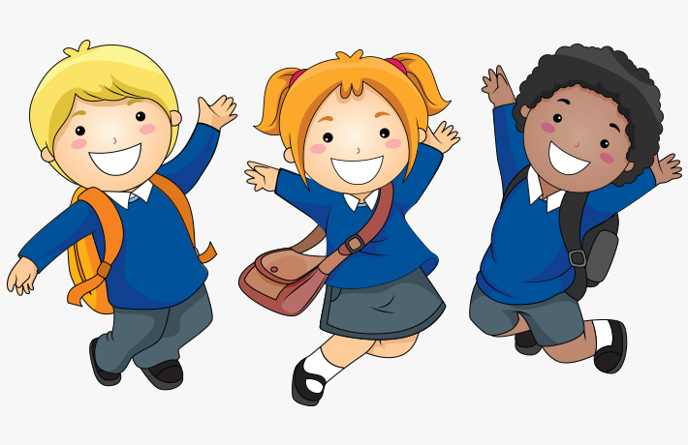
good

Slide 19
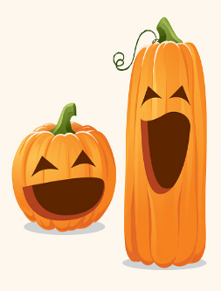
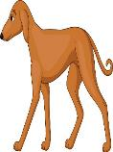
Which is tall & Which is short ?

Slide 20
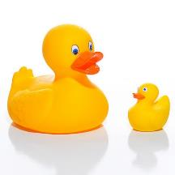
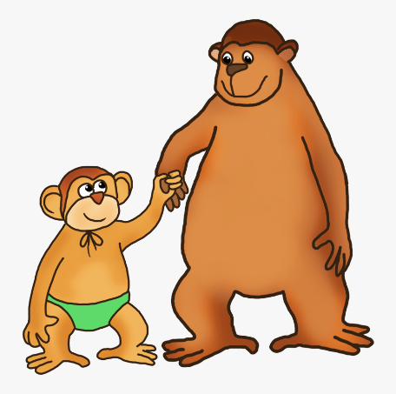
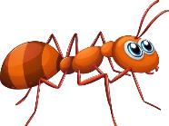
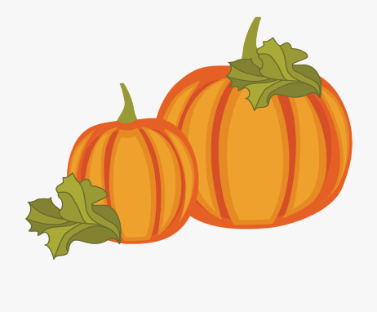
Which is big & Which is small ?

Slide 21
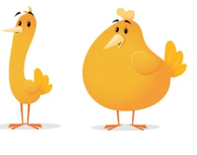
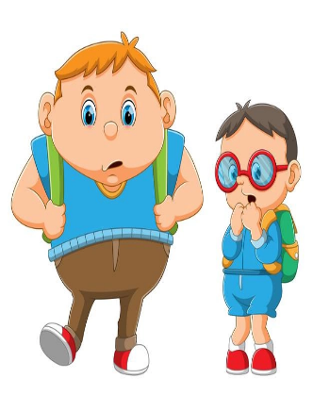
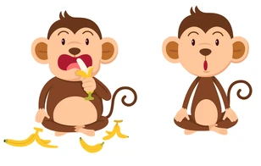
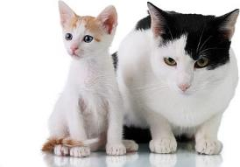
Which is fat & Which is thin ?

Slide 22
weldone

Slide 23
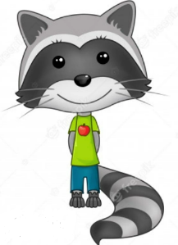
One day one word
Thin
চিকন

Slide 24
THANK YOU.
THAT’S ALL FOR TODAY.
GOODBYE STUDENTS .

