Slide 1
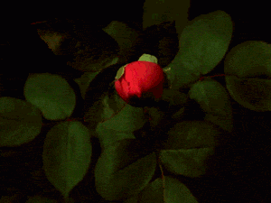
Notes:
Welcome slide.

Slide 2
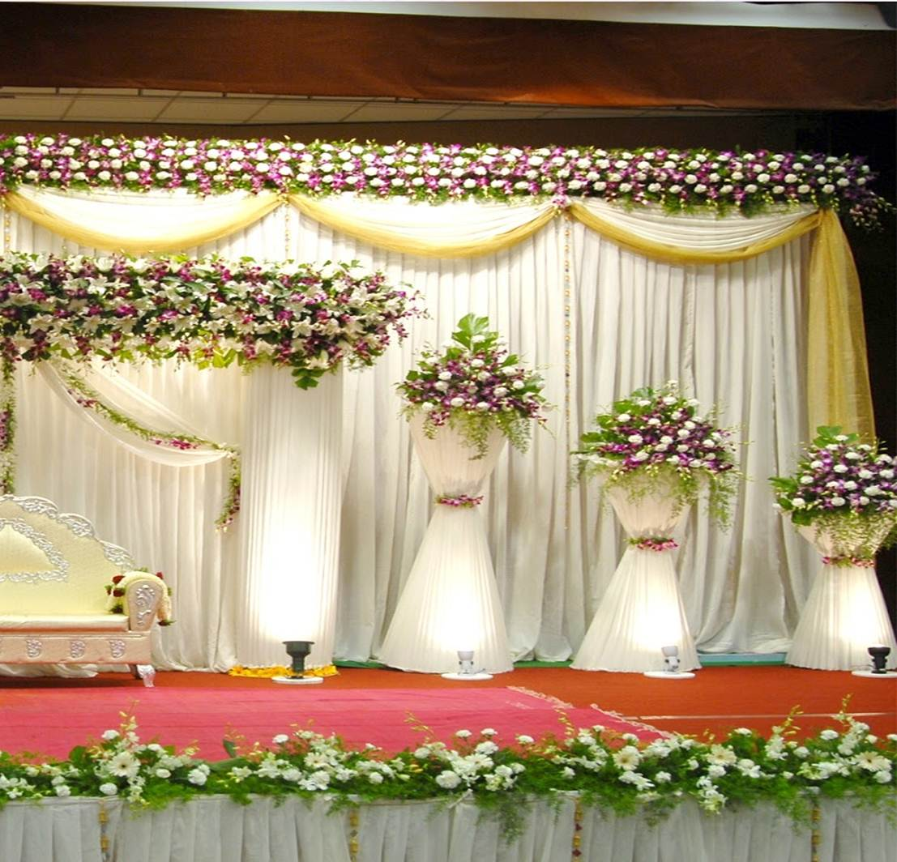
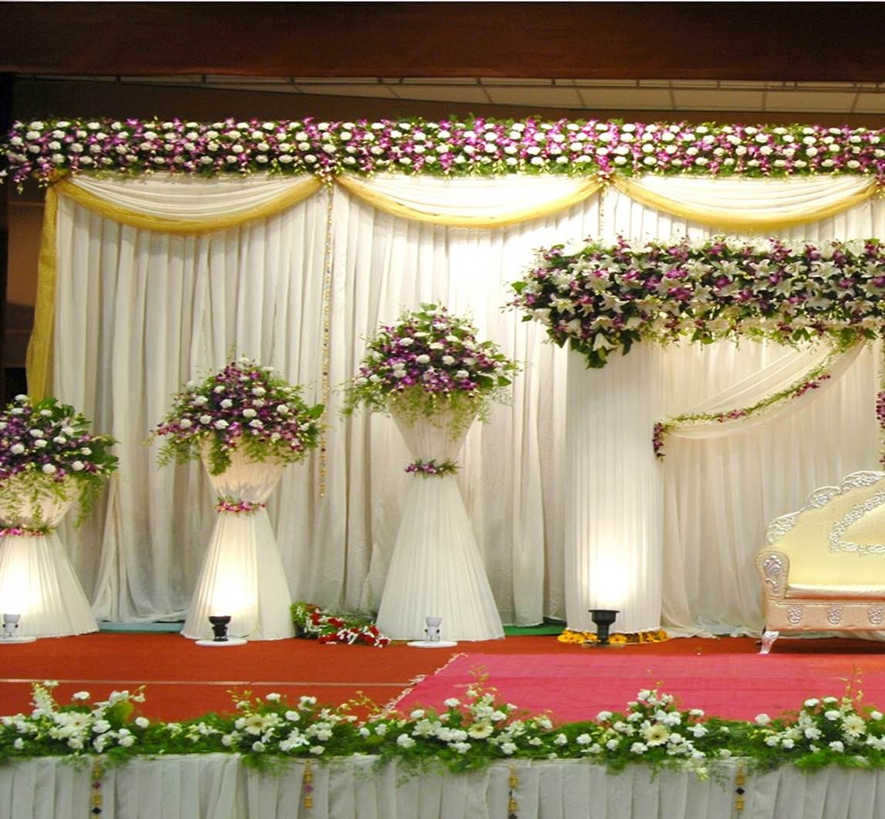
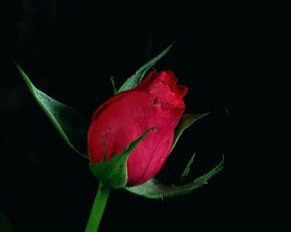
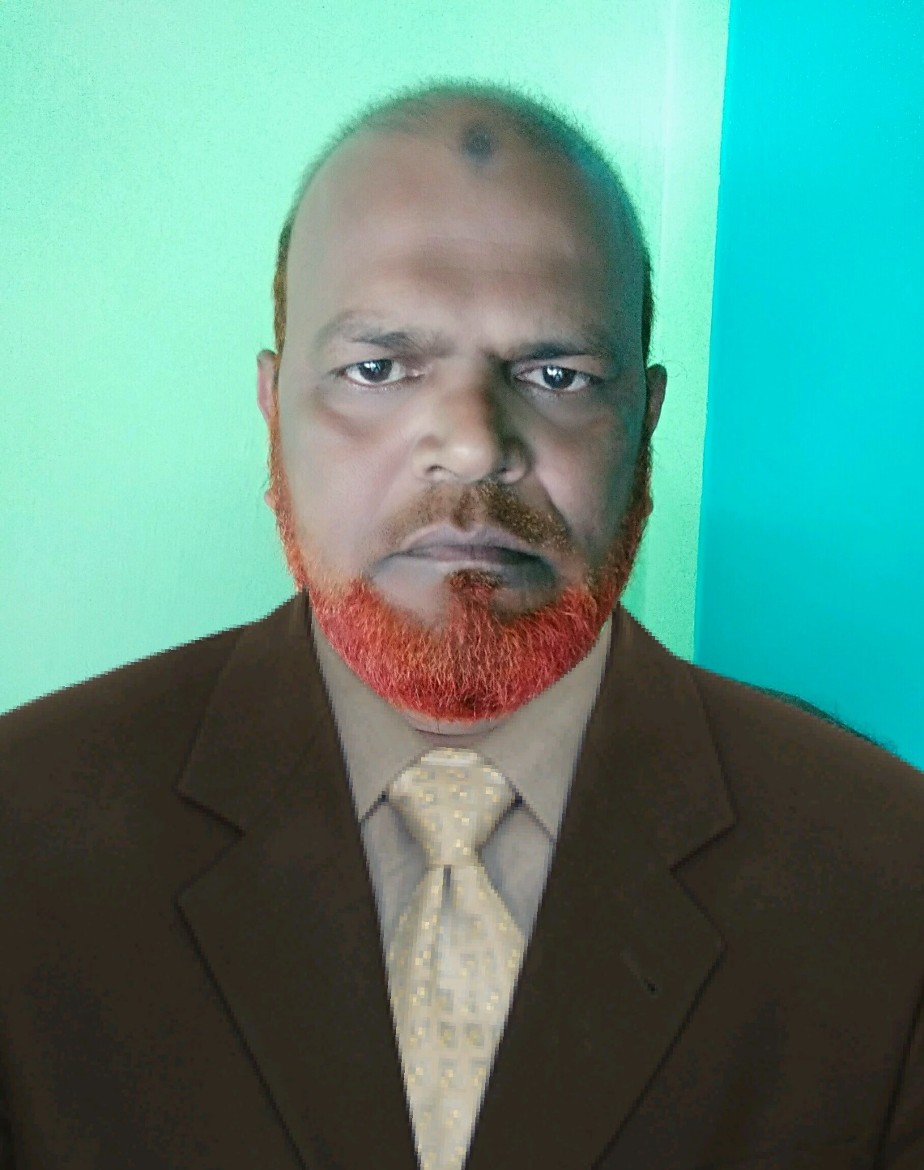
My identity
Assistant Teacher In English.
Atgharia High School .
01718911086
Haripur ,Thakurgoan
Md. Khalilur Rahman
Notes:
Identity of teacher & class

Slide 3
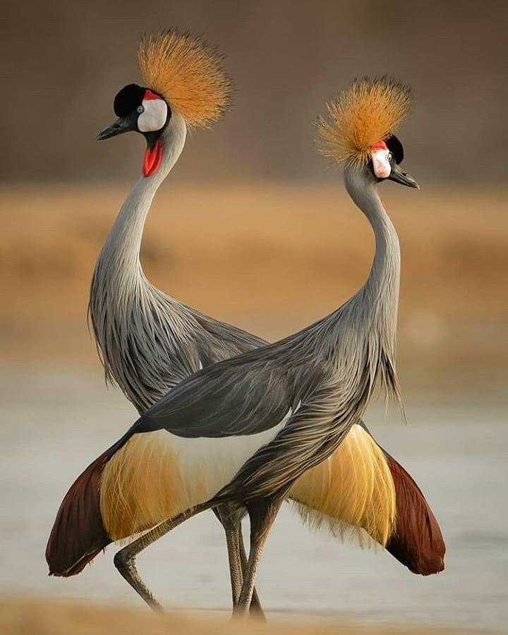
Subject Identity
English 2nd paper
Class : Six
Transformation of sentence.

Slide 4
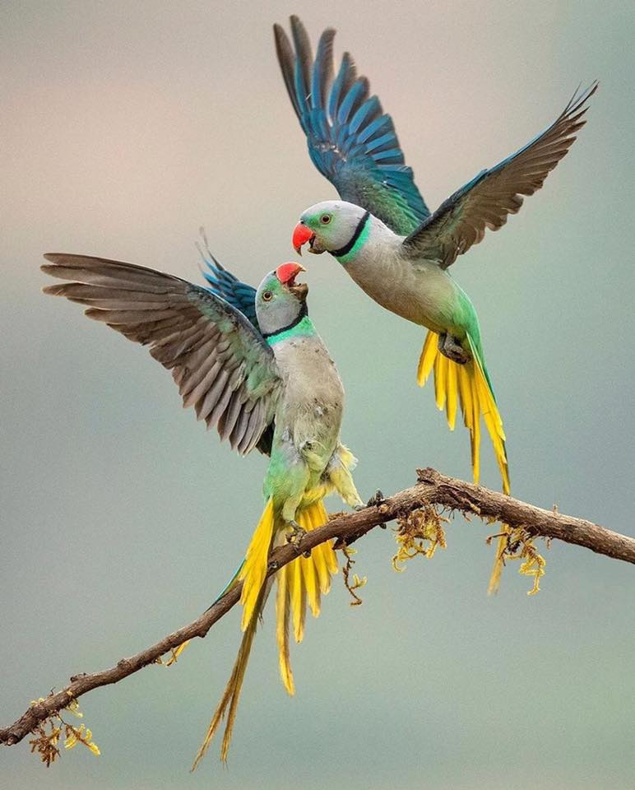
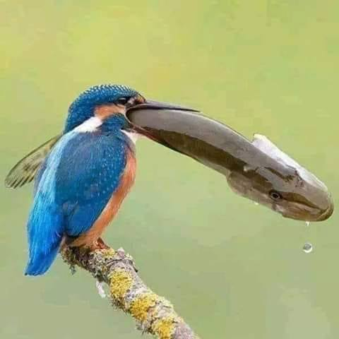
Look at the pictures and guise
Look at the pictures and guise

Slide 5
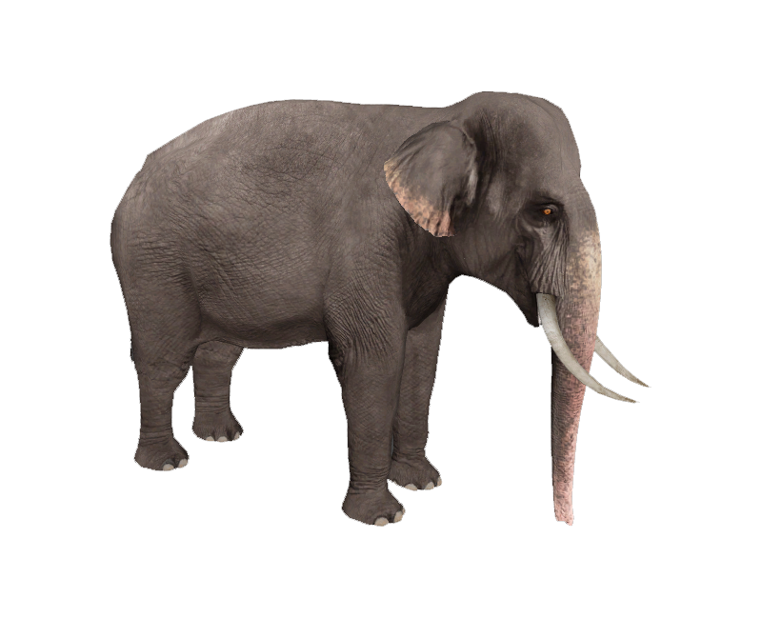
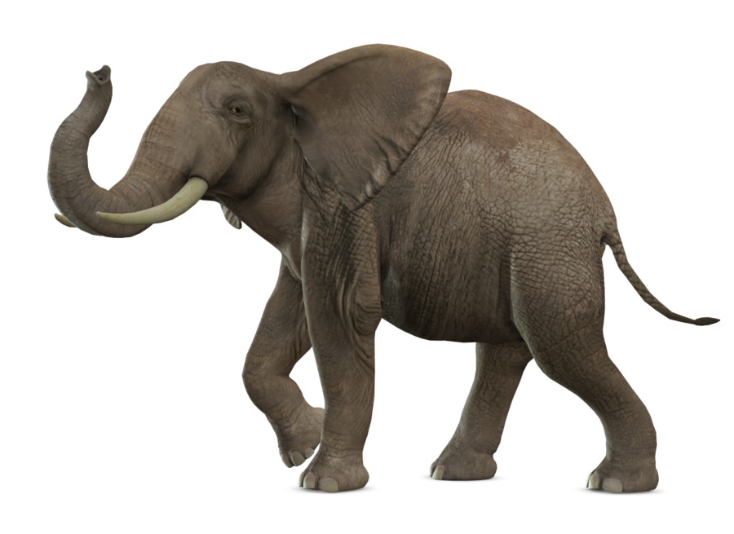
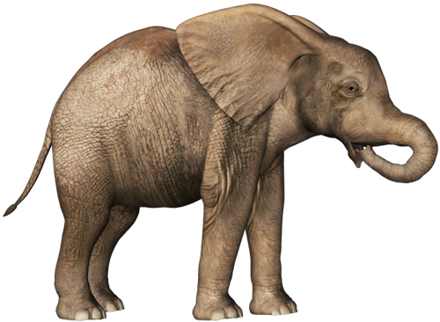
Look at the pictures and guise
largest
larger
large
Notes:
1st Suspension of the lesson. Notes for the teachers not for the students.

Slide 6
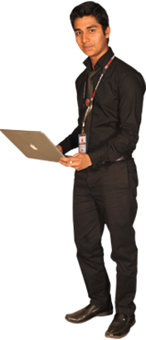
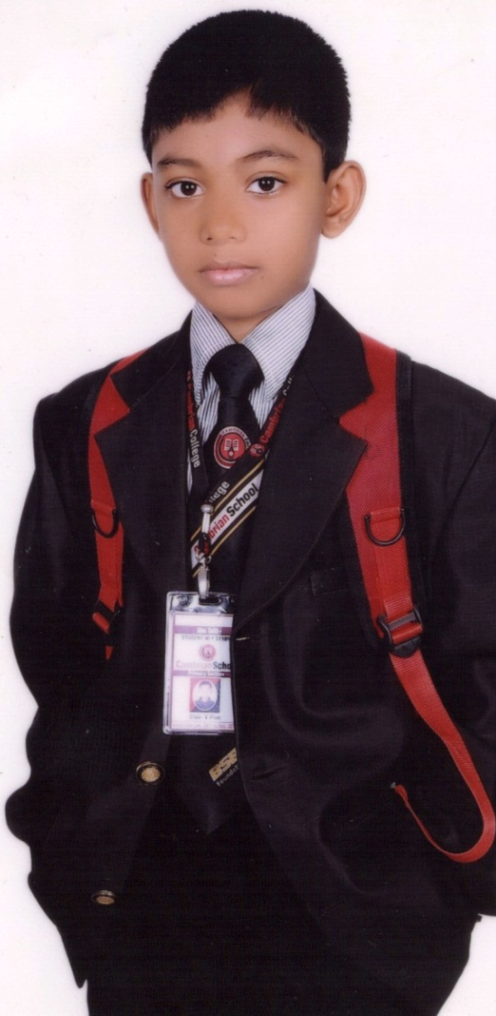
What do the pictures show in this slide?
Notes:
2nd suspension of the lesson.

Slide 7
largest
Yes
larger
large
DEGREE

Slide 8
Learning outcomes
By the end of this lesson students will be able to -
Define adjective.
Find out adjective.
Say the calcification of degree.
Mark the sentence.
Tale the rules of different degree.
Changing degree.

Slide 9
Adjcteive
Good, Fine, More beautiful , Worst, Taller, Biggest,
Good, Fine, More beautiful , Worst, Taller, Biggest,

Slide 10
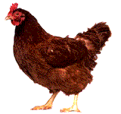
Definition of degree.
The comparison of adjective is called Degree.
If any one compares with any adjective this is called Degree.

Slide 11
1. She is a beautiful girl.
2. She is more beautiful than that girl.
3. She is the most beautiful of all girl.

Slide 12
1. She is a beautiful girl.
beautiful
2. She is more beautiful than that girl.
more beautiful
3. She is the most beautiful of all girl.
most beautiful

Slide 13
D1
Degree/ Adjective is three kinds
Degree
1.Positive
2.Comparative
3.Superlative
------
D2
er
D3
est

Slide 14
Single work
1. What is adjective.
2. What is the definition of degree.
3. How many kinds of degree.

Slide 15
Form of Adjective
Positive=A1 | Comparative=A2 | Superlative=A3
Good | Better | Best
Tall | Taller | Tallest
Brilliant | More/less brilliant | Most/lest brilliant
wise | Wiser | Wisest
Lovely | Lovelier | Loveliest
Up | Upper | Uppermost
Fast | Faster | Fastest

Slide 16
1.Positive
2.Comparative
3.Superlative
2.Comparative
1.Positive
3.Superlative
3.Superlative
1.Positive
2.Comparative

Slide 17
1. Structure of Positive sentence
No other/very few+obj+verb+so/as+A1+as+sub.
No other+girl in the class+is+as+good+as+Rabea.

Slide 18
2. Structure of Comparative sentence
sub+verb+A2+than any/all/most other+obj.
Rabea+is+better than any other+girl in the class.

Slide 19
3. Structure of Superlative sentence
Sub+verb+the/one of the+A3(of all)+obj.
Rabea+is+the+best+girl in the class.

Slide 20
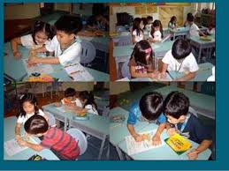
Pair work
1
Write the Structure of Superlative sentence and make a sentence according to the structure
2
Write the Structure of positive sentence and make a sentence according to the structure
3
Write the Structure of comparative sentence and make a sentence according to the structure

Slide 21
Some note
Positive | Comparative | Superlative
No other | Than any/all other | The
Very few | Than most other | One of the
Not as……. as | V
V + not | than
As…..as | Not less…….than
As….. as | V+ not

Slide 22
Do this example
No other boy in the class is as good as Sahadat.
sub+verb+A2+than any/all/most other +obj.
Com=
Sahadat is better than any other boys in the class.
sub+verb+the/one of the+A3+obj.
Sup=
Sahadat is the best boy in the class.

Slide 23
Do this example
Sahadat is better than most other boys in the class.
No other/very few+obj+verb+so/as+A1+as+sub.
Pos=
Very few boys in the class are as good as Sahadat.
sub+verb+the/one of the+A3(of all)+obj.
Sup=
Sahadat is one of the best of all boys in the class.

Slide 24
Do this example
Sahadat is one of the best boys in the class.
No other/very few+obj+verb+so/as+A1+as+sub.
Pos=
Very few boys in the class are as good as Sahadat.
sub+verb+A2+than any/all/most other+obj.
Com=
Sahadat is better than most other boys in the class.

Slide 25
Valuation
What is degree?
Degree is Comparison of adjective.
How many kinds of degree?
Degree is three kinds.
What is superlative form of brilliant?
Most brilliant

Slide 26
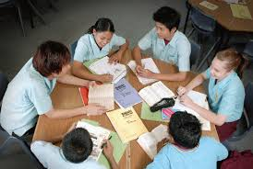
Group work
Change the following sentences.
Group - A
1. No other metal is as useful as iron.(Com)
Group - A
4. Rasel is the youngest boy of this class.(Pos)
2. I arrived earlier than you.(Sup)
5. No other is so great as Shakespeare. (Sup)

Slide 27
Home Work
Write the following two form of these adjective
Good, Fine, More beautiful , Worst, Taller, Biggest, bad
Change the following sentences
1. Chittagong is the biggest sea sport.(Com)
2. No other woman in the village is as clever as Farjana.(Sup)
3. Elephant is bigger than most other animal.(Pos)
4. Abdullah is one of the most important person in our office.(Com)

Slide 28
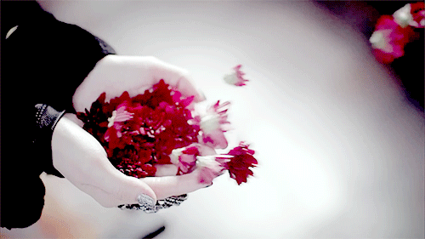
Thank you,
see again

