Slide 1
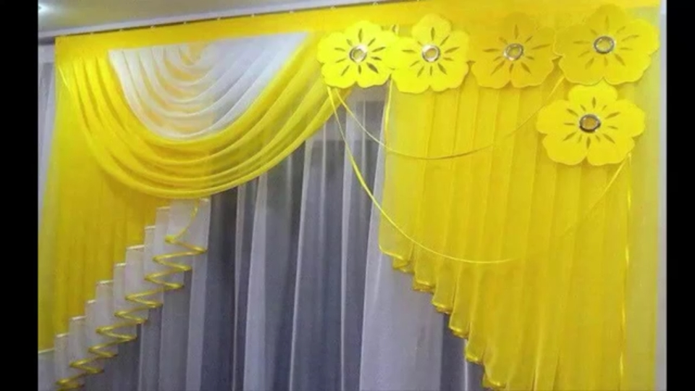

Slide 2
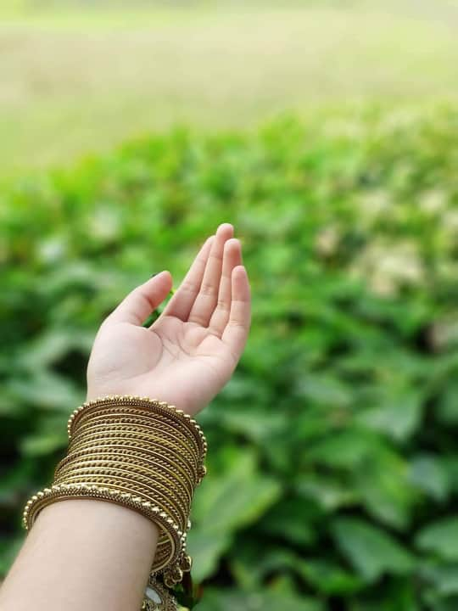

Slide 3
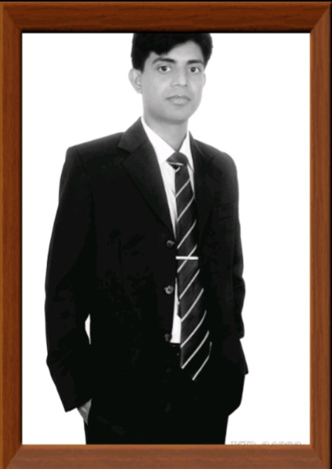
Teacher's Introduction
Md. Abdul khalek
Assistant teacher
Durgadah Govt.Primary School
Shahjadpur, Sirajgonj
E-mail: mdkhalek6770@gmail.com
Cell phone Number-01736846787

Slide 4
lesson Introduction
Class: one
Subject: English
Alphabet
Lesson: 4-6

Slide 5
Greetings
Good morning students
Good morning teacher
I am fine, Thank you
How are you?

Slide 6
Let’s enjoy an Alphabet song
Aa Bb Cc Dd Ee
Click here

Slide 7
Lesson title: Alphabet
Aa Bb Cc Dd Ee

Slide 8
Learning outcome
`````````````````````````````````````

Slide 9
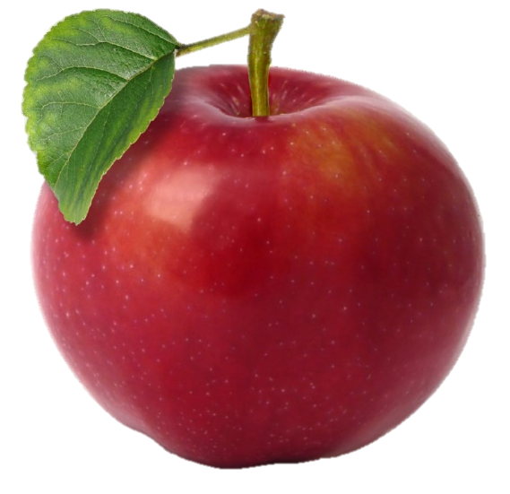
Look at the picture.
a
A
A for apple
A for Ant

Slide 10
Look at the picture.
B
b
B for ball

Slide 11
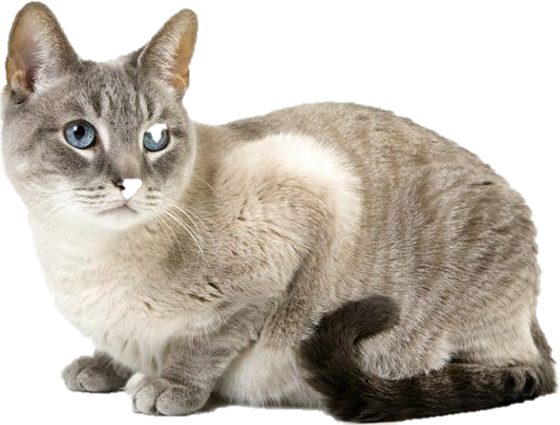
Look at the picture.
C
c
C for cap
C for cat

Slide 12
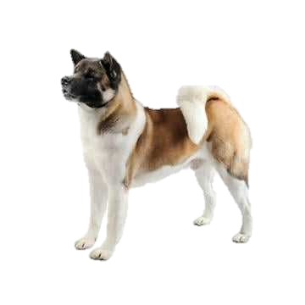
Look at the picture.
D
d
D for dog

Slide 13
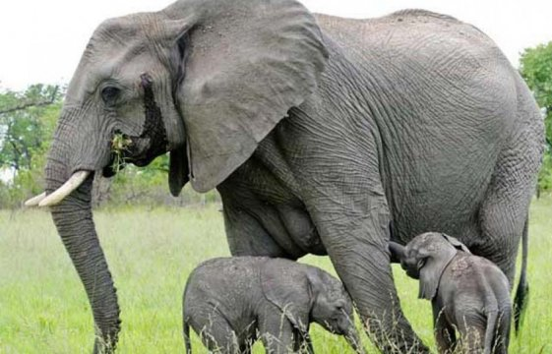
Look at the picture.
E
e
E for Elephant
E for egg

Slide 14
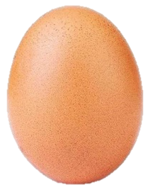
Say and match the pictures with the first letters.
A
B
B
C
D
E

Slide 15
Say and read, trace and write.

Slide 16
Capital letter.
Small letter.
a
A
b
B
c
C
d
D
e
E

Slide 17
Write the capital letters:
A
a________
b________
c________
d________
e________
B
C
D
E

Slide 18
HOME WORK
You will write A to E from home (capital and small letter)

