Slide 2
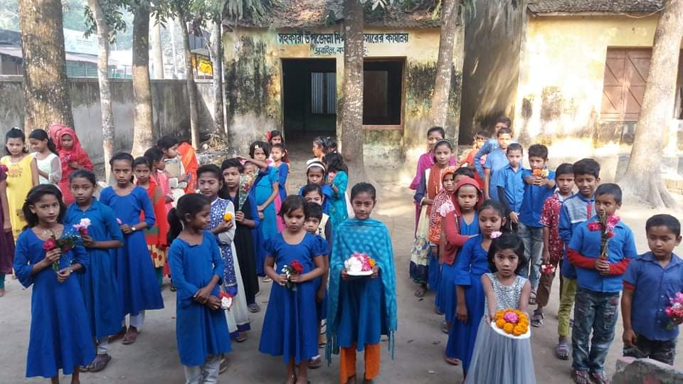
WELCOME TO ALL

Slide 3
TEACHER’S IDENTITY
NAHIDA AKHTER
ASSISTANT TEACHER
KALIKACCHA NORTH GOVT. PRIMARY SCHOOL
SARAIL,BRAHMANBARIA.
Email : nahidaakhter99@gmail.com

Slide 4
LEASSON
Class:- One
Unite: 13 ( Rhyme )
Lesson: 1-3 (A)
Time: 45 minutes
.

Slide 5
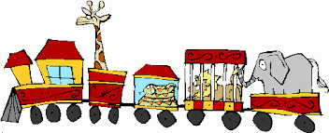
LEARNING OUTCOMES
Listening
1.1.1 : Become familiar with English sounds by
listening to common English words.
Speaking
1.1.1 : Repeat after the teacher simple words and phrases.
1.1.2 : Say simple words and phrases.

Slide 6
Let’s enjoy a video
https://www.youtube.com/results?search_query=animal+in+zoo

Slide 7
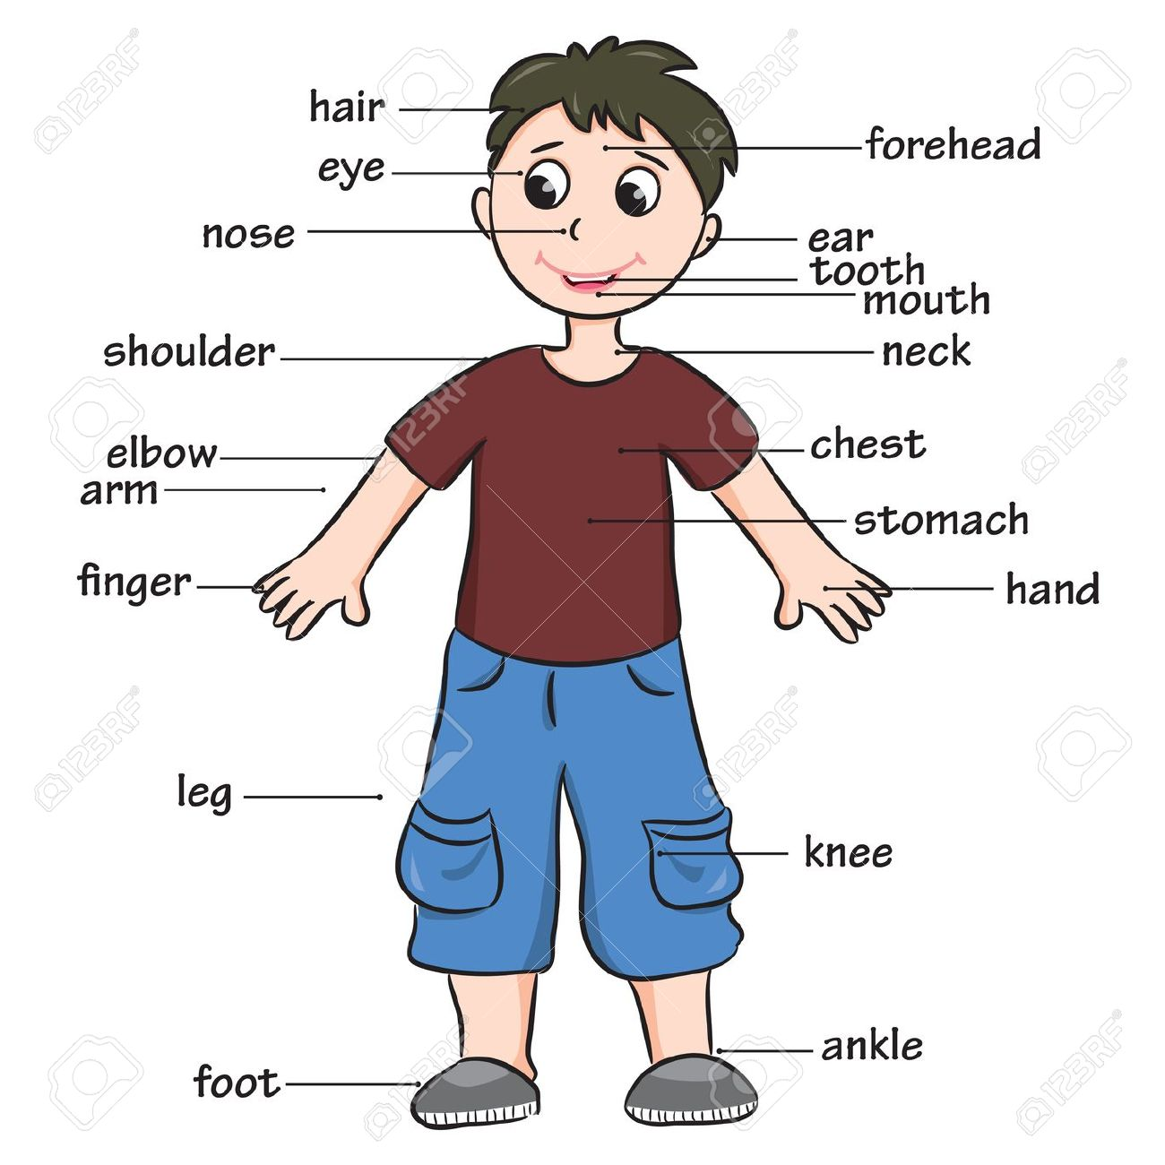
Look at the picture and think about it.
What about is the picture ?
The picture is about a human body.

Slide 8
Today’s lesson is—
Hands , feet , eyes , head .

Slide 9
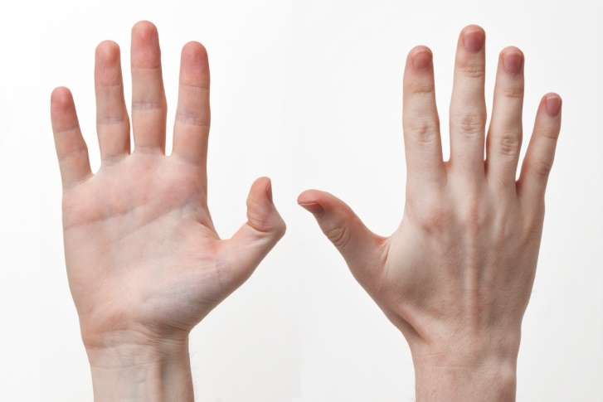
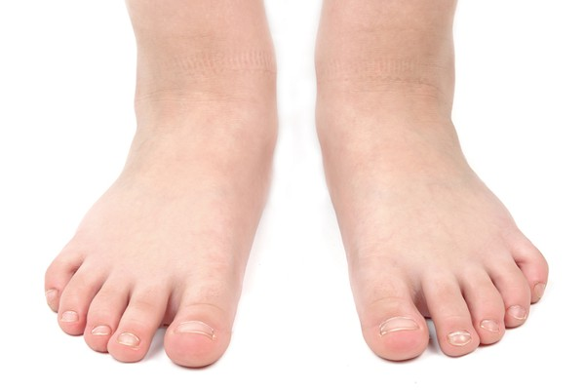
Look , listen and say.
hands
feet
eyes
head

Slide 10
Dear students listen to me attentively.
hands
feet

Slide 11
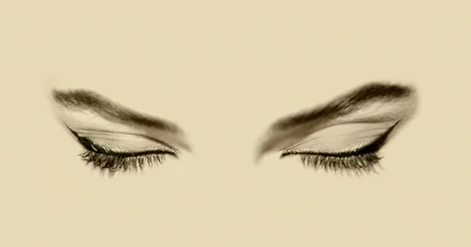
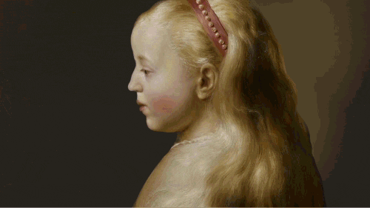
Dear students listen to me attentively.
eyes
head

Slide 12
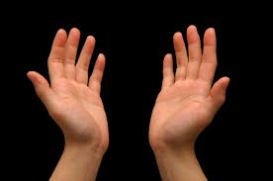
What can you see in the picture ?
These are ‘hands’.

Slide 13
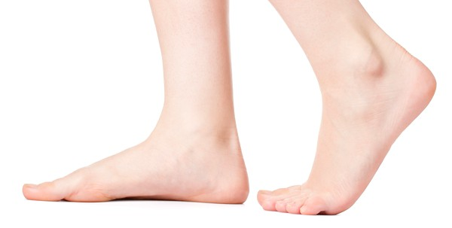
What can you see in the picture ?
These are ‘feet’.

Slide 14
Dear students , What can you see in the picture ?
These are ‘eyes’.

Slide 15
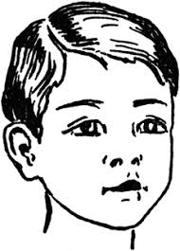
Dear students , What can you see in the picture ?
This is a ‘head’.

Slide 16
Dear students ,come in front of the class by turns.

Slide 17
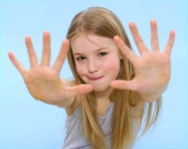
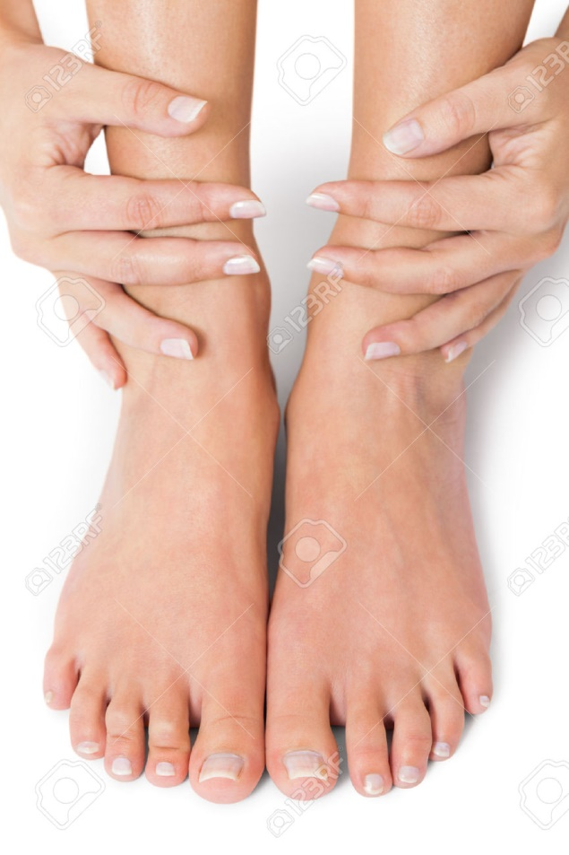
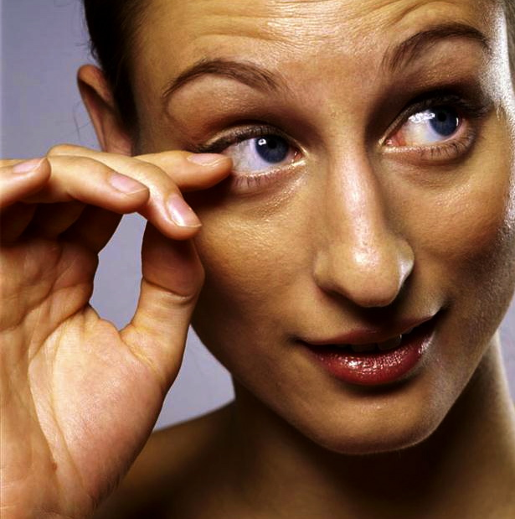
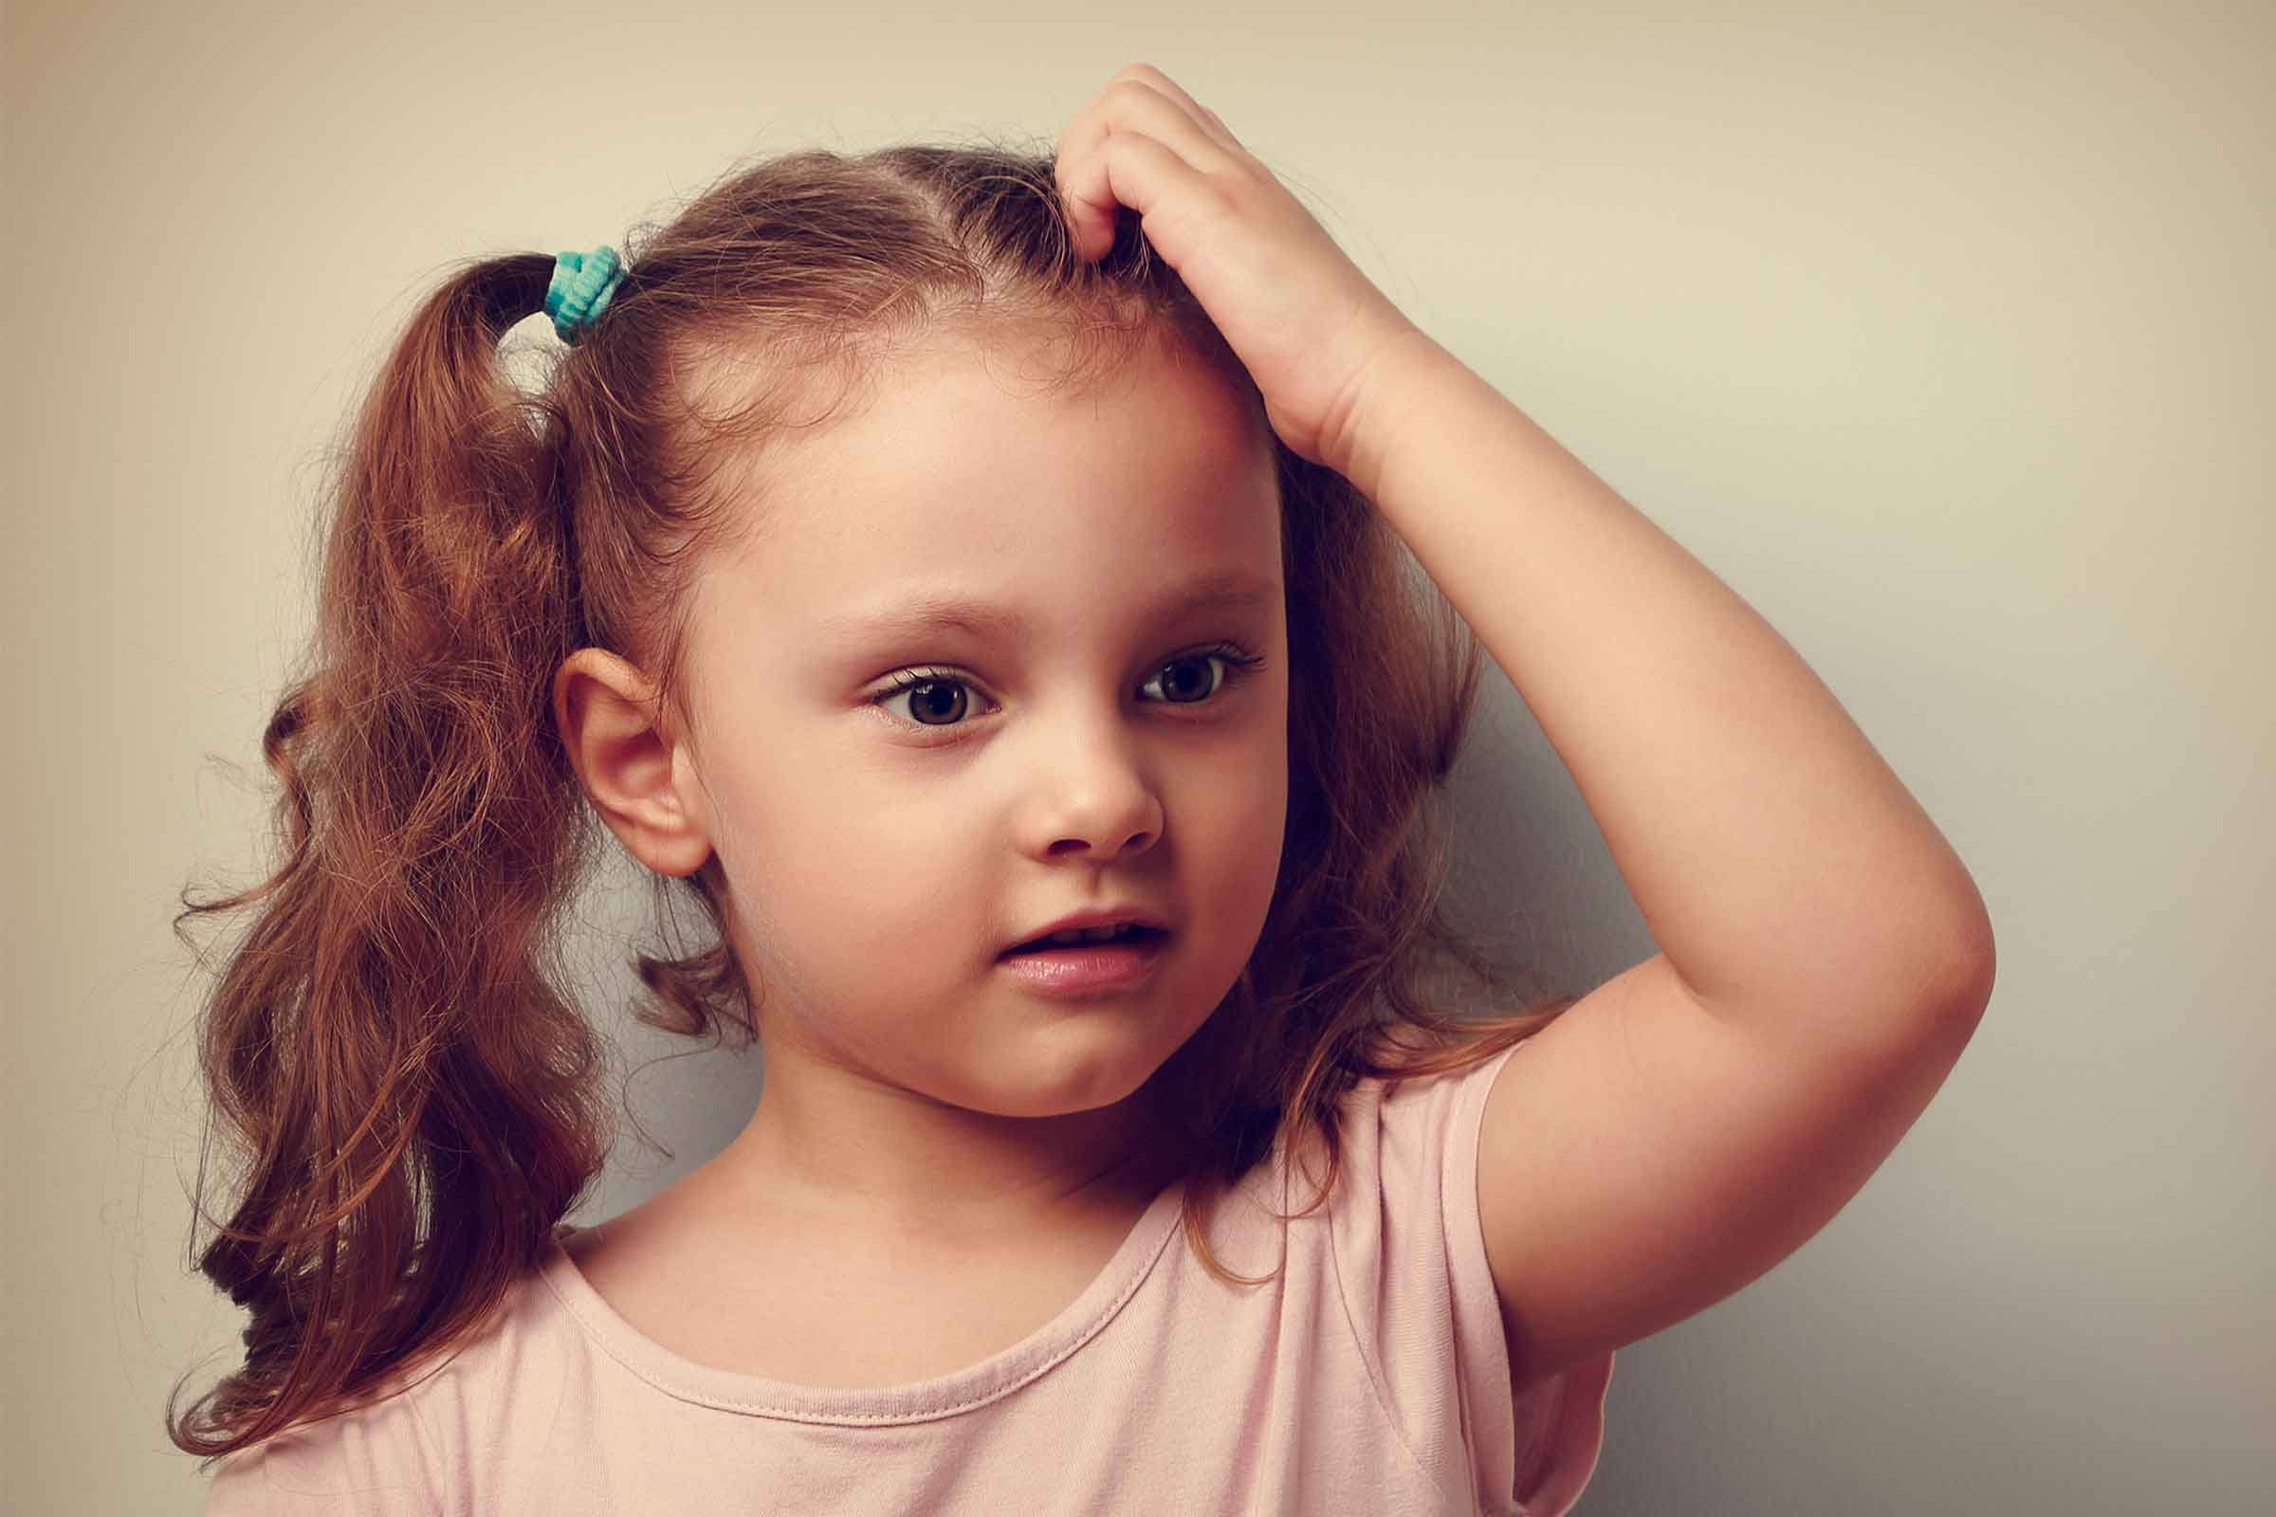
Dear students, show your hands.
Show your feet.
Show your eyes.
Show your head.

Slide 18
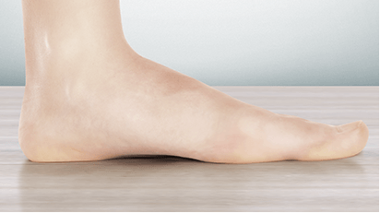
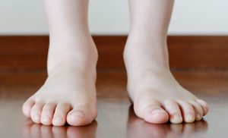
What is this?
What are these?
This is foot.
These are feet.
When we say foot, it means one leg.
When we say feet, it means two legs.

Slide 19
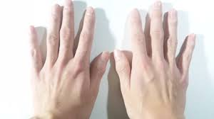
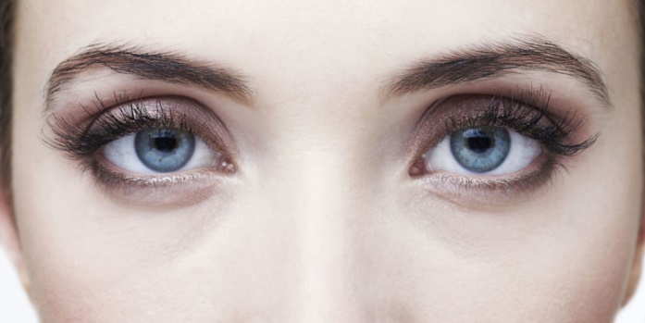
Dear students, listen to me again,
say the words after me.
feet
hands
eyes
head

Slide 20
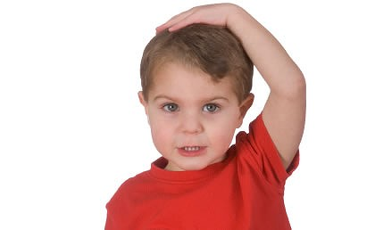
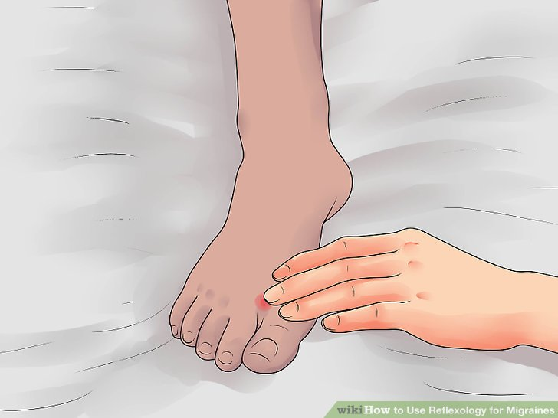
Dear students follow me carefully.
Touch your foot .
Touch your hands.
Touch your eyes .
Touch your head.

Slide 21
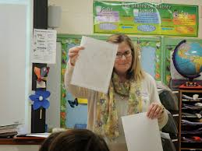
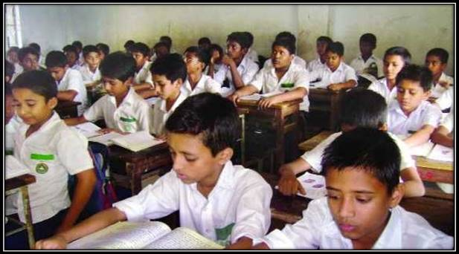
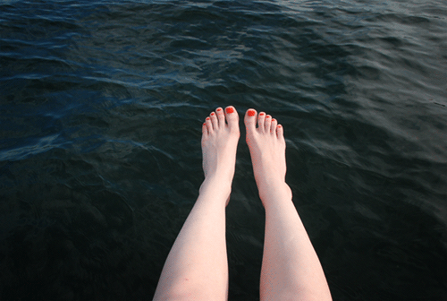
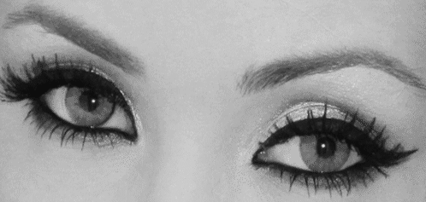
Every body, open your book . Page no 26.
Dear students , again say after me.
hands
feet
eyes
head

Slide 22
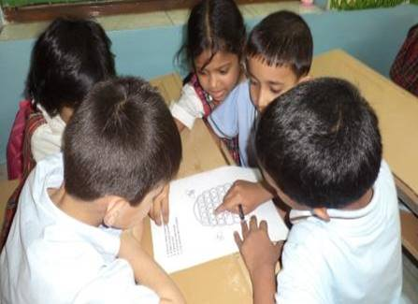
Discuss and say about the pictures in groups.
hands
feet
eyes
head

Slide 23
Discuss and say about the pictures in pairs
hands
eyes
head

Slide 24
Discuss about the pictures lonely.
eyes
feet

Slide 25
Evaluation ( oral ).
Everybody say name of the following pictures.
hands
feet
eyes
head

Slide 26
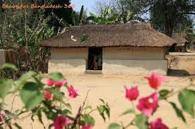
Home task.
Dear students, you will read the
today’s lesson at your home.

Slide 27
THANKS TO ALL
GOODBYE

