Slide 1
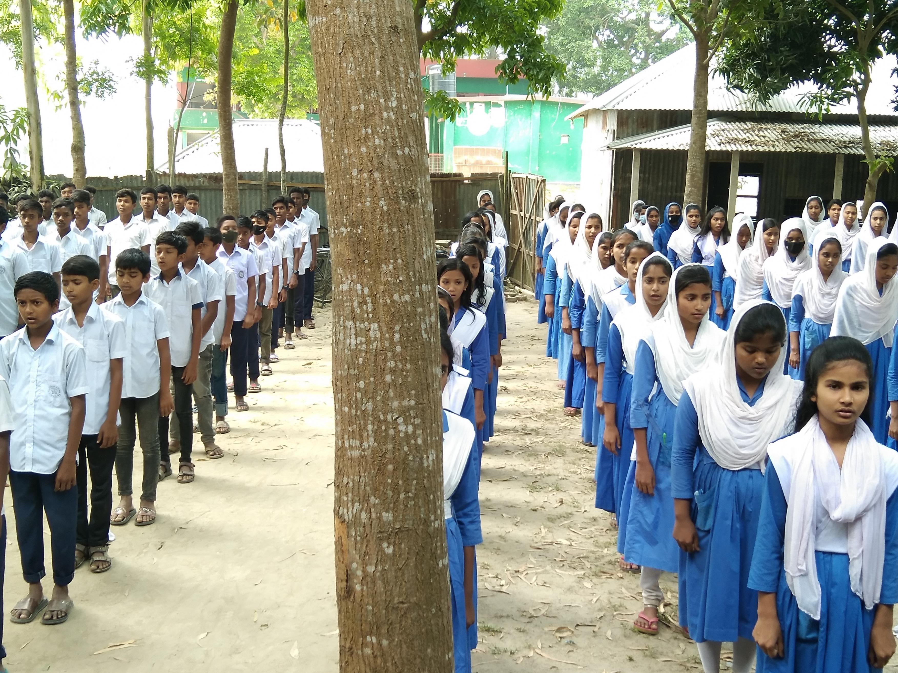
Welcome

Slide 2
Introduction
Assistant English Teacher of BANGALA KAZI SYDHUR RAHMAN SMRITY HIGH SCHOOL.
ULLAPARA, SIRAJGONJ.
Subject: English
Class: Nine-Ten
Time: 50 minutes
03/06/2022

Slide 3
What do you see in the picture? So, today’s lesson is about ‘ Pahela Boishakh’

Slide 4
Learning Outcomes: By the end of the lesson the learners will be able to… .
Talk about festivals
Read the text and identify some new words
Ask and answer questions
Use suitable words in the blanks
Describe a festival

Slide 5
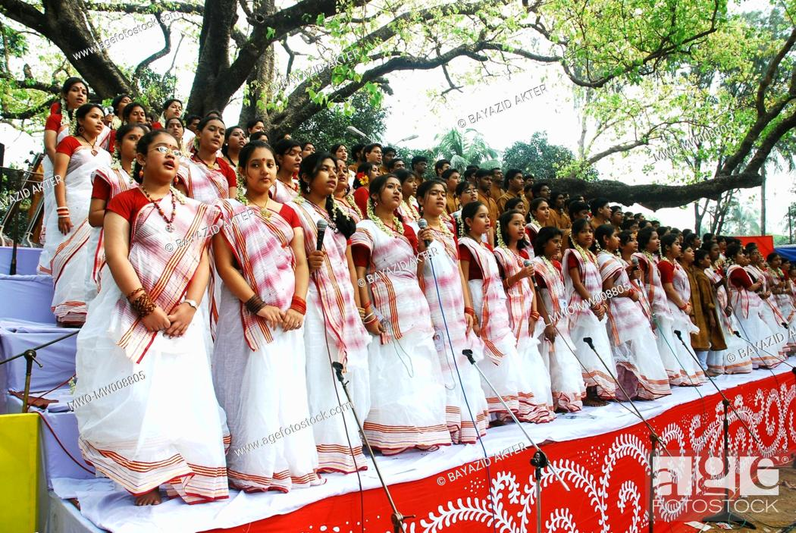
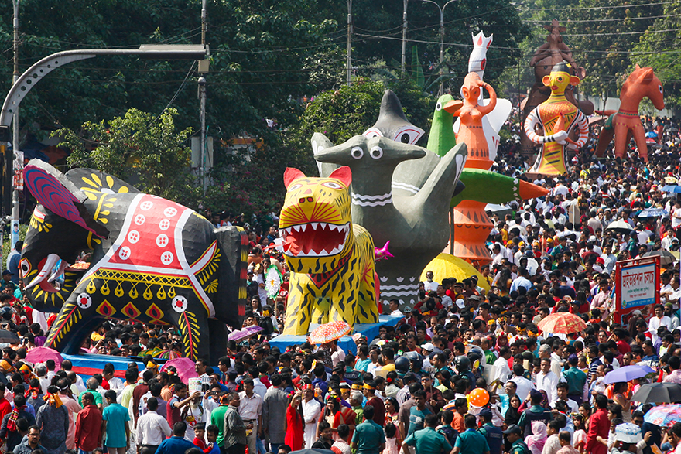
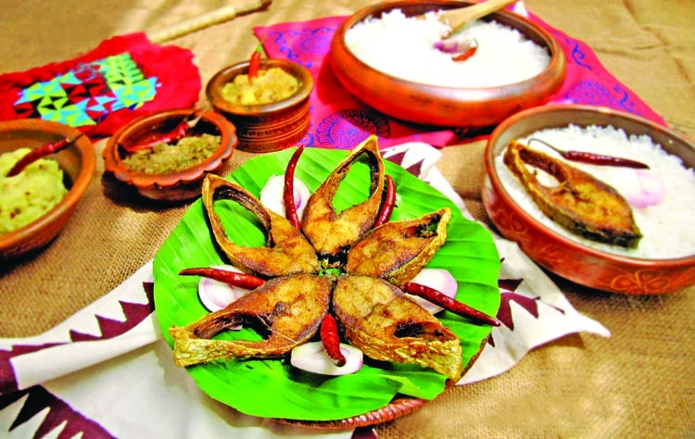
What can you tell me about the pictures?

Slide 6
Read the text silently.

Slide 7
Vocabulary /Synonym/Antonym
Root Word-----Bengali Meaning------Synonym----Antonym
Significance (N)-----তাৎপর্য-----Implication-----Insignificance
Renowned (Adj.)-------বিখ্যাত---------Famous-----Obscure
Celebrate (V)-----উদযাপন-----Observe------Critisize
Procession(N)----------মিছিল----------Succession-----Disorder
Fascinating (Adj.)---------আকর্ষণীয়-----Interesting------Boring

Slide 8
Pair Work
Ask and answer these questions:
. What is the Bengali New Year’s Day?
How do they celebrate the day?
Why is Pahela Boishakh so special?

Slide 9
Pahela Boishakh is a traditional (a)-------that is celebrated all over the country every year. It (b)--------people to begin a new (c)-------with new expectations. Everyone wears (d)----------clothes and eats traditional food on this day. Different organizations arrange different (e)--------programmes throughout the country. Answers: (a) festival (b) encourages (c) life (d) traditional (e) cultural
Individual Work
Complete the passage using suitable words.
Cultural | life | tradional
festival | encourages

Slide 10
Evaluation
Fill in the blanks.
The day of ‘Pahela Boishakh’ is a --------.
On this occasion, People are in a --------mood.
Pahela Boishakh is a day of------.
The word ‘ traditional’ means-------.
The day is-------all over the country.

Slide 11
Describe your own cultural or religious festival that you celebrate using the following words. Colour – special- traditional- religious-dance-cultural-flowers-food-songs-festive
Home Work

