Slide 1
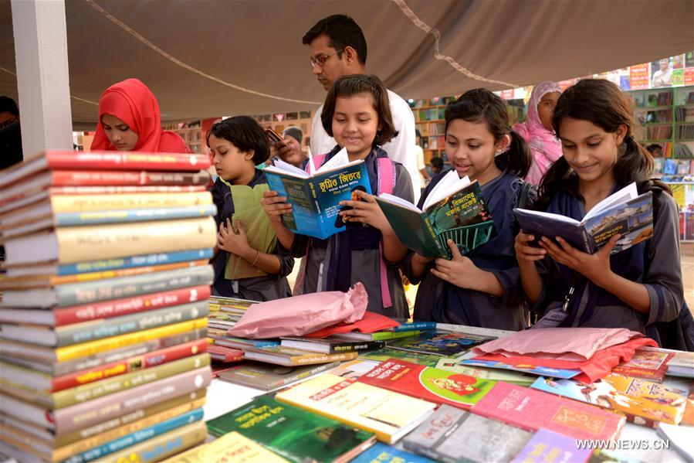
Welcome to English Class

Slide 2
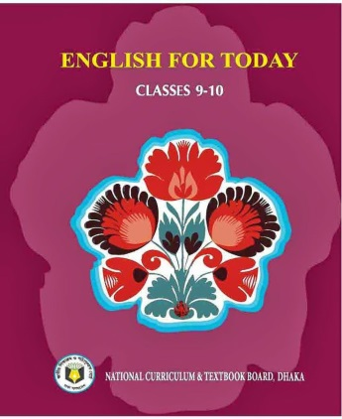
Identity
Mst. Sewli Khatun
Assistant Teacher of Bangala Kazi Sydhur Rahman Smrity High School, Ullapara , Sirajgonj.
Class : Nine-Ten
Subject : English 1st paper
Time : 50 Minutes
Date : 00/00/2019

Slide 3
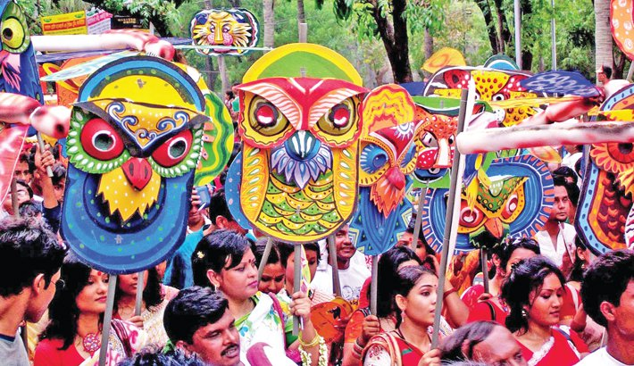
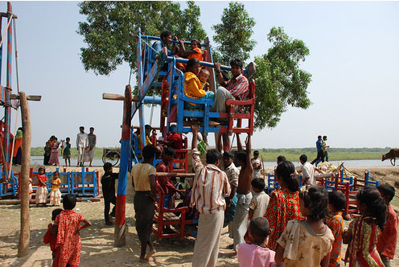
Let’s see the picture and talk about them.
Baishakhi Mela
Village fair

Slide 4
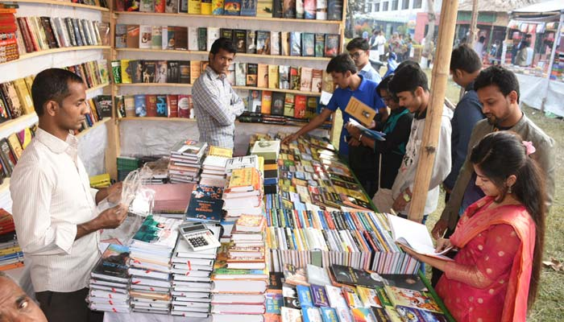
But What type of fair is this ?
This is book fair

Slide 5
Observe the video
https://www.youtube.com/watch?v=NodYuzCvR5A&feature=youtu.be
What is the video about ?
This is book fair

Slide 6
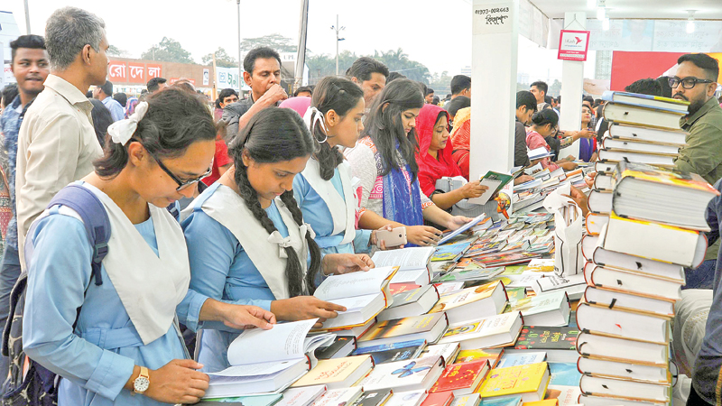
So, dear think about our today’s lesson.
Is it writing about?
Yes.
Our today’s lesson is….
“ A Book Fair”
Paragraph writing

Slide 7
Learning outcomes
After we have studied this topic, we will be able to-
tell about book fair,
ask and answer questions,
practise speaking and writing familiar affair,
write short paragraph.

Slide 8
Before writing paragraph on A Book Fair you have to think over some questions. For example---
a)What is a book fair?
b) When and where is it held?
c) What purpose does it serve?
d)When and Which book fair did you visit?
e) How is it organized?
f) How popular is it?
g) What kinds of books are usually available in a book fair?
h) What is your personal impression of a book fair?

Slide 9
What is a book fair?
A book fair is an exhibition where different types books are displayed and sold. Now a days it has become very popular.

Slide 10
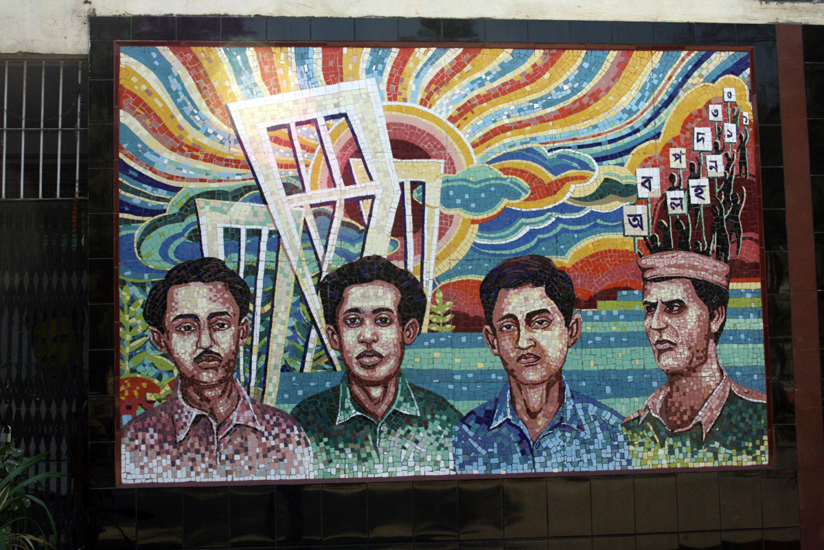
When is it held?
Every year it is held on the occasion of 21st February to remind us the struggle and sacrifice in the language movement. It is also held on the month of December to signify our victory of over our Liberation War in 1971.

Slide 11
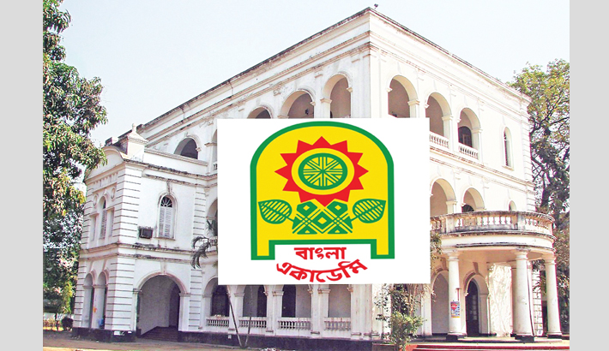
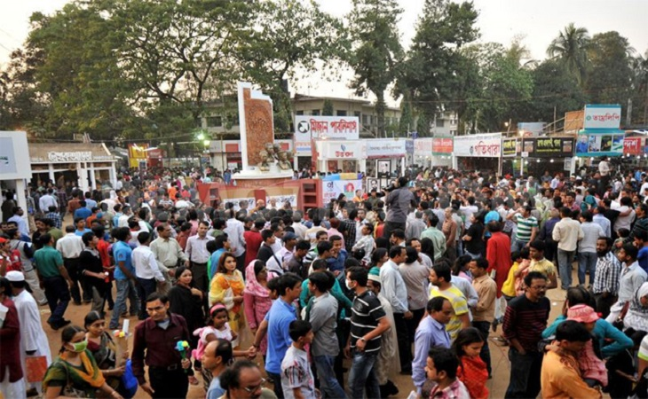
Who organizes it and where is it held?
The fair is centrally organized Bangla Academy authority in the premises of the institution. Moreover, It is held all the district towns over the country.

Slide 12
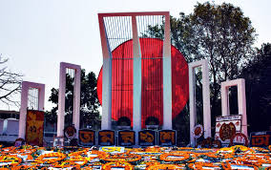
What is the starting and closing time of the book fair?
Ekushey Boi Mela is started on 1st February and closed on 28th February. But Dhaka Boi Mela is started on 1st December and closed on 31st December.

Slide 13
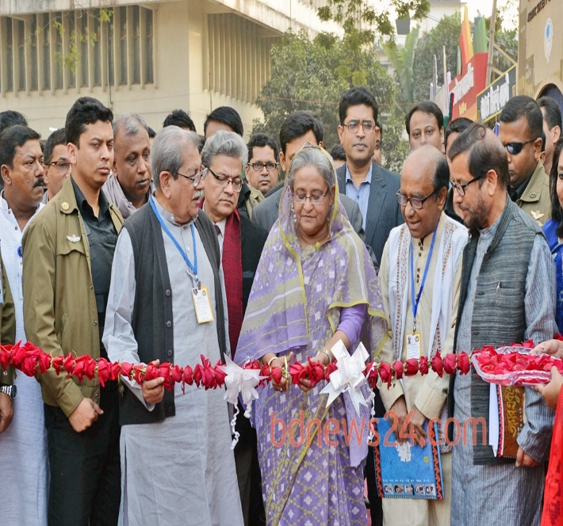
How is it started and who inaugurates ?
It is started with a gorgeous inaugural ceremony. Sometimes the President or the Prime Minister or the Education Minister inaugurates the ceremony.

Slide 14
When and Which book fair did you visit?
I visited the Ekushey book fair last year with some of my friends.

Slide 15
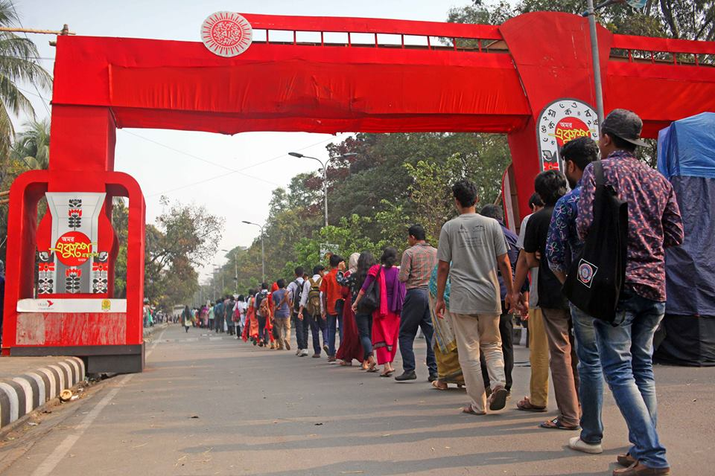
What did you see in the book fair?
When I entered the main gate of the fair I saw different environment. There was a huge gathering. There are thousands of stalls of different publishers. I visited more than hundreds of stalls set up in different rows. All the stalls were laden with different books as…………

Slide 16
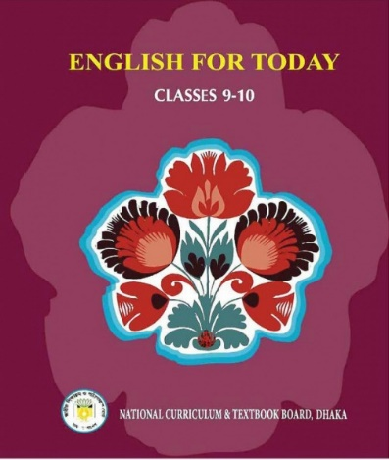
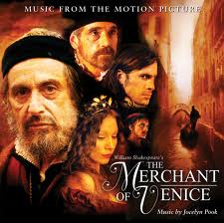
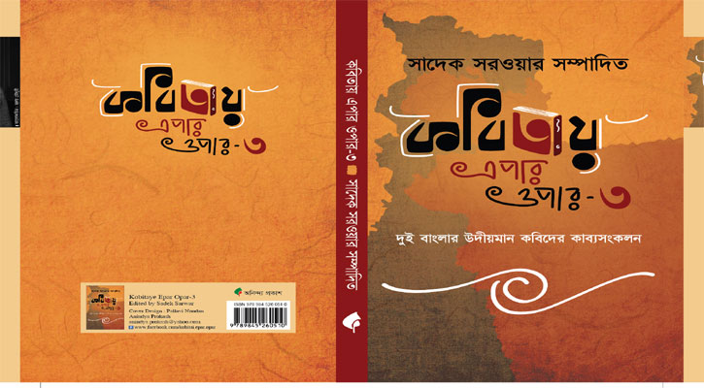
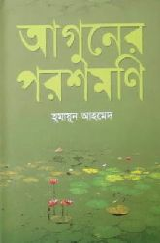
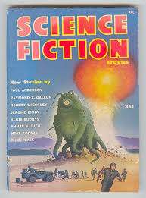
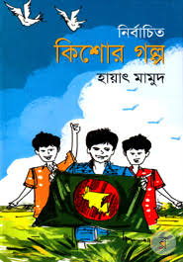
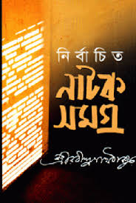
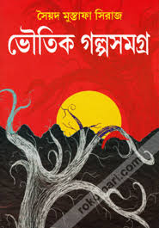
text books, story books. poetry books, science fictions, ghost books, children books, dramas, stories, novels reference books etc.

Slide 17
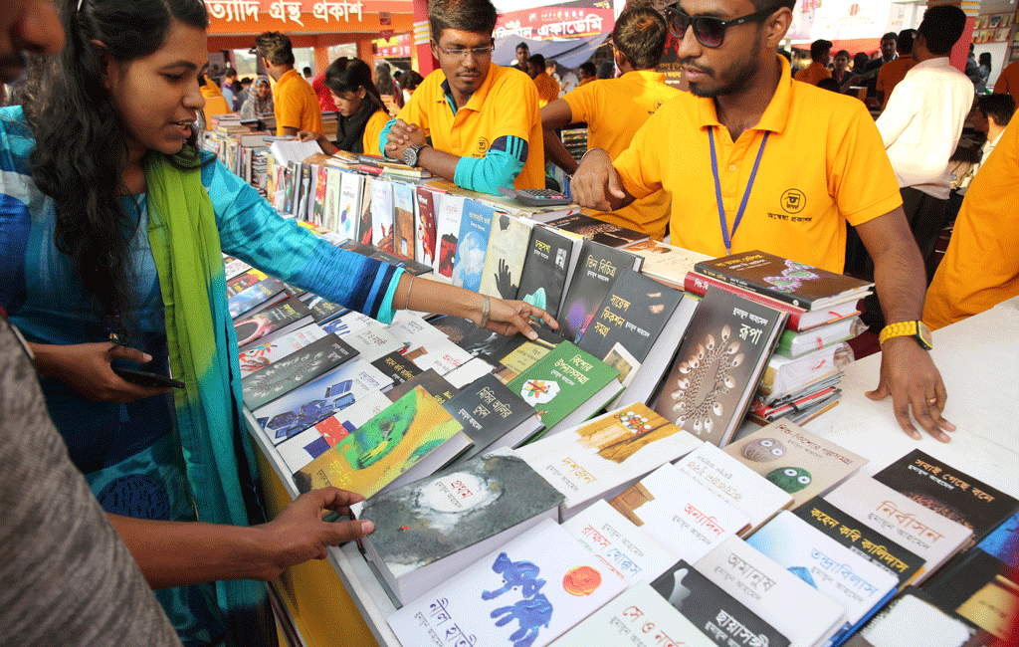
Who gathered to the book fair and what were they doing?
Men, women, children and specially the book lovers gathered to the fair. They were busy with seeing, buying and visiting with their favourite poets and writers.

Slide 18
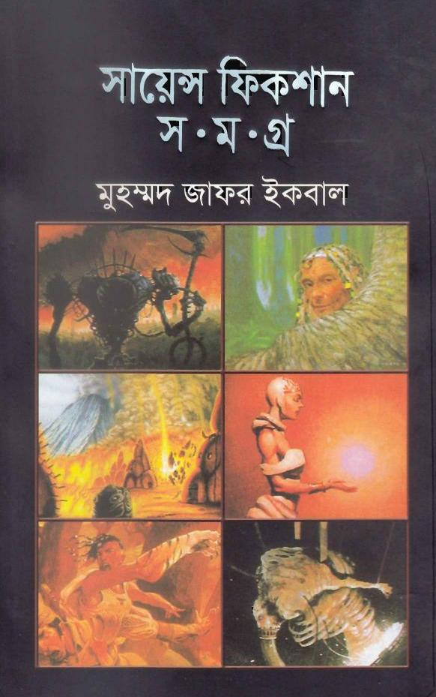
Did you buy any book for yourself ?
I bought some science fictions of my favourite writers Dr. Jafor Iqbal and pursued to buy more but my pocket didn't support me. So I collected some catalogues so that I can but later.

Slide 19
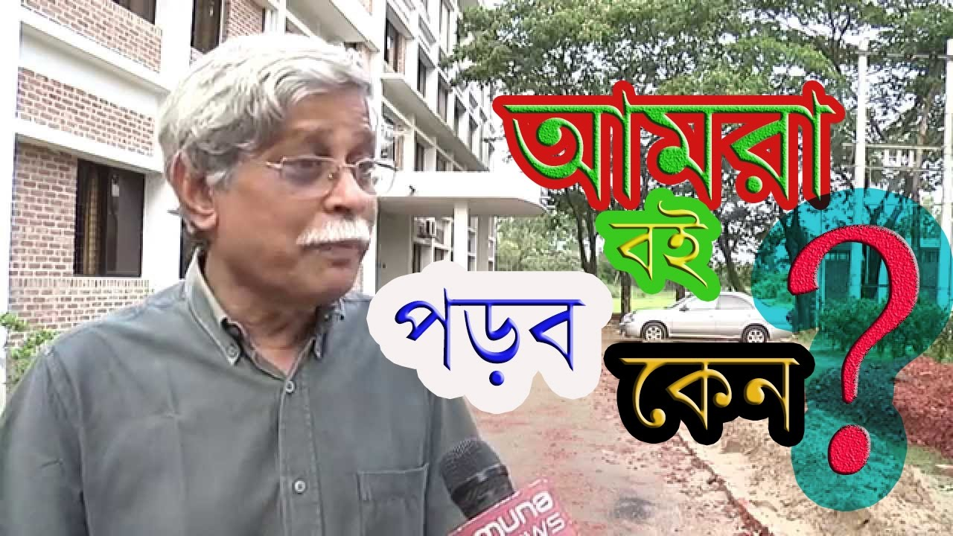
What was most interesting to you?
Luckily I got an opportunity to meet with my favourite writer Dr. Jafor Iqbal and took an autograph from him. I was influenced with his words very much.

Slide 20
What is your thinking about the book fair ?
A book fair is very important because it upgrades our knowledge, it broadens our outlook. It reminds us that books are our best friends. It creates a sense of interest for books amongst the general mass.

Slide 21
How much did you enjoy the book fair and what is your feelings about it ?
I enjoyed the book fair very much and I will
never miss the book fair as long as I live.

Slide 22
The complete Paragraph
A book fair is an exhibition where different types books are displayed and sold. Now a days it has become very popular. Every year it is held on the occasion of 21st February to remind us the struggle and sacrifice in the language movement. It is also held on the month of December to signify our victory of over our Liberation War in 1971. The fair is centrally organized Bangla Academy authority in the premises of the institution. Moreover, It is held all the district towns over the country. Ekushey Boi Mela is started on 1st February and closed on 28th February. But Dhaka Boi Mela is started on 1st December and closed on 31st December. It is started with a gorgeous inaugural ceremony. Sometimes the President or the Prime Minister or the Education Minister inaugurates the ceremony. I visited the Ekushey book fair last year with some of my friends.When I entered the main gate I saw different environment. There was a huge gathering. There are thousands of stalls of different publishers.

Slide 23
I visited more than hundreds of stalls set up in different rows. All the stalls were laden with different books as text books, story books. poetry books, science fictions, ghost books, children books, dramas, stories, novels reference books etc. Men, women, children and specially the book lovers gathered to the fair. They were busy with seeing, buying and visiting with their favourite poets and writers. I bought some science fictions of my favourite writers Dr. Jafor Iqbal and pursued to buy more but my pocket didn't support me. So I collected some catalogues so that I can but later. Luckily I got an opportunity to meet with my favourite writer Dr. Jafor Iqbal and took an autograph from him. I was influenced with his words very much. A book fair is very important because it upgrades our knowledge, it broadens our outlook. It reminds us that books are our best friends. It creates a sense of interest for books amongst the general mass. I enjoyed the book fair very much andI will never miss the book fair as long as I live.

Slide 24
Evaluation
What is a book fair?
When is it arranged?
How is it started and who inaugurates?
Who attends the book fair?
Why do the people come to the book fair?
What is the importance of a book fair?

Slide 25
Home work
Write a paragraph on
“A book fair you visited”

Slide 26
Good bye
Thank you for your Participation
May God bless you

