Slide 1
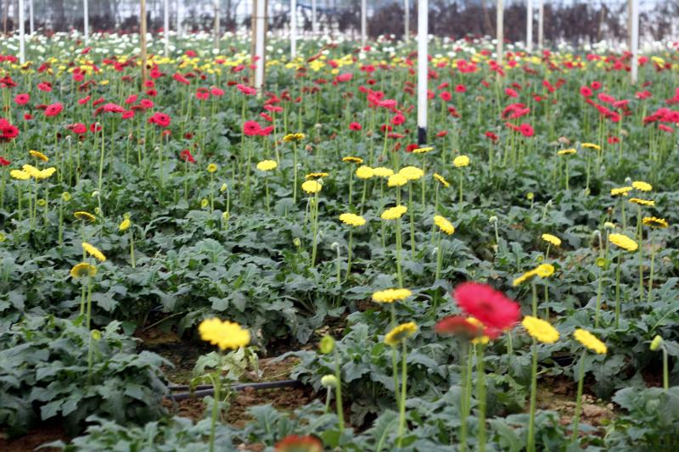
my
dear
students

Slide 2
INTRODUCTION
MARGAET ADHIKARI
ASSISTANT TEACHER
BALIGOAN GOVT. PRIMARY SCHOOL
KAMALGONJ,MOULVIBAZAR
ENGLISH FOR TODAY
CLASS – ONE
UNIT -- 10
LESSON – 4-6

Slide 3
Greetings
Good morning, students.
How are you, my dear little students?
Good morning, teacher.
Fine, thank you, teacher.

Slide 4
Now let’s see a video song

Slide 5
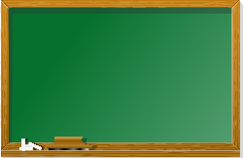
Look, listen and say
apple, ball ,cat, ant, cap, fish, dog, goat, elephant, egg.

Slide 6
Dear students-
Let’s watch a picture and think about this:
Hen

Slide 7
Today We are going to read
Alphabet (H h).

Slide 8
Learning outcomes
By end of the lesson students will be able to-------
1.1.1 to become familiar with English sounds by listen to
common English word.
1.1.2 to say simple words after the teacher with proper sounds and stress.
1.2.1 to recognize and read the alphabet both small and
capital (non-cursive) letters.
3.1.2 write words using non-cursive small letters.

Slide 9
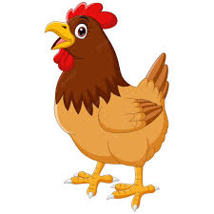
Look at the picture?
What is this?
This is Hen.

Slide 10
Look, listen and say
H
h
Hen

Slide 11
Letter practice
H
e
n
H

Slide 12
WCW
Find out the Letter “H”
D | H | E
H | C | H
A | H | B

Slide 13
Say and read. Trace and write.
H
H
H
h
h
h
Individual work

Slide 14
Match the letter
Pair Work
Hen
h

Slide 15
Dear students, open your textbook at page no - 21.

Slide 16
Say , Trace and write.
Evaluation
Fill in the gap.
h
_en
h
_n
e
_n

Slide 17
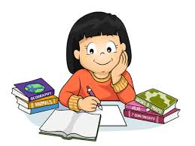
Home work
Write the capital letter “H”.
and small letter “h”.

Slide 18
No more today,See you later, thank you,bye………

