Slide 1
WELCOME

Slide 2
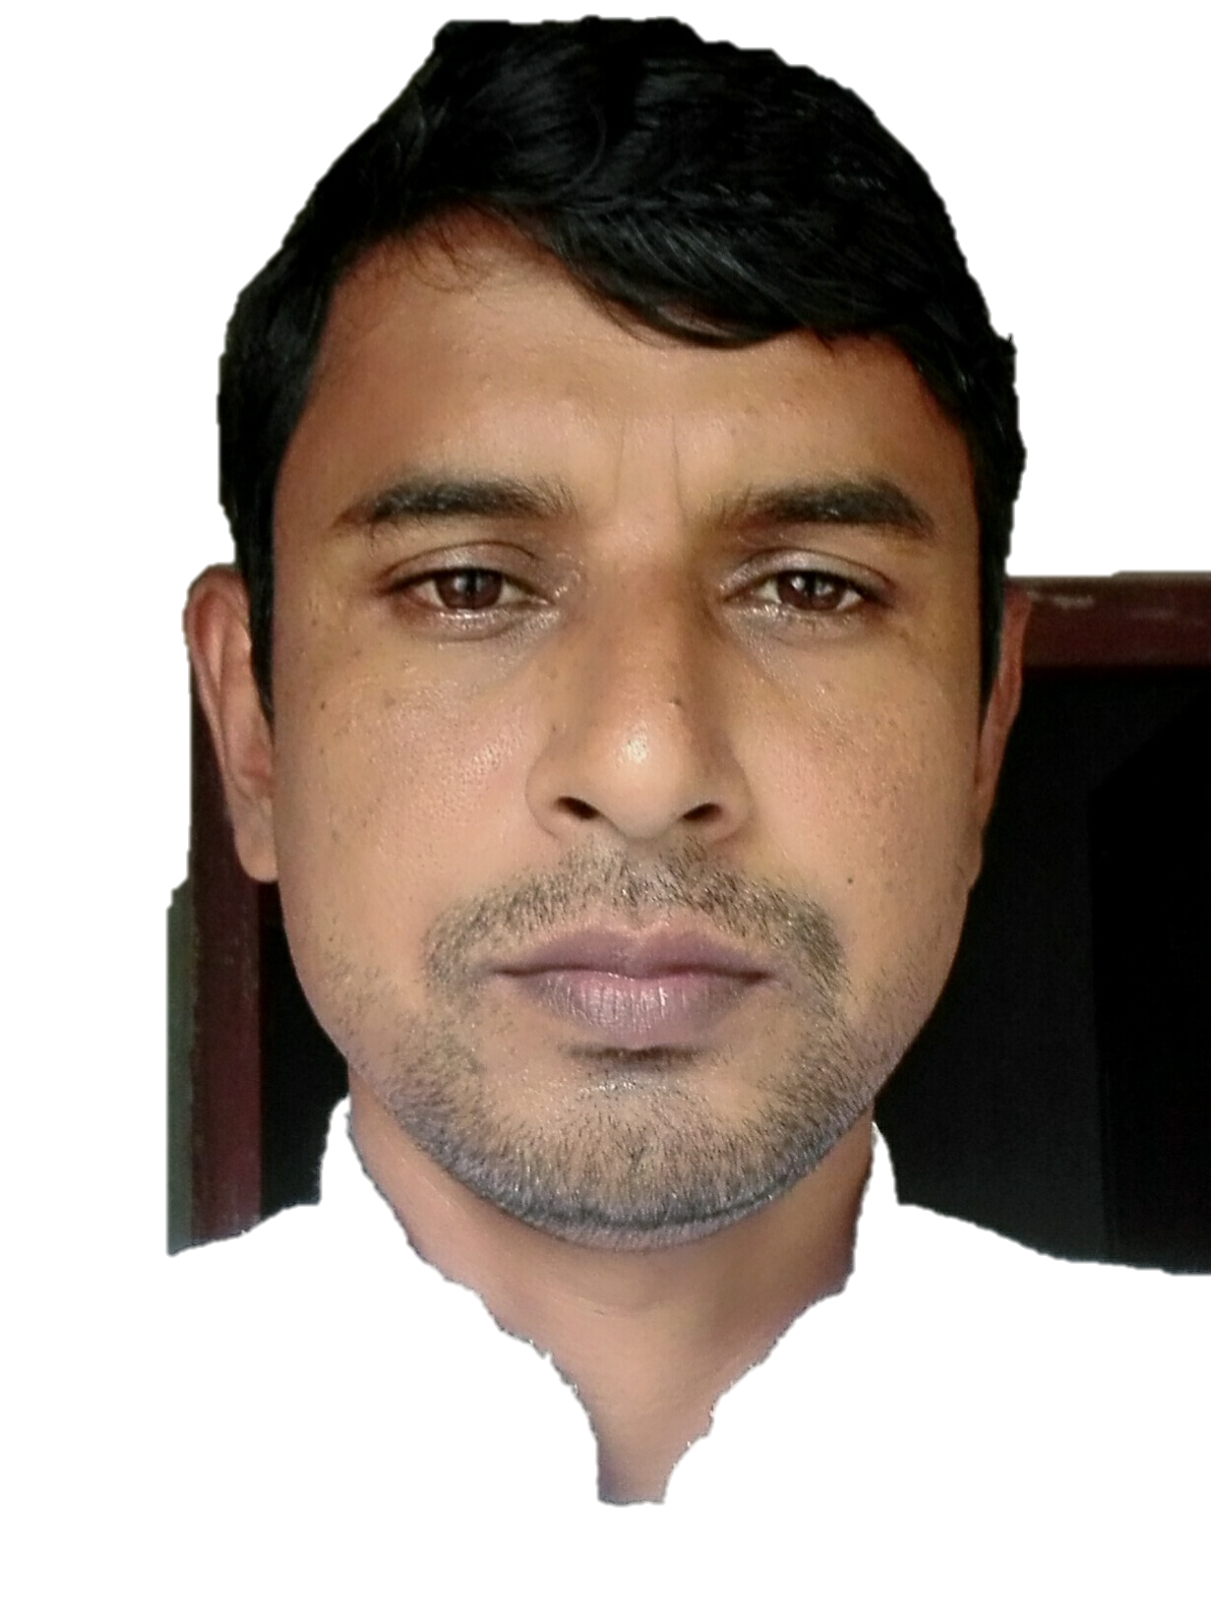
IDENTITY
ABU SAYEEM
Assistant Teacher
Bhulbaria Government Primary School. Singra, Natore.
01717852715
Class: Three
Subject: English
Unit: 23
Lesson: 1
Time: 45 mins

Slide 3
Learning outcomes
Students will be able to-
Listening;
1.1.1 Recognize English sound differences in the context of words.
Speaking;
1.1.1 repeat words, phrases and sentences after the teacher with proper sounds and stress.
1.1.2 say words, phrases and sentences with proper sounds and stress.
Reading;
1.5.1 read simple sentences with proper pronunciation and tress.
5.1.3 read text.

Slide 4
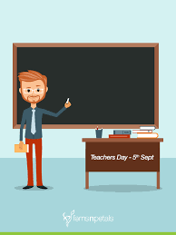
Today we’ll learn…
What do they do ?
Lesson 1

Slide 5
Open your English book at Page 46
What do you see in the picture below?
What do they do?

Slide 6
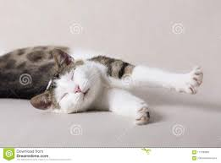
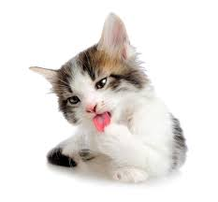
I’m a cat
In the morning,I’m lazy and slow.
I get up late.

Slide 7
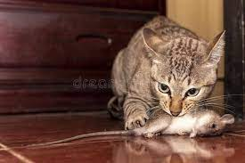
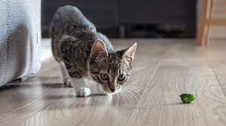
I catch rats.
In the afternoon, I’m active.

Slide 8
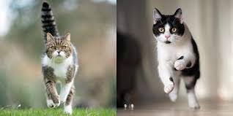
I’m quick!

Slide 9
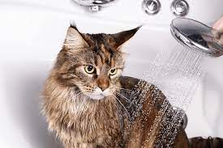
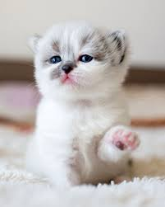
I’m a clean animal.
I wash myself everyday.

Slide 10
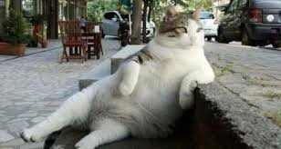
New word:
Lazy
Unwilling to work.

Slide 11
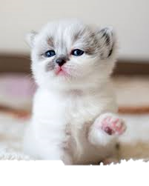
New word:
clean.
Free of dirt.

Slide 12
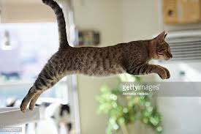
New word:
Active
Having the power of acting or
Quick in physical movement.

Slide 13
New word:
Quick
Moving with speed.

Slide 14
Tearchers Reading

Slide 15
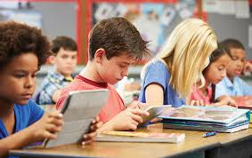
Student Reading

Slide 16
I.W
Answer the questions.
1.When does the cat get up?
The cat gets up late in the morning.
2.What does the cat catch?
The cat catches rats.
3. What kind of animal the cat is?
The cat is very calm and pet animal.

Slide 17
Match the words with their opposite words.
P.W
Quick Lazy
Late Slow
Clean Early
Active Dirty

Slide 18
Fill in the blanks with suitable word.
P.W
late
clean
rats
everyday
The cat catches_ _ _ _.
The cat is a _ _ _ _ animal.
It gets up _ _ _.
It washes itself _ _ _ _ _.

Slide 19
Task
Say 3 sentences about Dog.

Slide 20
Thank You
Good bye

