Slide 1
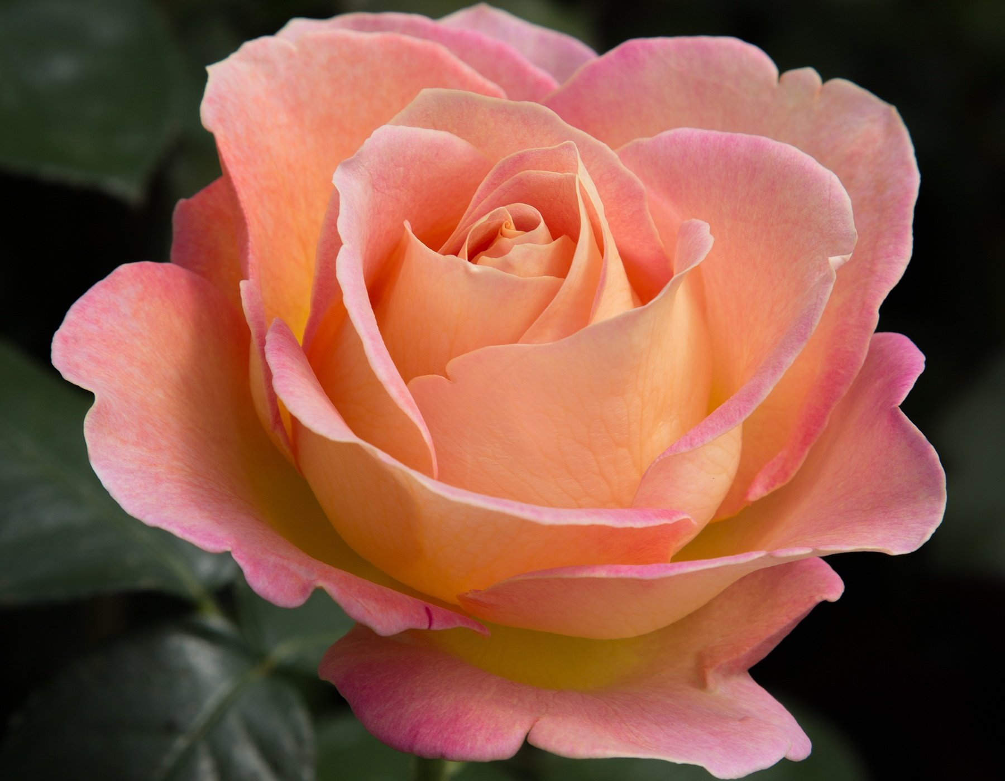
WELCOME TO MY MULTIMEDIA CLASS

Slide 2
Presented By
Lesson
Subject : English
Class: Five
Time: 50 minutes
Date: 07-01-2023
Md . Hafizur Rahman
Md . Hafizur Rahman
Assistant Teacher
Haripur Government Primary School
Haripur , Thakurgaon .
Phone: 01716437086
Email:hafizict5@gmail.com

Slide 3
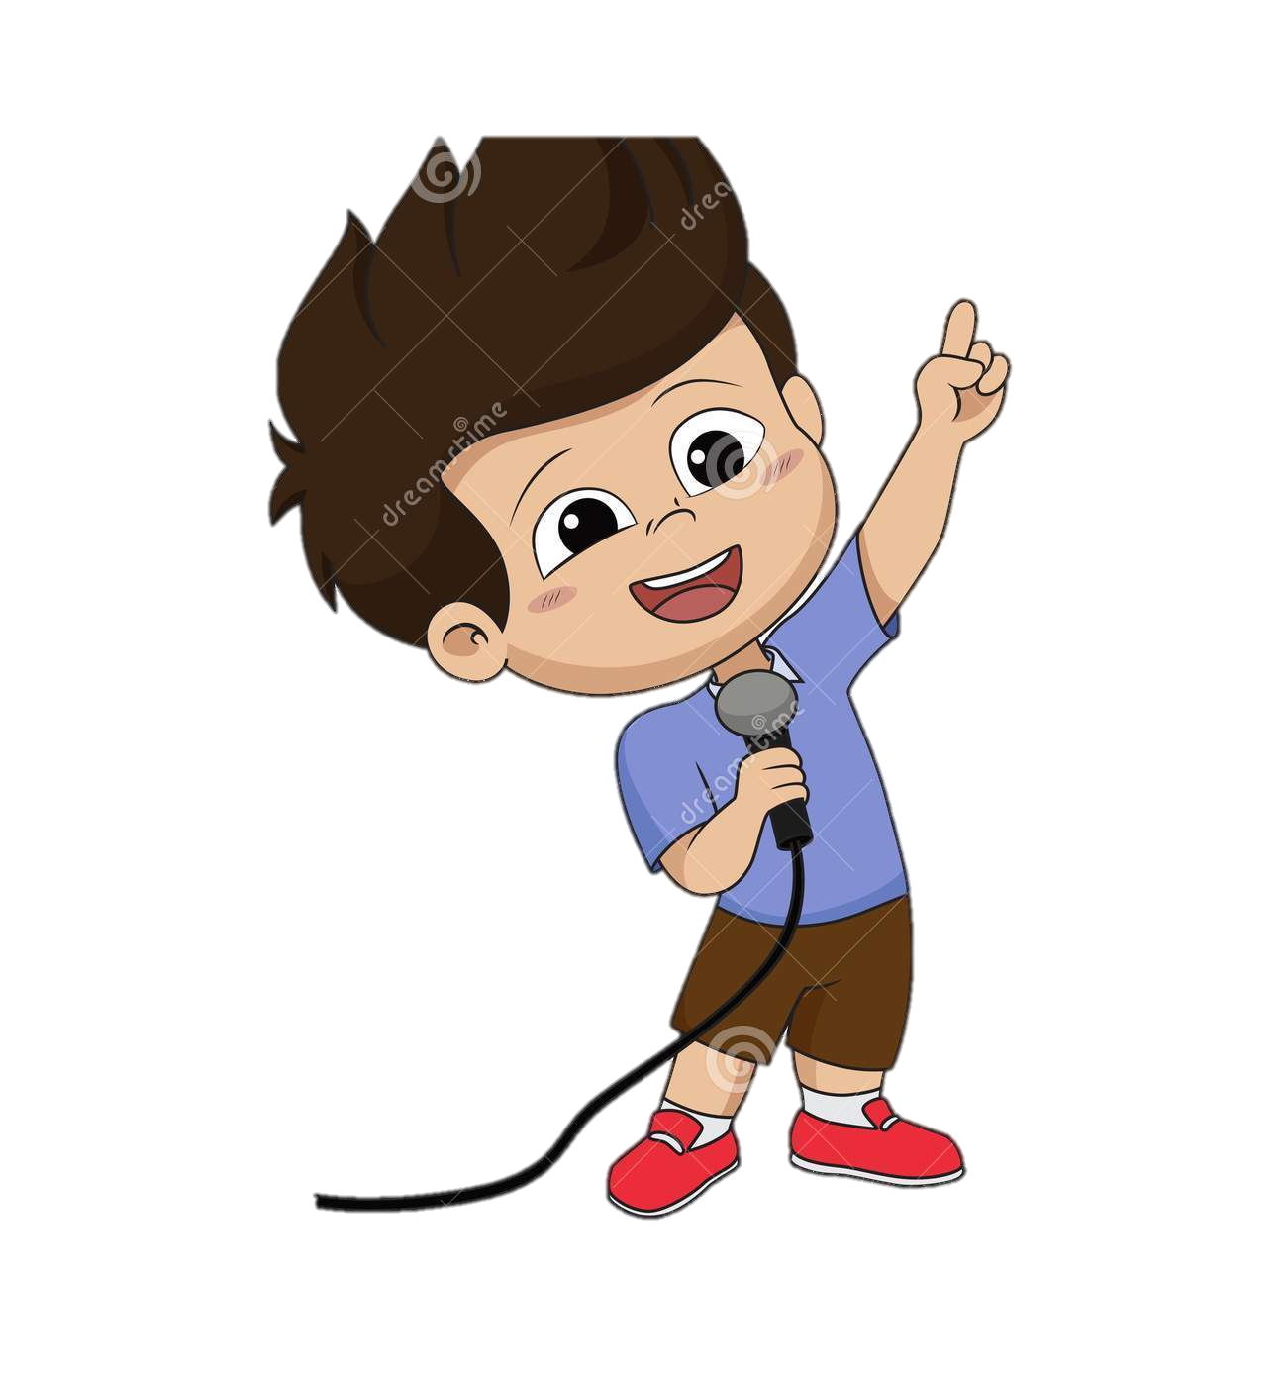
Let’s sing
We shell over come Song together

Slide 4
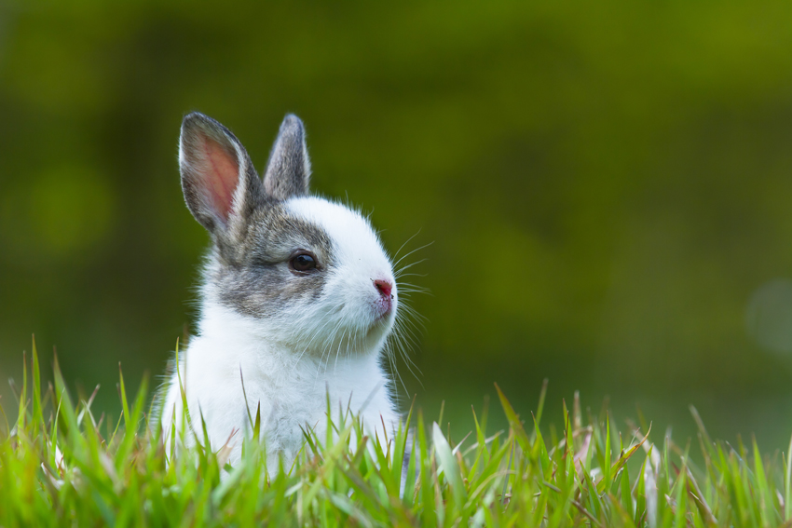
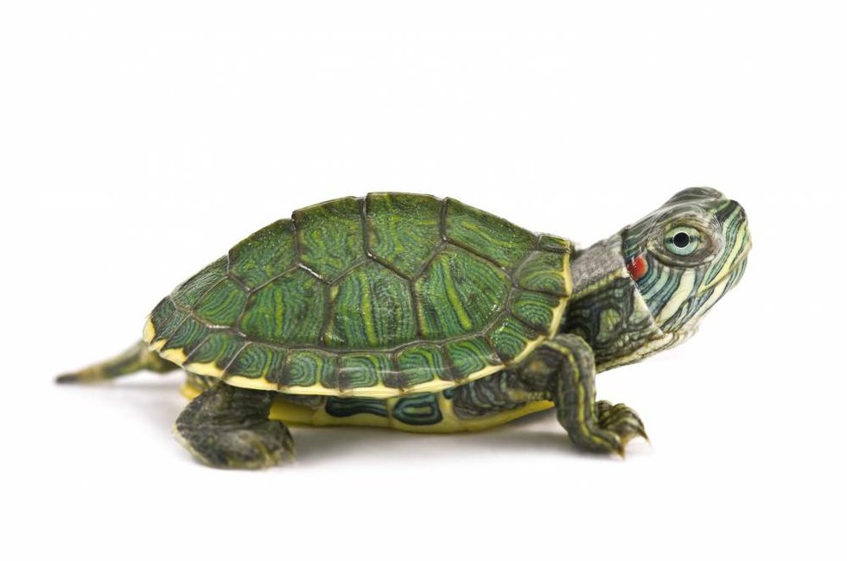
Dear Student ,what do you see in the picture?
Hare
Tortoise
Do you know, which of the two species fastest and slowest animal?

Slide 5
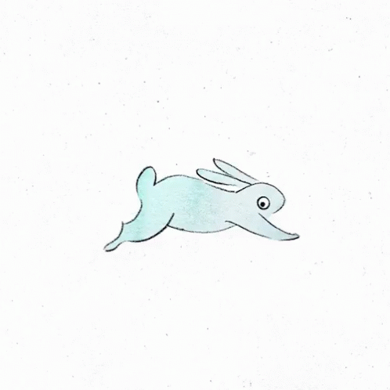
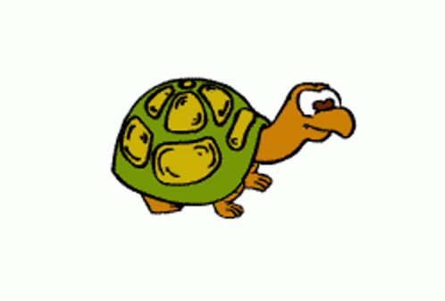
Thank you
Hare is the fastest animal.
Tortoise is the slowest animal.
Can you guess what’s the lesson today?

Slide 6
Prior knowledge check
What we read in our previous class
The hare and the tortoise
One day ………… the race began

Slide 7
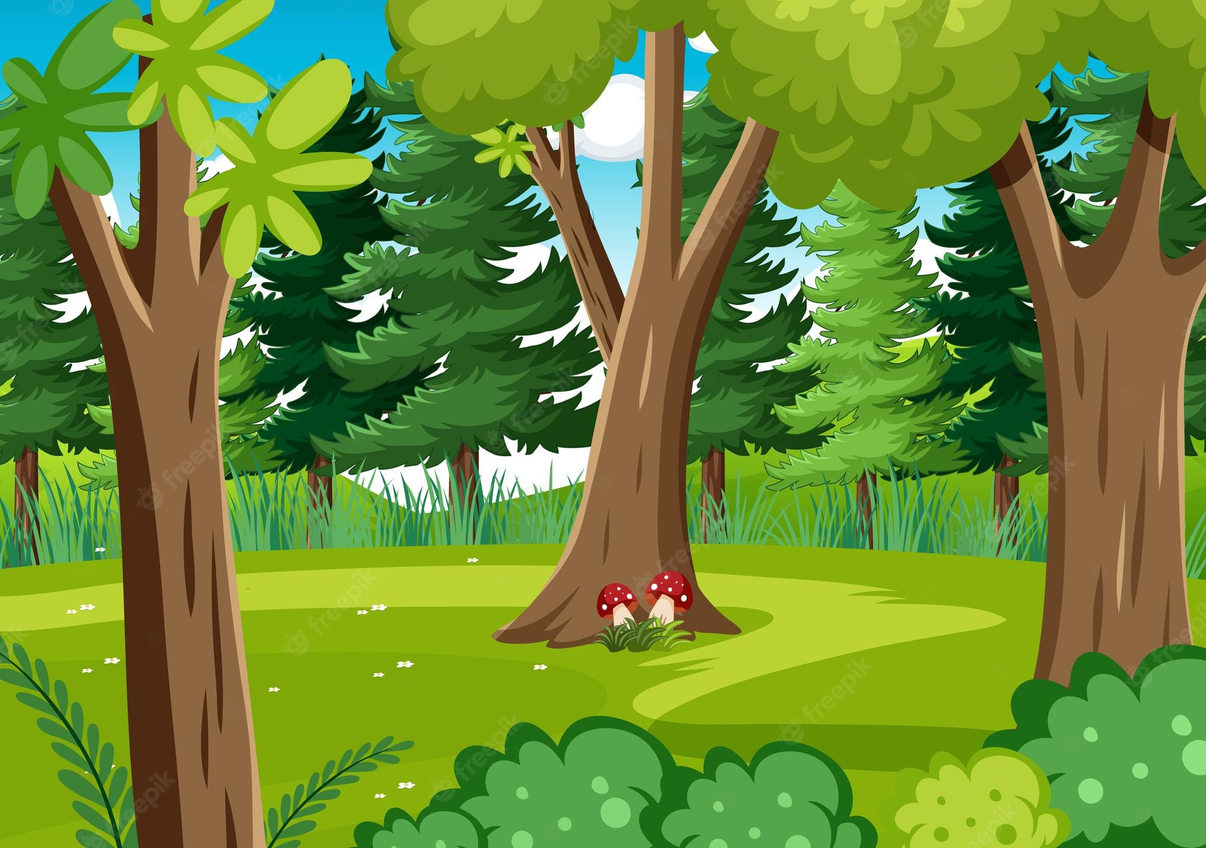
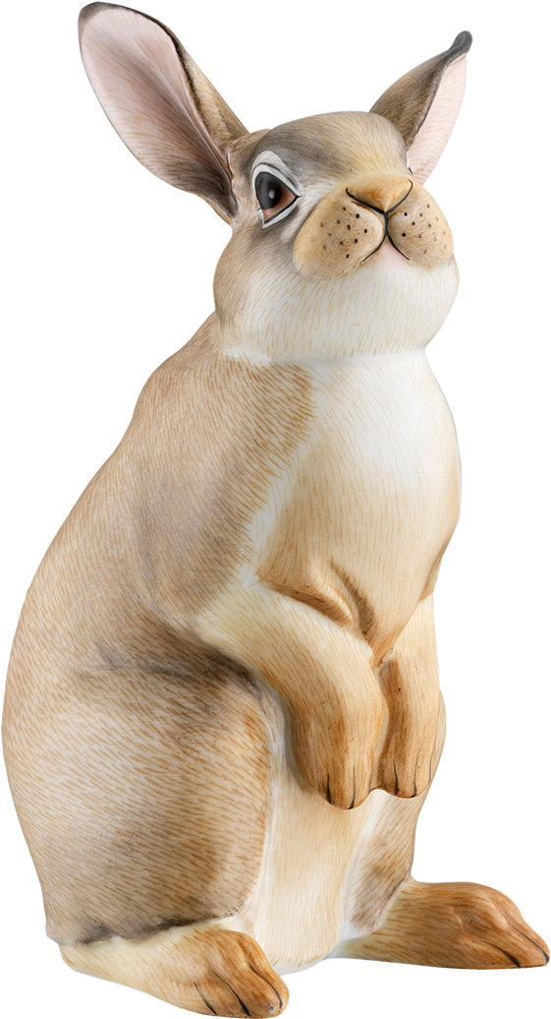
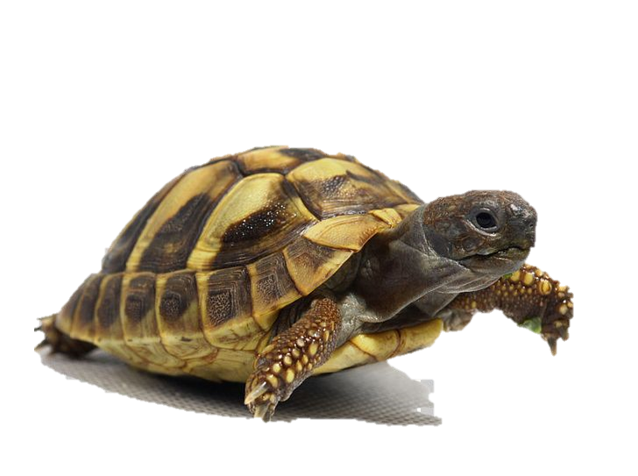
Today lesson
The hare and the tortoise
The hare ran ………… win the race

Slide 8
Learning Outcomes
By end of the lesson student will be able to-
Listening:
4.2.1-understand and enjoy simple stories.
3.4.1-understand statements made by the teacher and student.
Reading
1.7.1 - read paragraphs, dialogues, stories, letters and other text.

Slide 9
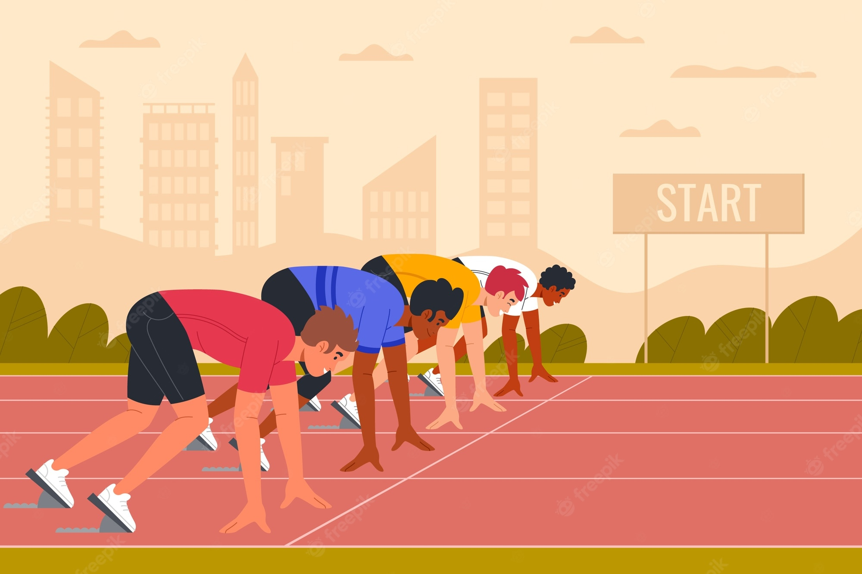
Introducing new words
Furious
very angry.
ক্ষিপ্ত
The hare was furious!

Slide 10
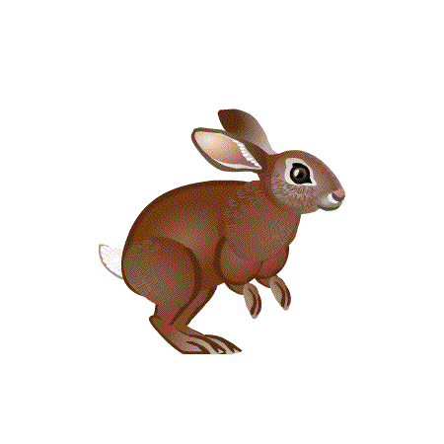
Introducing new words
Fast
Quick
দ্রুত
The hare is the fastest animal in the forest

Slide 11
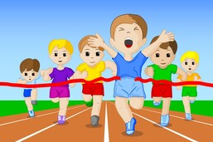
Introducing new words
Cross
Across
অতিক্রম করা
The tortoise cross the finish line .

Slide 12
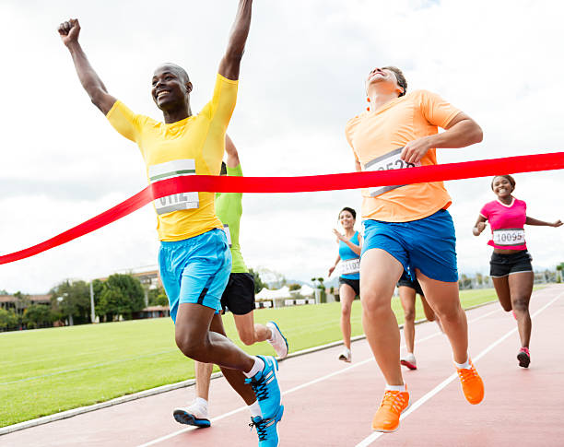
Introducing new words
Finish
End.
শেষ করা
They cross the finish line .

Slide 13
Introducing new words
Slow
Late.
ধীরে
The tortoise is the slowest animal.

Slide 14
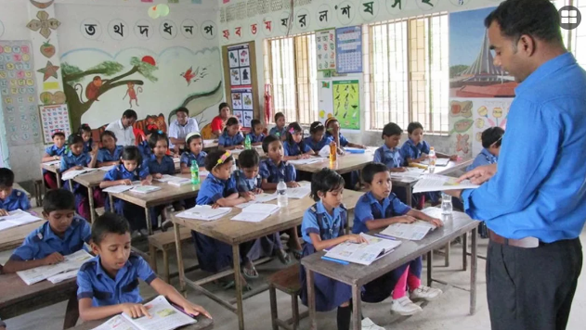
Teacher speaking loudly

Slide 15
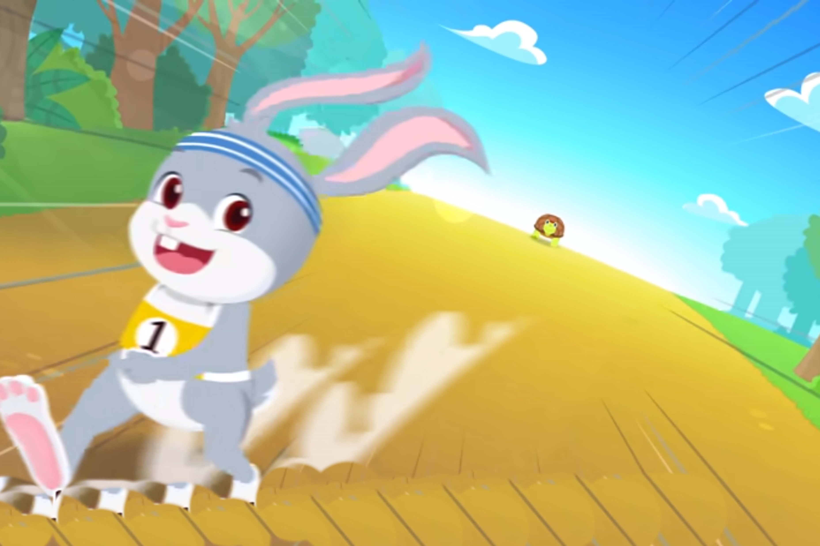
Let’s know the lesson with the picture
The hare ran quickly and in a few minutes the hare was out of sight.
The hare said to himself,”The tortoise is very far behind. I can see the finish line. I have time for a nap!”

Slide 16
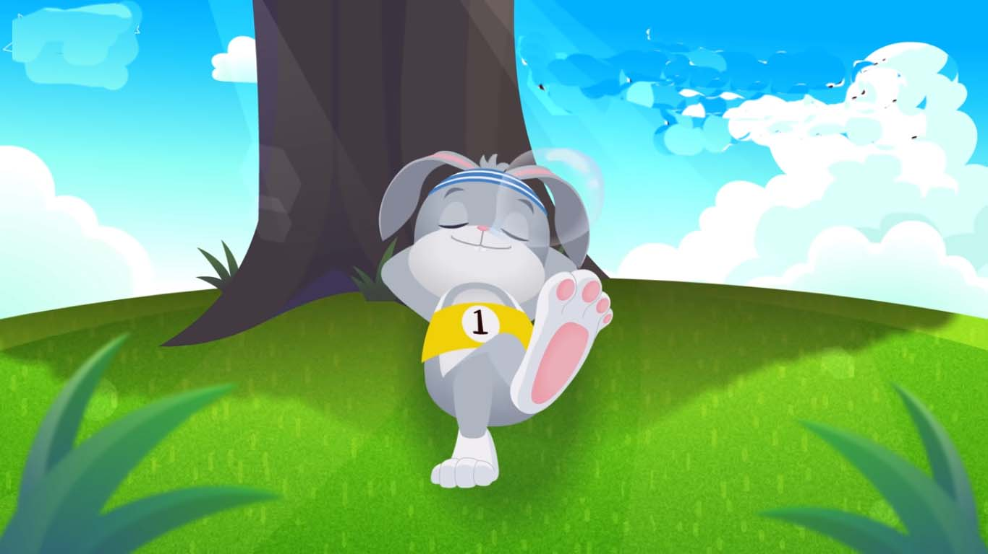
Let’s know the lesson with the picture
Soon the hare was asleep under a tree next to the path.

Slide 17
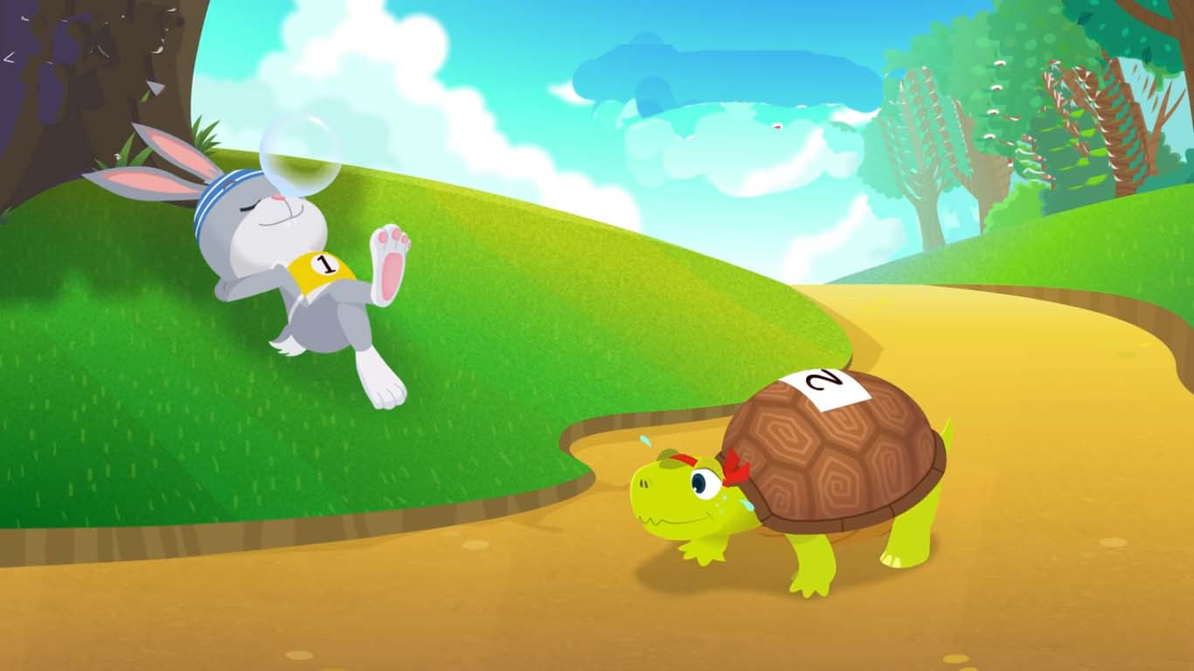
Let’s know the lesson with the picture
The tortoise walked steadily, on and on. He didn’t stop. Soon, he passed the sleeping hare.

Slide 18
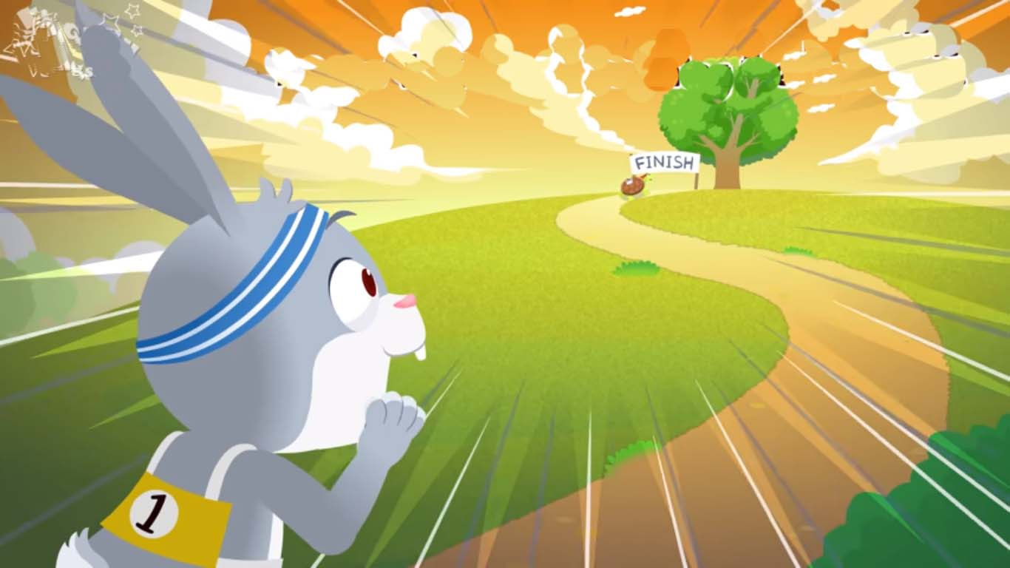
Let’s know the lesson with the picture
The hare slept for an hour. When he finally woke up, he looked at the finish line .He could not believe his eyes! Tortoise was almost at the finish line!

Slide 19
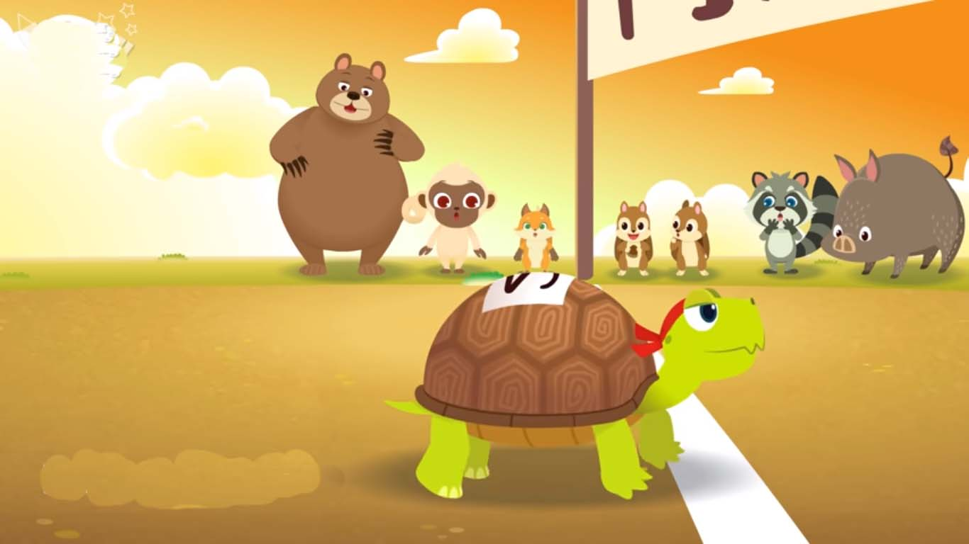
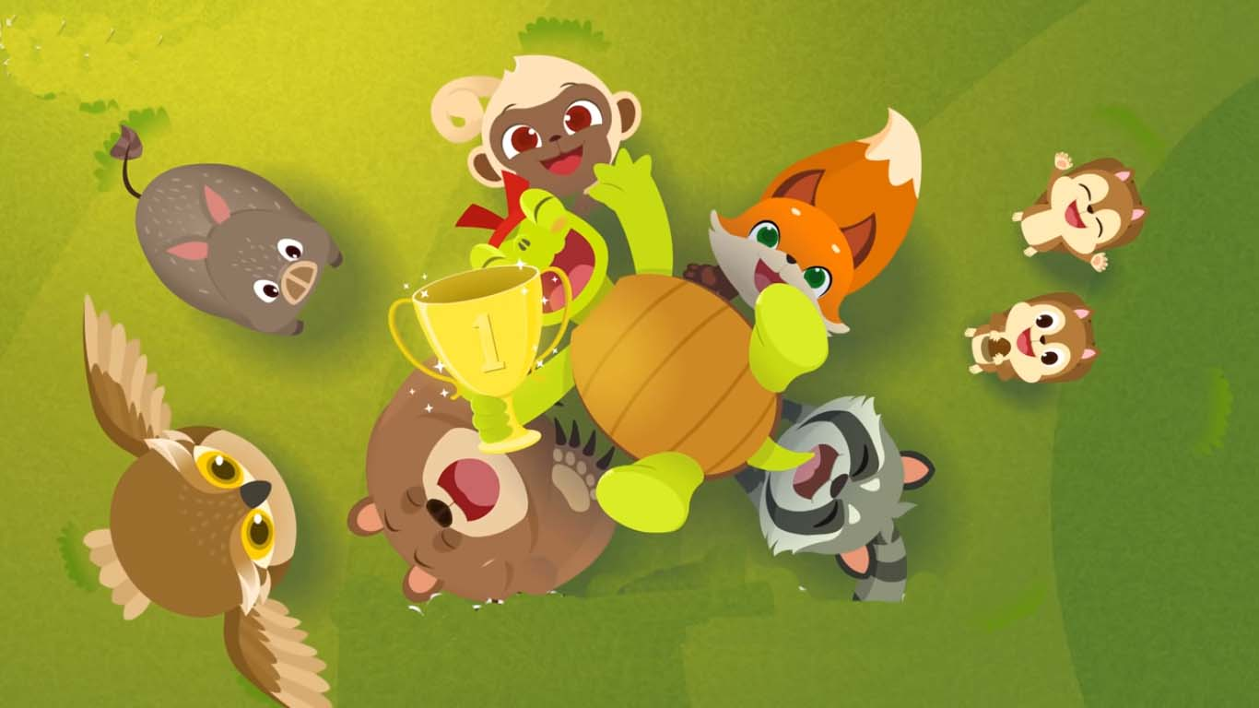
Let’s know the lesson with the picture
The hare ran as fast as he could, but it was too late. The tortoise crossed the finish line and won the competition! The hare was furious!

Slide 20
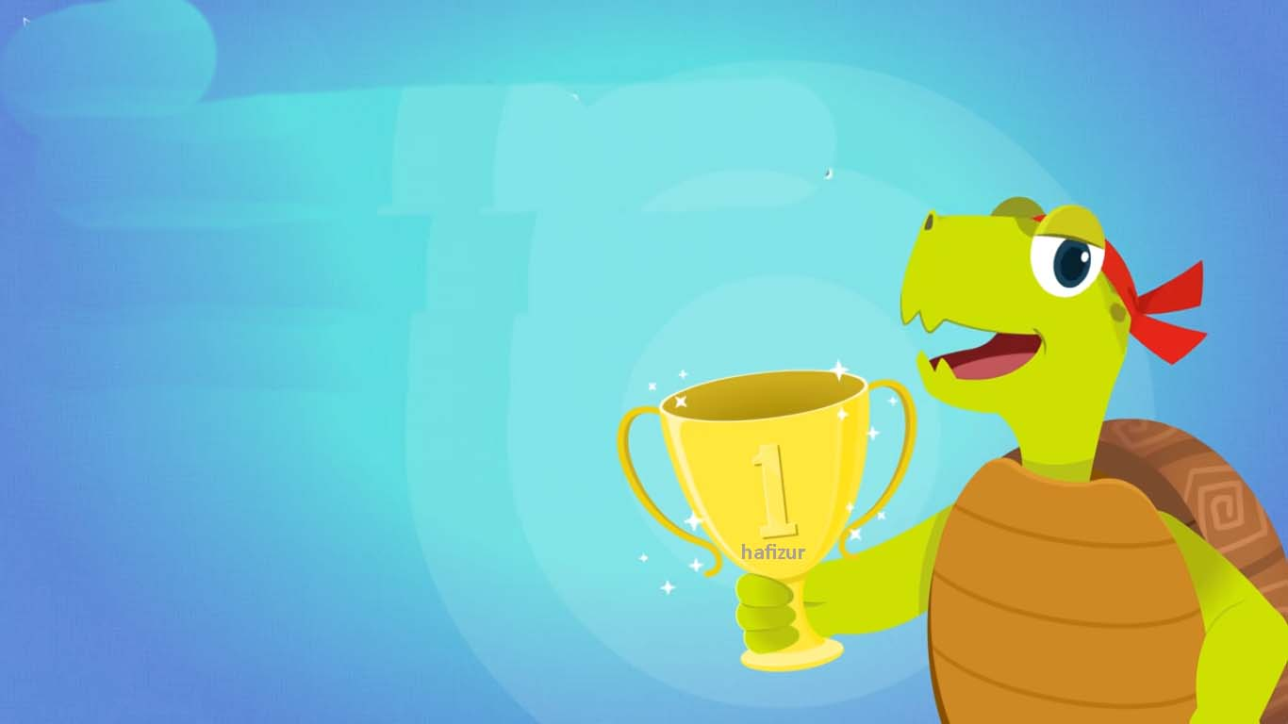
Let’s know the lesson with the picture
The tortoise looked back at the hare and smiled.
Then he said, “Slow but steady wins the race!”

Slide 21
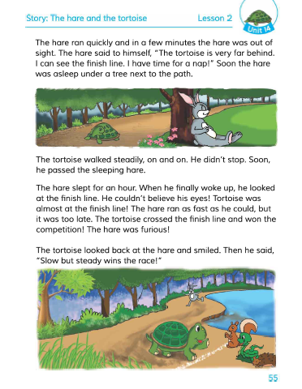
Open your book and turn to page 55

Slide 22
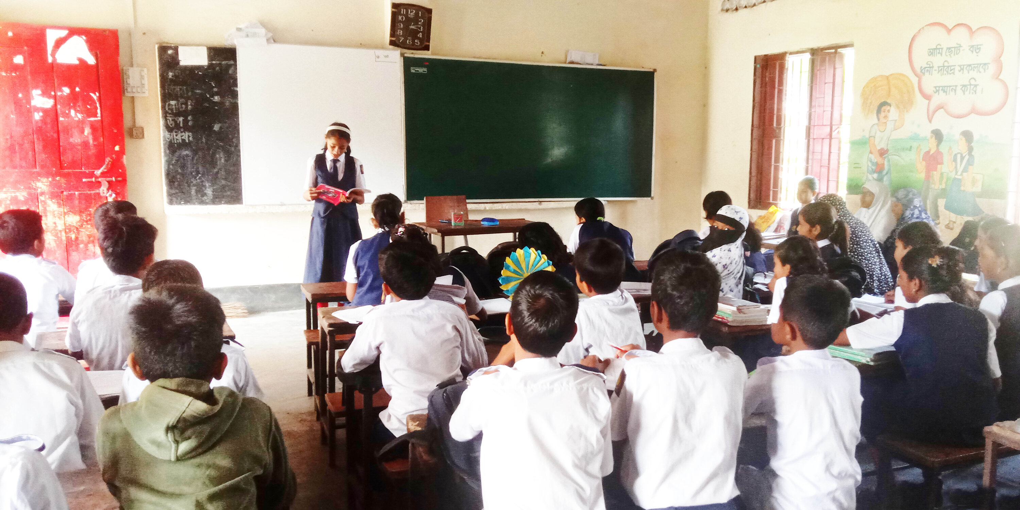
Students reading loudly

Slide 23
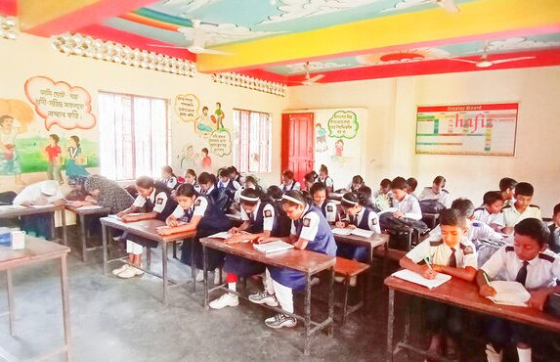
Students silent reading

Slide 24
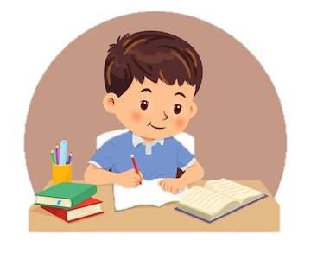
Individual work
Write True for correct statement and False for incorrect statement
True
False
a)
The hare walked quickly
Seeing the tortoise to win, the hare became angry.
True
False
b)
The hare passed the sleeping tortoise.
True
c)
False
True
False
d)
The hare is the slowest animal
The hare won the competition.
True
False
e)
Let’s check the answer

Slide 25
Pair work
Match the words of the column A with past form in column B
column-a | Column-B
smile | looked
look | slept
sleep | won
win | crossed
cross | walked
walk | smiled

Slide 26
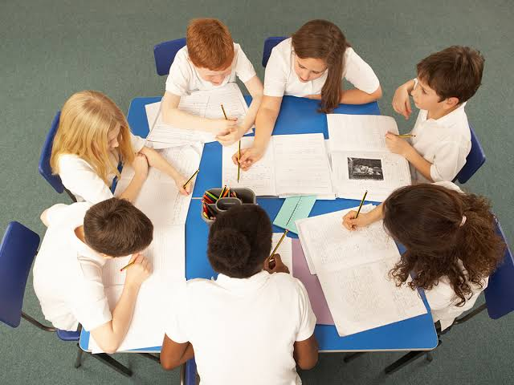
Group work
Group
Tiger
Group
Hare
Group
Tortoise
Group
Lion
- Have you experienced any race ?
- Have you participate in a race ?
When was it?
Who won the race

Slide 27
Evaluation
a) Who ran the race?
b) Where did the hare sleep?
c) How did the tortoise win the race?
d) How long did the hare sleep?
e) Why did the hare become furious?

Slide 28
One day one word
Steady
অটল
sentence making
Slow but steady wins the race.

Slide 29
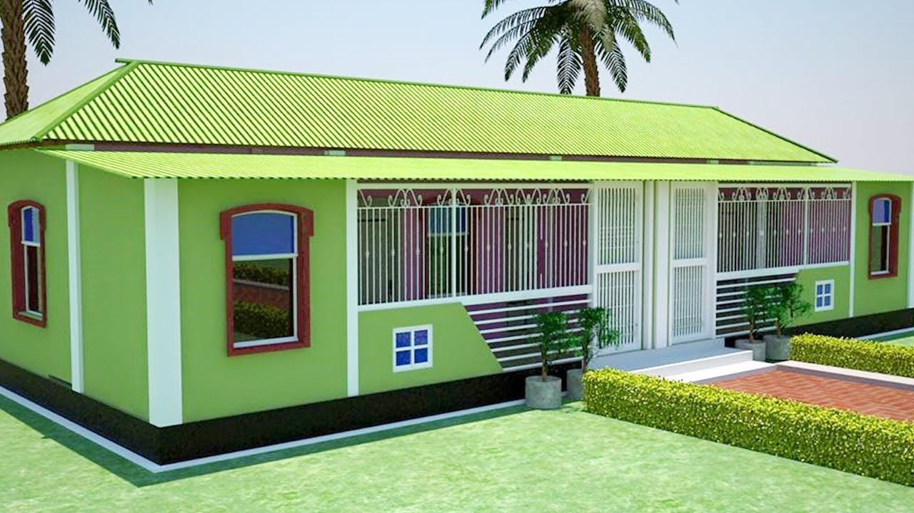
Home Task
Write 5 sentences About “Your Daily routine”.

Slide 30
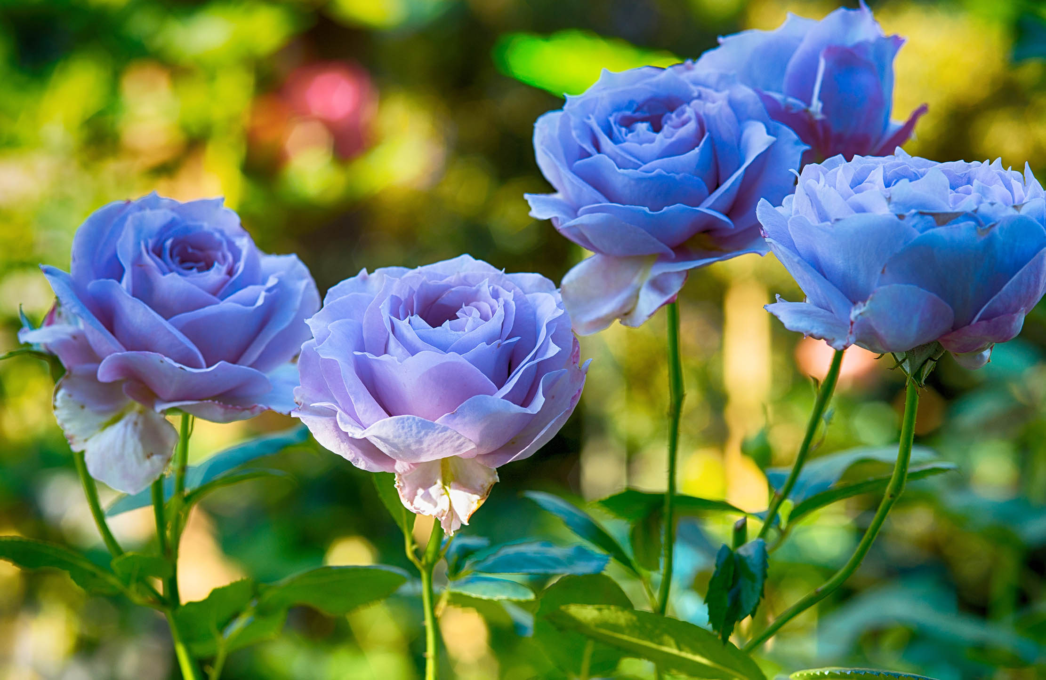
Good Bye

