Slide 1
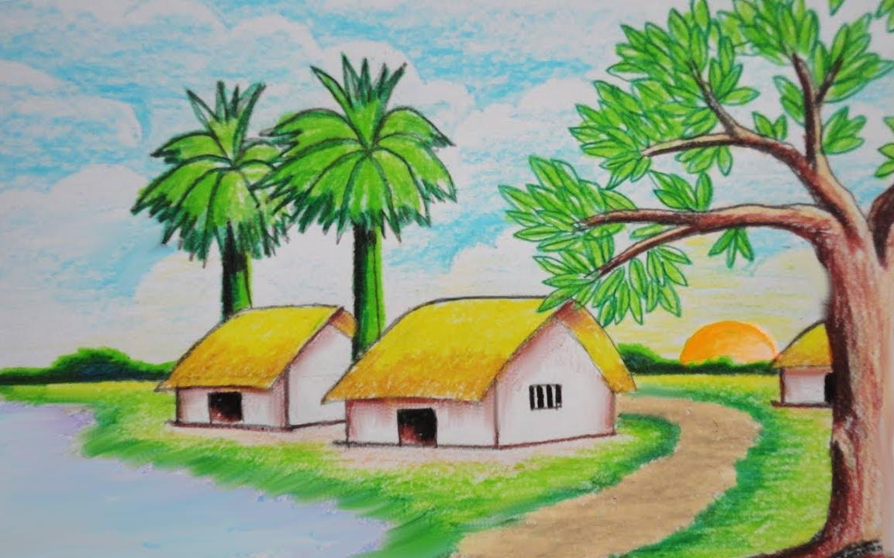
Welcome to my class

Slide 2
Introduction
Nahidal Arjin
Class : One
Subject : English
Lesson:6
Unit : 1
Page: 9
Assistant Teacher
Boddipur Govt. Primary School
Satkhira Sadar, Satkhira

Slide 3
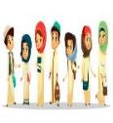
Greetings
How are you, my dear students?
Good morning, students.
Good morning, teacher.
Fine, thank you, teacher.

Slide 4
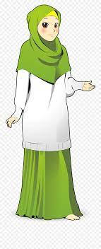
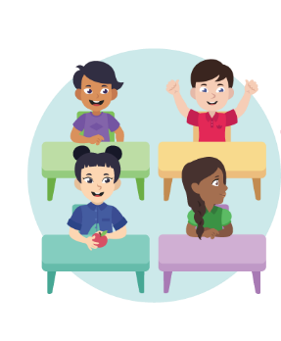
Review of the previous session:
‘What did we learn yesterday?’
What do we say and respond at farewalls?
‘Goodbye, Students.’
‘Goodbye, Teacher.’

Slide 5
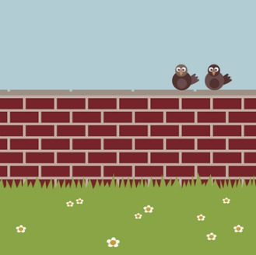
What do you see in the picture?
These are two birds sittings on a wall.

Slide 6
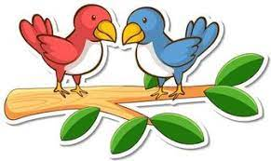
Lets see a video

Slide 7
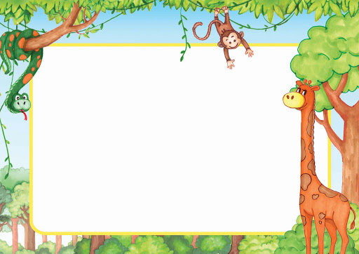
Lesson Declaration
Two little black birds

Slide 8
Learning outcomes

Slide 9
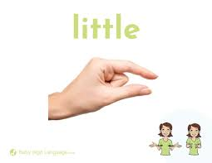
Let’s know the meaning of new words
Little
ছোট
Black
কালো

Slide 10
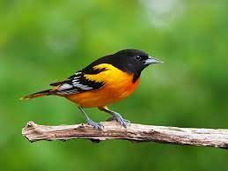
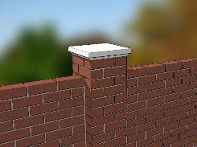
Let’s know the meaning of new words
Birds
পাখি
Wall
দেয়াল/ প্রাচীর

Slide 11
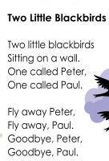
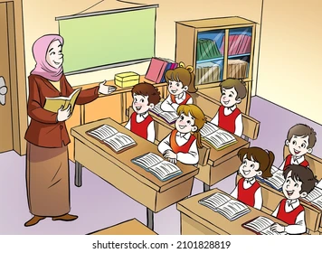
Teacher’s reading

Slide 12
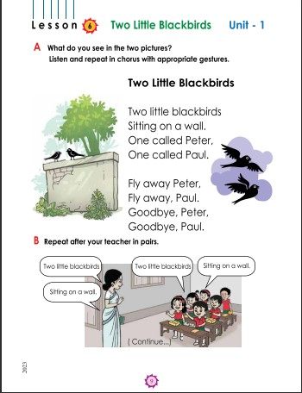
Open at page 9

Slide 13
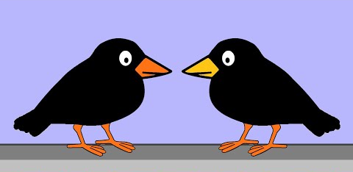
Look, listen and say
Two little blackbirds

Slide 14
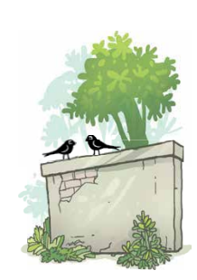
Look, listen and say
Sitting on a wall.

Slide 15
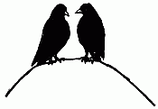
Look, listen and say
One called Peter
One called Paul.

Slide 16
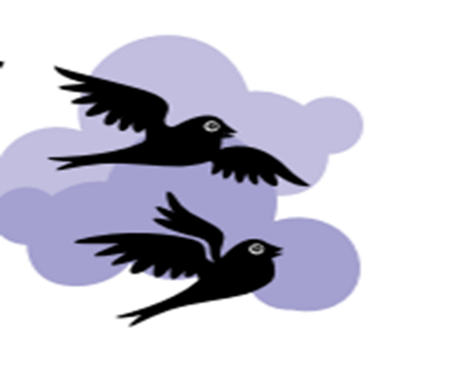
Look, listen and say
Fly away Peter
Fly away Paul.

Slide 17
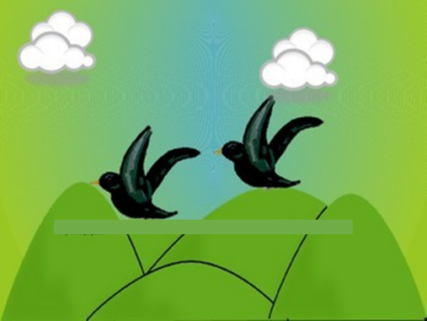
Look, listen and say
Goodbye Peter
Goodbye Paul.

Slide 18
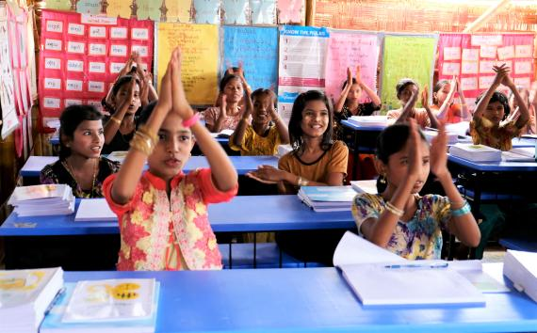
Say With Action
My dear students Now you are recite the Rhyme with action .

Slide 19
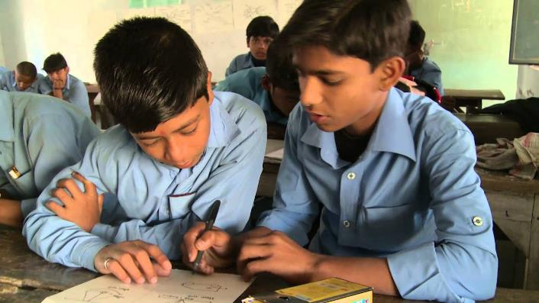
Recite the rhyme in Pairs.
My dear students Now you are recite the Rhyme with in pair .

Slide 20
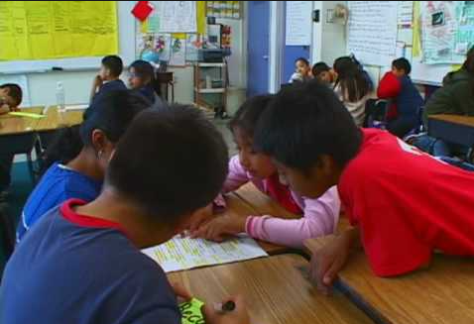
Group practice
My dear students Now you divide into 4 groups and recite the Rhyme with group.

Slide 21
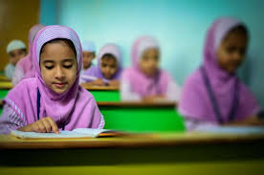
Evaluation
Now you will recite the Rhyme one by one.

Slide 22
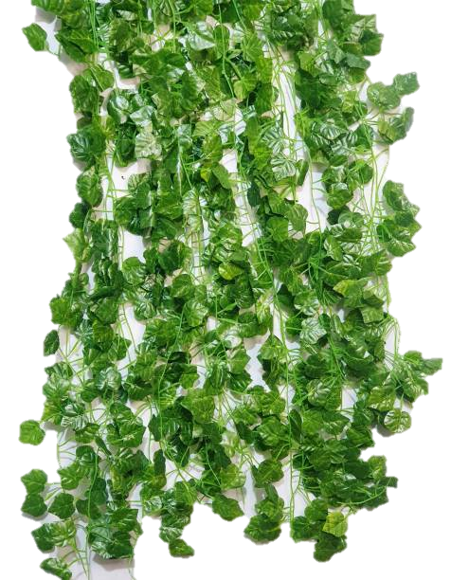
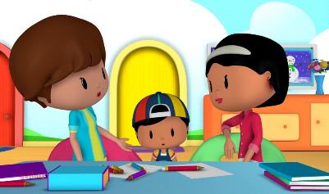
Home task
Dear students, you will read the
today’s lesson at your home.

Slide 23
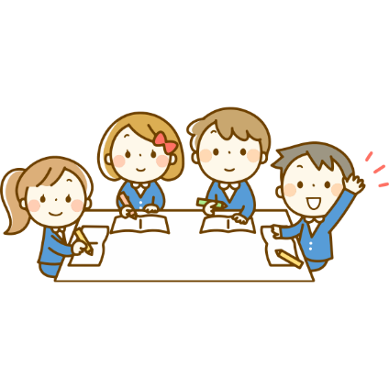
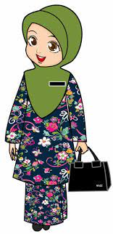
Summary of the session
‘What have we learnt today?’
‘Two little black birds.’

Slide 24
See you in the next class. Bye.

