Slide 2
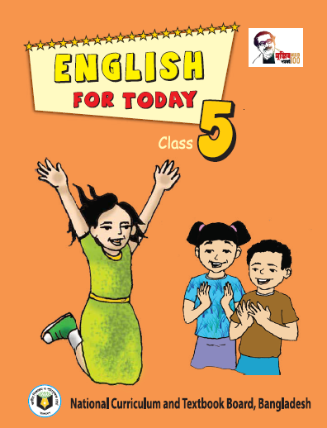
PRESENTED BY
Md Soyel Rana
Assistant Teacher
Baksha Sundorpur Govt Primary Sschool
Ranisonkail Thakurgoan
E-mail- soyelranalp@gmail.com
Lesson introduce
Class-5
Subject: English
Unit:-12
Lesson:1
( Hi Tamal …..special place)
Page:14

Slide 3
Learning Outcomes
Student’s will be able to-
Listening:1.3.1- to recognize which words in a sentence are stressed.
Speaking:1.1.1-to say words and phrases and sentences with proper sounds and stress.
Reading: 1.5.1-to read words , phrases and sentences with proper pronunciation , stress and intonation.
Writing: 5.1.3-to make sentences using words nd phrases ,following instructions.

Slide 4
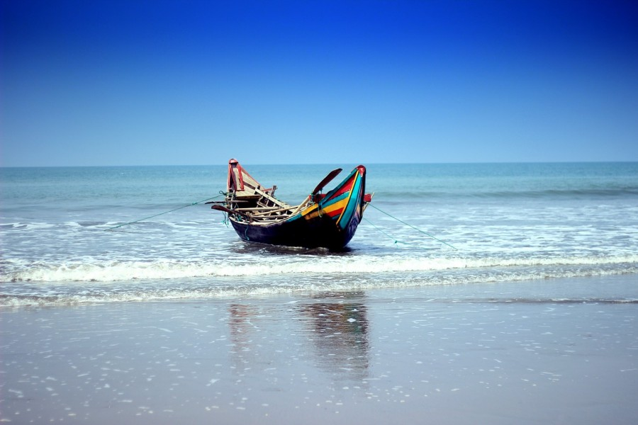
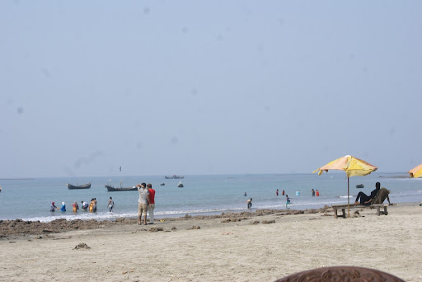
What can you see in the picture?
Yes, Sea beach

Slide 5
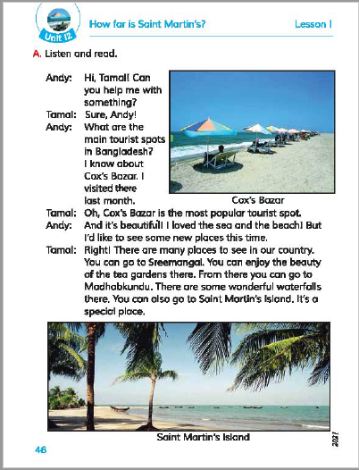
Our today’s topic is
How far is Saint Martin’s?

Slide 6
I will read the text and Put your finger under the line
Open your book page no-46.

Slide 7
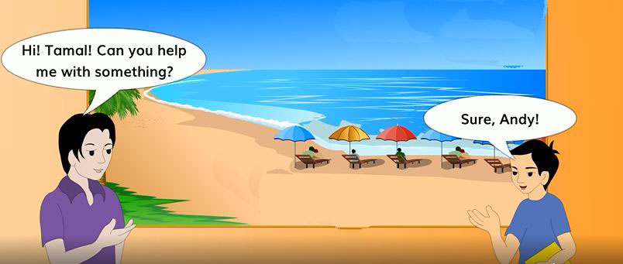
Teacher’s loud reading

Slide 8
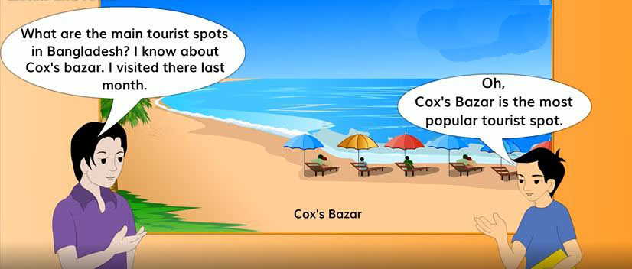
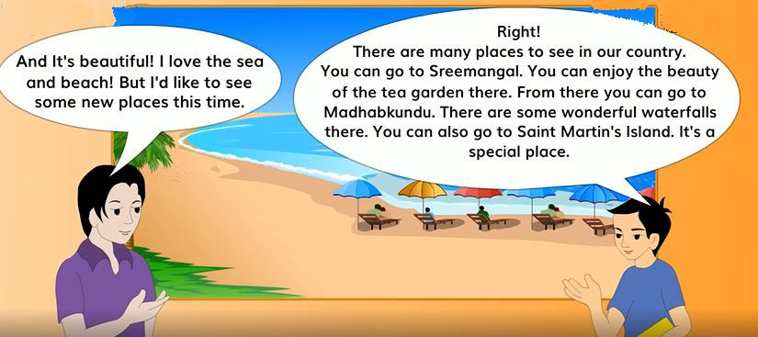

Slide 9
Word Meaning
Tourist
One Who visit some place
Something Correct
Right
A place
Spot
A source of water over a hill
Waterfall

Slide 10
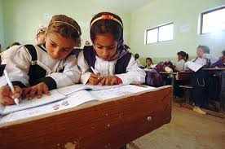
Pair work
ACT THE DIALOGUE,

Slide 11
Individual work
2. What is the most popular tourist spot in Bangladesh
Answer : Cox’s Bazar is the most popular tourist spot in Bangladesh
1.What is Sreemangal famous for?
Answer :Sreemangal is famous for tea garden.
3. Where do we see waterfalls ?
Answer : Madhobkundu.

Slide 12
Pair work
Write True or false, if false give the correct statement
1) Sreemangal is famous for teagarden.
True
2) Saintmartin is a park
False
3) Cox’sbazar is the most popular tourist spot in Bangladesh.
True
4)We can see waterfalls in Saintmartin Island.
False
5) Andy visited Cox’sbazar last month.
True

Slide 13
Home Work
Write 5 sentences about a place where you will visit next holyday

